Slide 1
LLVM in the age of LLMs: Machine Learning for IR, Optimization, & More
William S. Moses
University of Illinois, Urbana Champaign
wsmoses@Illinois.edu
AI4Dev Workshop @ SC’23
Nov 13, 2023

Slide 2
This Talk

Slide 3
This Talk
An introduction to an assortment of interesting and relevant ML and compiler literature leading to why the community is focused on LLM’s

Slide 4
This Talk
An introduction to an assortment of interesting and relevant ML and compiler literature leading to why the community is focused on LLM’s
Will provide an intuition for effectively combining compilers + ML through a series of personal case studies

Slide 5
This Talk
An introduction to an assortment of interesting and relevant ML and compiler literature leading to why the community is focused on LLM’s
Will provide an intuition for effectively combining compilers + ML through a series of personal case studies
A biased view of interesting places for the field to go.

Slide 6
This Talk
An introduction to an assortment of interesting and relevant ML and compiler literature leading to why the community is focused on LLM’s
Will provide an intuition for effectively combining compilers + ML through a series of personal case studies
A biased view of interesting places for the field to go.
This Talk is Not

Slide 7
This Talk
An introduction to an assortment of interesting and relevant ML and compiler literature leading to why the community is focused on LLM’s
Will provide an intuition for effectively combining compilers + ML through a series of personal case studies
A biased view of interesting places for the field to go.
This Talk is Not
A comprehensive look at all the related literature (aka not your next paper’s related work section)

Slide 8
This Talk
An introduction to an assortment of interesting and relevant ML and compiler literature leading to why the community is focused on LLM’s
Will provide an intuition for effectively combining compilers + ML through a series of personal case studies
A biased view of interesting places for the field to go.
This Talk is Not
A comprehensive look at all the related literature (aka not your next paper’s related work section)
An intro course on ML for HPC

Slide 9
This Talk
An introduction to an assortment of interesting and relevant ML and compiler literature leading to why the community is focused on LLM’s
Will provide an intuition for effectively combining compilers + ML through a series of personal case studies
A biased view of interesting places for the field to go.
This Talk is Not
A comprehensive look at all the related literature (aka not your next paper’s related work section)
An intro course on ML for HPC
Your PhD thesis

Slide 10
This Talk
An introduction to an assortment of interesting and relevant ML and compiler literature leading to why the community is focused on LLM’s
Will provide an intuition for effectively combining compilers + ML through a series of personal case studies
A biased view of interesting places for the field to go.
This Talk is Not
A comprehensive look at all the related literature (aka not your next paper’s related work section)
An intro course on ML for HPC
Your PhD thesis
… Or is it? (https://grad.illinois.edu/admissions/apply)

Slide 12
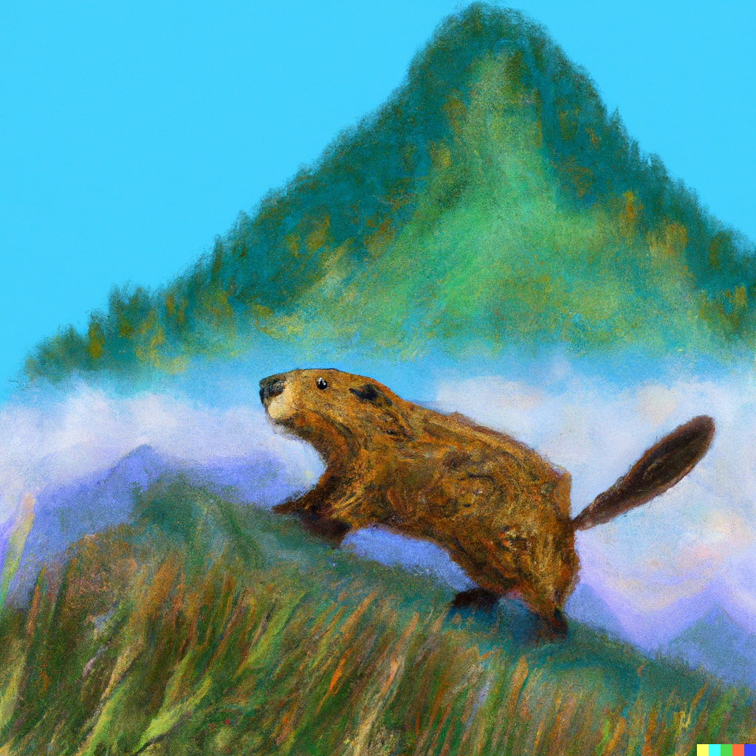
Beaver hiking up a mountain in the style of Monet (DALLE)
DeepL Translator

Slide 13
Why is AI so successful now (and not 20 years ago)?

Slide 14
Why is AI so successful now (and not 20 years ago)?
How do we emulate that success in program optimization?

Slide 15
Why is AI so successful now (and not 20 years ago)?
How do we emulate that success in program optimization?
…and push even further?

Slide 16
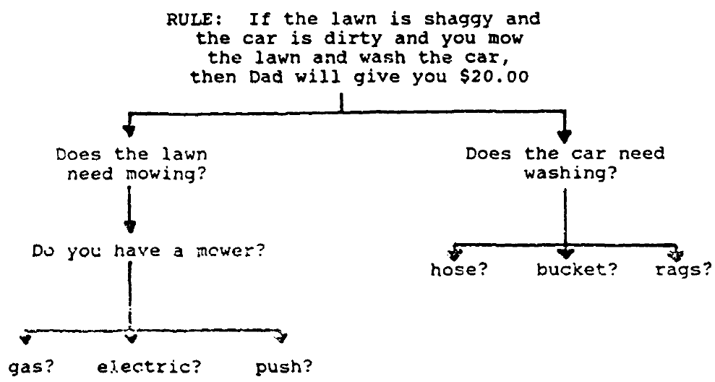
Early Successful Efforts in AI
“Good Old Fashioned AI” (GOFAI) aka Symbolic AI
Can we build AI by writing a sufficiently expressive set of rules?
Led to creation of LISP programming language, computer time sharing, and many more “non-AI”

Slide 17
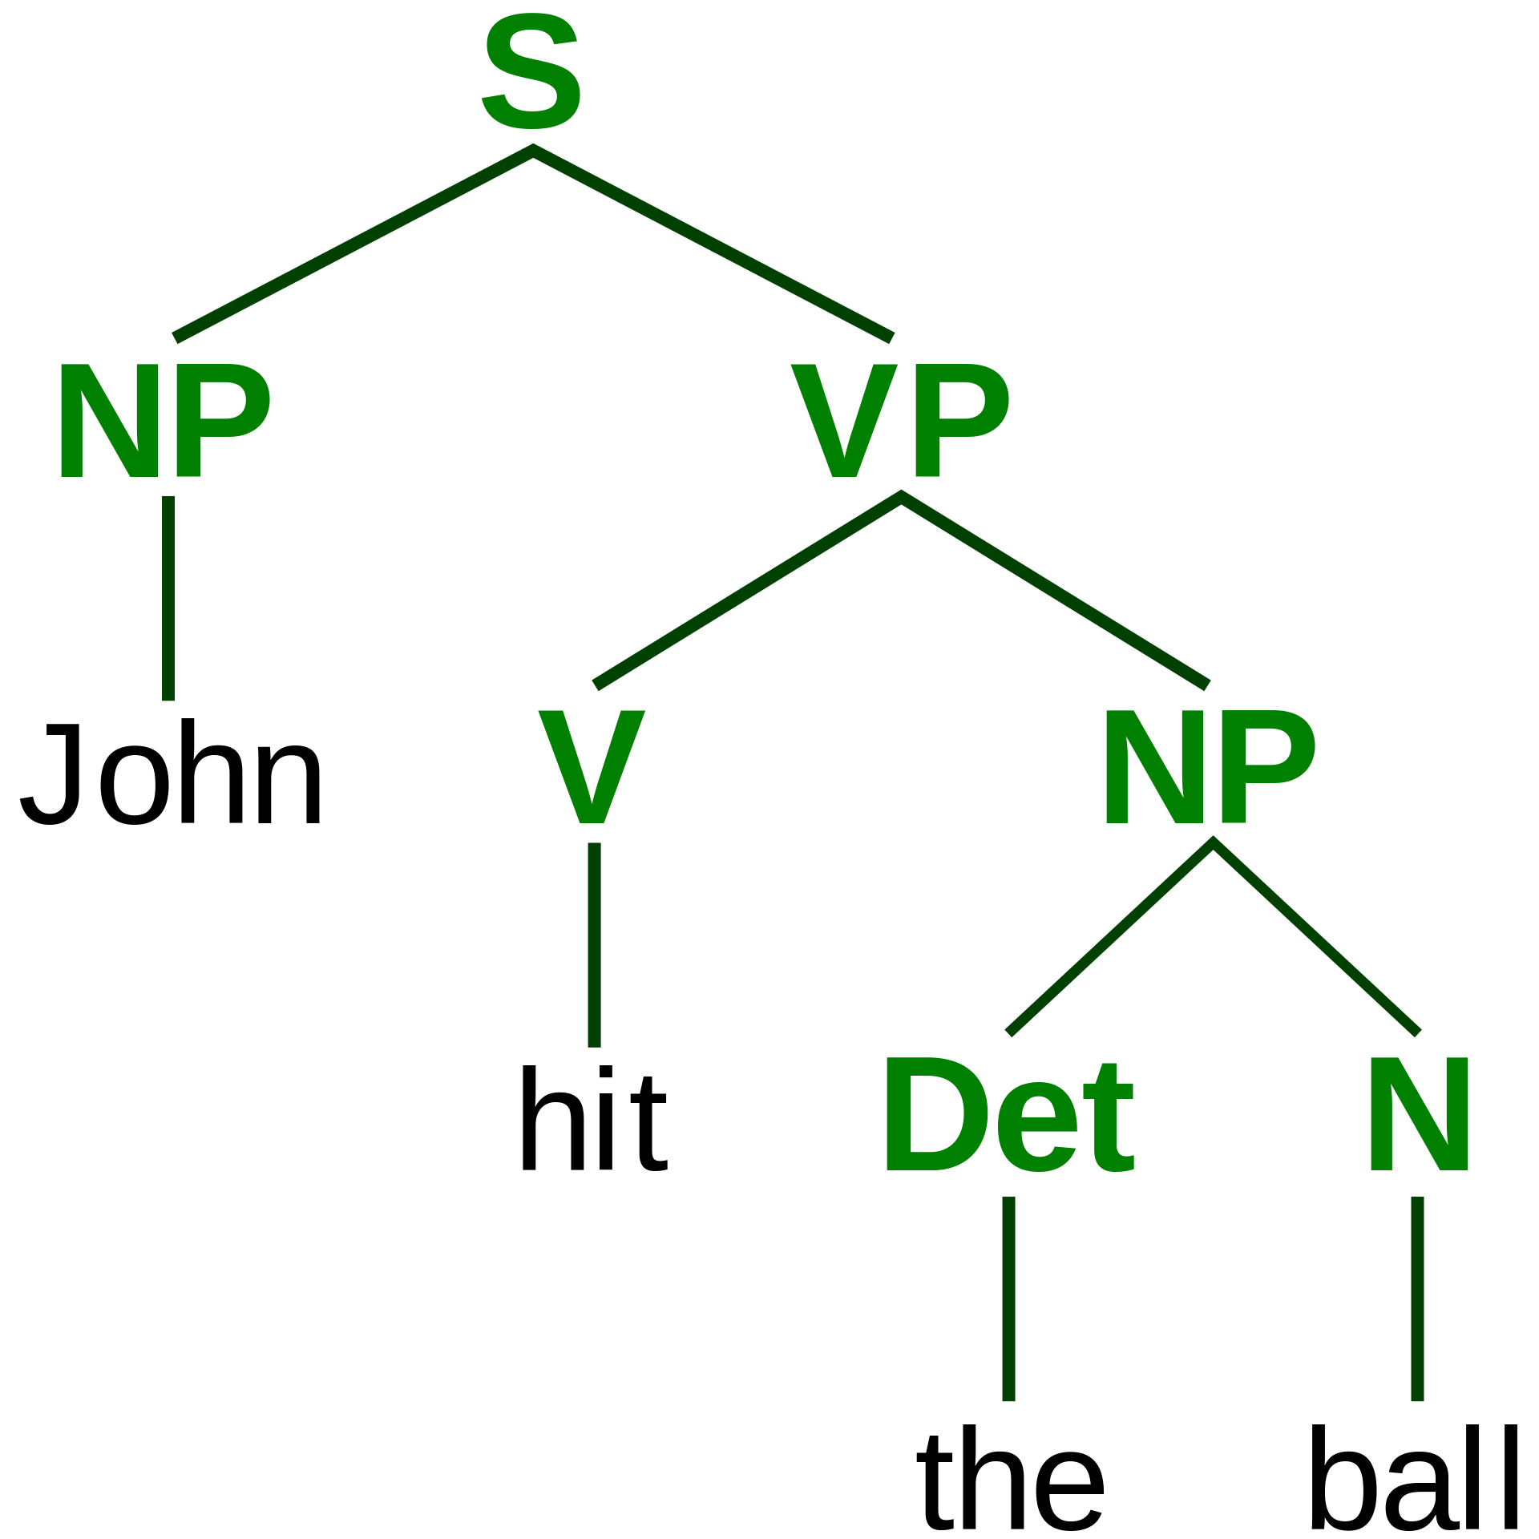
Early Successful Efforts in AI
“Good Old Fashioned AI” (GOFAI) aka Symbolic AI
Can we build AI by writing a sufficiently expressive set of rules?
Led to creation of LISP programming language, computer time sharing, and many more “non-AI”
Analyzing language by modelling stages of language (tokenizing, features, etc)
Parse Tree

Slide 18
Early Successful Efforts in AI
“Good Old Fashioned AI” (GOFAI) aka Symbolic AI
Can we build AI by writing a sufficiently expressive set of rules?
Led to creation of LISP programming language, computer time sharing, and many more “non-AI”
Analyzing language by modelling stages of language (tokenizing, features, etc)
Parse Tree
Sophisticated filters to identify information in images
Canny Edge Detection (1986)
*
+ ..

Slide 19
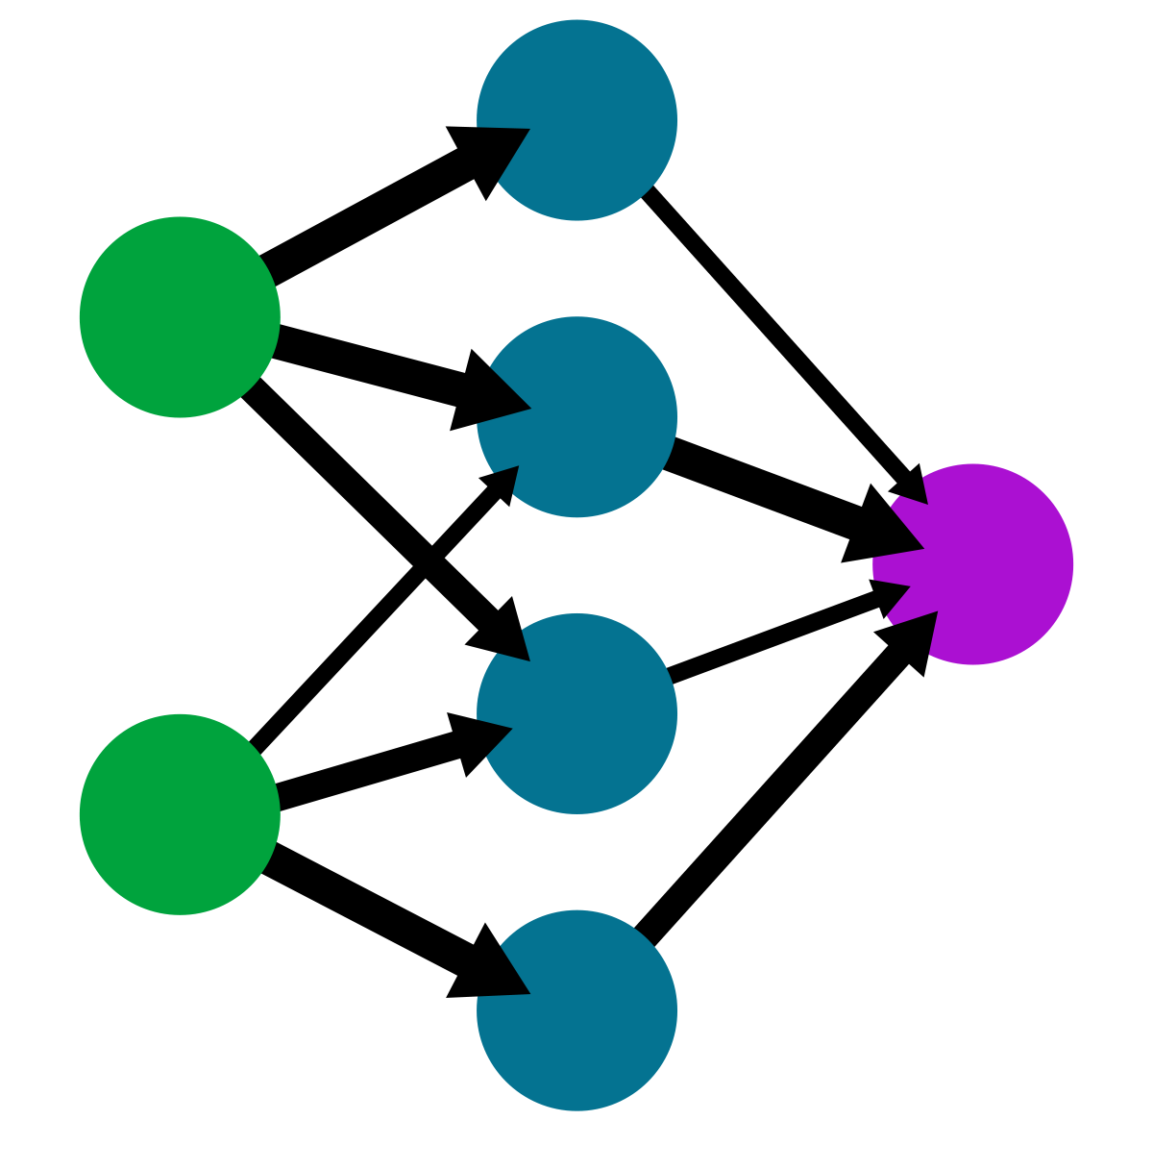
Early Successful Efforts in AI
“Good Old Fashioned AI” (GOFAI) aka Symbolic AI
Can we build AI by writing a sufficiently expressive set of rules?
Led to creation of LISP programming language, computer time sharing, and many more “non-AI”
Analyzing language by modelling stages of language (tokenizing, features, etc)
Parse Tree
Sophisticated filters to identify information in images
Canny Edge Detection (1986)
Artificial Neural Networks

Slide 20
Early AI <-> Compiler Optimization

Slide 21
Early AI <-> Compiler Optimization
y(i) = A(i,j) * x(j)
GOFAI & Program Transformations
for (int32_t i0 = 0; i0 < ((A1_dimension + 31) / 32); i0++) {
for (int32_t i1 = 0; i1 < 32; i1++) {
int32_t i = i0 * 32 + i1;
double tjy_val = 0.0;
for (int32_t jA = A2_pos[i]; jA < A2_pos[(i + 1)]; jA++) {
int32_t j = A2_crd[jA];
tjy_val += A_vals[jA] * x_vals[j];
}
y_vals[i] = tjy_val;
}
}
}

Slide 22
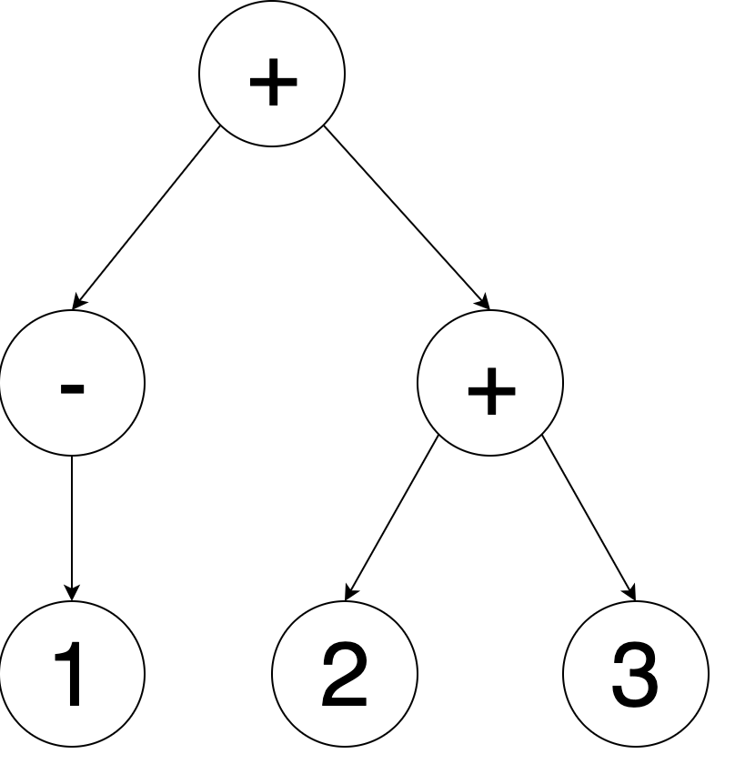
Early AI <-> Compiler Optimization
y(i) = A(i,j) * x(j)
GOFAI & Program Transformations
Early NLP & Program AST/IR
for (int32_t i0 = 0; i0 < ((A1_dimension + 31) / 32); i0++) {
for (int32_t i1 = 0; i1 < 32; i1++) {
int32_t i = i0 * 32 + i1;
double tjy_val = 0.0;
for (int32_t jA = A2_pos[i]; jA < A2_pos[(i + 1)]; jA++) {
int32_t j = A2_crd[jA];
tjy_val += A_vals[jA] * x_vals[j];
}
y_vals[i] = tjy_val;
}
}
}

Slide 23
Early AI <-> Compiler Optimization
y(i) = A(i,j) * x(j)
GOFAI & Program Transformations
Early NLP & Program AST/IR
Coarse Filters & Program Metrics
for (int32_t i0 = 0; i0 < ((A1_dimension + 31) / 32); i0++) {
for (int32_t i1 = 0; i1 < 32; i1++) {
int32_t i = i0 * 32 + i1;
double tjy_val = 0.0;
for (int32_t jA = A2_pos[i]; jA < A2_pos[(i + 1)]; jA++) {
int32_t j = A2_crd[jA];
tjy_val += A_vals[jA] * x_vals[j];
}
y_vals[i] = tjy_val;
}
}
}
f1 has 100 instructions f2 has 10 instructions f3 has 1000 instructions

Slide 24
Early Successful Efforts in AI
“Good Old Fashioned AI” (GOFAI) aka Symbolic AI
Can we build AI by writing a sufficiently expressive set of rules?
Led to creation of LISP programming language, computer time sharing, and many more “non-AI”
Analyzing language by modelling stages of language (tokenizing, features, etc)
Parse Tree
Sophisticated filters to identify information in images
Canny Edge Detection (1986)
Artificial Neural Networks

Slide 25
Early Successful Efforts in AI
“Good Old Fashioned AI” (GOFAI) aka Symbolic AI
Can we build AI by writing a sufficiently expressive set of rules?
Led to creation of LISP programming language, computer time sharing, and many more “non-AI”
Analyzing language by modelling stages of language (tokenizing, features, etc)
Parse Tree
Sophisticated filters to identify information in images
Canny Edge Detection (1986)
Artificial Neural Networks

Slide 26
Early Successful Efforts in AI
Symbolic AI lost out as it is bottlenecked by the need to manually specify transformations

Slide 27
Early Successful Efforts in AI
Symbolic AI lost out as it is bottlenecked by the need to manually specify transformations
Fortunately in compilers we never have to manually specify transformations
int compute(taco_tensor_t *y, taco_tensor_t *A, taco_tensor_t *x) {
int y1_dimension = (int)(y->dimensions[0]);
double* restrict y_vals = (double*)(y->vals);
int A1_dimension = (int)(A->dimensions[0]);
int* restrict A2_pos = (int*)(A->indices[1][0]);
int* restrict A2_crd = (int*)(A->indices[1][1]);
double* restrict A_vals = (double*)(A->vals);
int x1_dimension = (int)(x->dimensions[0]);
double* restrict x_vals = (double*)(x->vals);
#pragma omp parallel for schedule(runtime)
for (int32_t i0 = 0; i0 < ((A1_dimension + 31) / 32); i0++) {
for (int32_t i1 = 0; i1 < 32; i1++) {
int32_t i = i0 * 32 + i1;
if (i >= A1_dimension)
continue;
double tjy_val = 0.0;
for (int32_t jA = A2_pos[i]; jA < A2_pos[(i + 1)]; jA++) {
int32_t j = A2_crd[jA];
tjy_val += A_vals[jA] * x_vals[j];
}
y_vals[i] = tjy_val;
}
}
return 0;
}
y(i) = A(i,j) * x(j)

Slide 28
Early Successful Efforts in AI
Symbolic AI lost out as it is bottlenecked by the need to manually specify transformations
Fortunately in compilers we never have to manually specify transformations
int compute(taco_tensor_t *y, taco_tensor_t *A, taco_tensor_t *x) {
int y1_dimension = (int)(y->dimensions[0]);
double* restrict y_vals = (double*)(y->vals);
int A1_dimension = (int)(A->dimensions[0]);
int* restrict A1_pos = (int*)(A->indices[0][0]);
int* restrict A1_crd = (int*)(A->indices[0][1]);
int* restrict A2_pos = (int*)(A->indices[1][0]);
int* restrict A2_crd = (int*)(A->indices[1][1]);
double* restrict A_vals = (double*)(A->vals);
int x1_dimension = (int)(x->dimensions[0]);
double* restrict x_vals = (double*)(x->vals);
#pragma omp parallel for schedule(static)
for (int32_t py = 0; py < y1_dimension; py++) {
y_vals[py] = 0.0;
}
#pragma omp parallel for schedule(runtime)
for (int32_t i0 = 0; i0 < ((A1_dimension + 31) / 32); i0++) {
int32_t pA1_begin = i0 * 32;
int32_t iA = taco_binarySearchAfter(A1_crd, A1_pos[0], A1_pos[1], pA1_begin);
int32_t pA1_end = A1_pos[1];
int32_t iA0 = A1_crd[iA];
int32_t i = A1_crd[iA];
int32_t i1 = i - i0 * 32;
int32_t i1_end = 32;
while (iA < pA1_end && i1 < i1_end) {
iA0 = A1_crd[iA];
i = A1_crd[iA];
if (iA0 == i) {
double tjy_val = 0.0;
for (int32_t jA = A2_pos[iA]; jA < A2_pos[(iA + 1)]; jA++) {
int32_t j = A2_crd[jA];
tjy_val += A_vals[jA] * x_vals[j];
}
y_vals[i] = tjy_val;
}
iA += (int32_t)(iA0 == i);
iA0 = A1_crd[iA];
i = A1_crd[iA];
i1 = i - i0 * 32;
}
}
return 0;
}
int compute(taco_tensor_t *y, taco_tensor_t *A, taco_tensor_t *x) {
int y1_dimension = (int)(y->dimensions[0]);
double* restrict y_vals = (double*)(y->vals);
int A1_dimension = (int)(A->dimensions[0]);
int* restrict A1_pos = (int*)(A->indices[0][0]);
int* restrict A1_crd = (int*)(A->indices[0][1]);
int* restrict A2_pos = (int*)(A->indices[1][0]);
int* restrict A2_crd = (int*)(A->indices[1][1]);
double* restrict A_vals = (double*)(A->vals);
int* restrict x1_pos = (int*)(x->indices[0][0]);
int* restrict x1_crd = (int*)(x->indices[0][1]);
double* restrict x_vals = (double*)(x->vals);
#pragma omp parallel for schedule(static)
for (int32_t py = 0; py < y1_dimension; py++) {
y_vals[py] = 0.0;
}
#pragma omp parallel for schedule(runtime)
for (int32_t i0 = 0; i0 < ((A1_dimension + 31) / 32); i0++) {
int32_t pA1_begin = i0 * 32;
int32_t iA = taco_binarySearchAfter(A1_crd, A1_pos[0], A1_pos[1], pA1_begin);
int32_t pA1_end = A1_pos[1];
int32_t iA0 = A1_crd[iA];
int32_t i = A1_crd[iA];
int32_t i1 = i - i0 * 32;
int32_t i1_end = 32;
while (iA < pA1_end && i1 < i1_end) {
iA0 = A1_crd[iA];
i = A1_crd[iA];
if (iA0 == i) {
double tjy_val = 0.0;
int32_t jA = A2_pos[iA];
int32_t pA2_end = A2_pos[(iA + 1)];
int32_t jx = x1_pos[0];
int32_t px1_end = x1_pos[1];
while (jA < pA2_end && jx < px1_end) {
int32_t jA0 = A2_crd[jA];
int32_t jx0 = x1_crd[jx];
int32_t j = TACO_MIN(jA0,jx0);
if (jA0 == j && jx0 == j) {
tjy_val += A_vals[jA] * x_vals[jx];
}
jA += (int32_t)(jA0 == j);
jx += (int32_t)(jx0 == j);
}
y_vals[i] = tjy_val;
}
iA += (int32_t)(iA0 == i);
iA0 = A1_crd[iA];
i = A1_crd[iA];
i1 = i - i0 * 32;
}
}
return 0;
}
int compute(taco_tensor_t *y, taco_tensor_t *A, taco_tensor_t *x) {
int y1_dimension = (int)(y->dimensions[0]);
double* restrict y_vals = (double*)(y->vals);
int A1_dimension = (int)(A->dimensions[0]);
int* restrict A2_pos = (int*)(A->indices[1][0]);
int* restrict A2_crd = (int*)(A->indices[1][1]);
double* restrict A_vals = (double*)(A->vals);
int x1_dimension = (int)(x->dimensions[0]);
double* restrict x_vals = (double*)(x->vals);
#pragma omp parallel for schedule(runtime)
for (int32_t i0 = 0; i0 < ((A1_dimension + 31) / 32); i0++) {
for (int32_t i1 = 0; i1 < 32; i1++) {
int32_t i = i0 * 32 + i1;
if (i >= A1_dimension)
continue;
double tjy_val = 0.0;
for (int32_t jA = A2_pos[i]; jA < A2_pos[(i + 1)]; jA++) {
int32_t j = A2_crd[jA];
tjy_val += A_vals[jA] * x_vals[j];
}
y_vals[i] = tjy_val;
}
}
return 0;
}
y(i) = A(i,j) * x(j)
…

Slide 29
Extending the reasoning of compilers
Manually specified transformations are the bread and butter of compilers (we tend to call the ”optimization passes”)
Very GOFAI style-symbolic reasoning of “we can prove program A is faster than program B”
Often extend this to say if we think A is faster than B
Compilers are rampant with manually specified heuristics of when we think A is faster than B … and often get it wrong (or at least for some people)
Hundreds of arbitrarily chosen flags, orderings, etc.
A change to optimization pass ordering led to a 50% performance reduction for NVPTX (https://bugs.llvm.org/show_bug.cgi?id=52037)
…

Slide 30
Automated transformations within compilers
Much work early work focused on using ML to automate the “coarse reasoning” of input programs, and select parameters for the fastest program
Advantage: all output programs are correct
Tensor Comprehensions (2017) used genetic algorithms to pick schedules (achieved 90+% of peak)
End-to-end Deep Learning of Optimization Heuristics (2017) used LSTM networks to predict
Yet, you still need to manually specify the structure of the output programs

Slide 31
Future of Optimization + ML
Automated Transformations

Slide 32
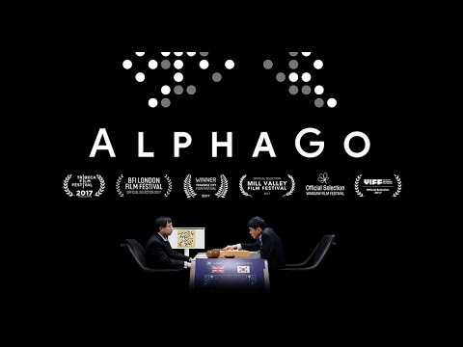
(Deep) Reinforcement Learning
The significant area of AI research in the mid-late 2010’s
Achieved state of the art skill at various games including Go, StarCraft, Atari games, etc
Given a state s and set of possible actions actions(s), pick the optimal action a that maximizes a (often end-game) reward.

Slide 33
(Deep) Reinforcement Learning
The significant area of AI research in the mid-late 2010’s
Achieved state of the art skill at various games including Go, StarCraft, Atari games, etc
Given a state s and set of possible actions actions(s), pick the optimal action a that maximizes a (often end-game) reward.
Idea: we can model each GOFAI-style compiler optimization as one of these actions!

Slide 34
Reinforcement Learning for Compilers
AutoPhase (2019) used deep RL to predict optimal LLVM compiler pass orderings
Achieved 28% boost beyond O3, with promising generality results
At the time, no good way to represent the program in a way that can be analyzed by the network
Demonstrates the significant data and compute problem within RL: bottlenecked by the iterations through the reward/action simulator
Learning to optimize halide with tree search and random programs (2019) used beam search (e.g. greedily take the top k)
ProTuner (2020) used plain old Monte Carlo Tree Search (MCTS) to search for schedules
MLGO (2021) use policy gradients and evolution strategies to optimize for size (7% reduction beyond Oz)

Slide 35
Future of Optimization + ML
Automated Transformations
Neural Program Representation

Slide 36
Unsupervised Learning + Transformers
Earlier approaches were bottlenecked by the amount of labeled data
Train on a large corpus of unlabeled data (all of the internet) & fine-tune on a small dataset (some sample phrases in two languages)
Transformers enable efficient contextual access without serializing inputs
This is the secret sauce behind modern LLMs (like GPT).
Language
+
Unlabeled Data
General Model
French to English
Pretraining
Translate English to French
Fine Tuning
Task
Fine-tune Model

Slide 37
How well can Transformers compile code?
Goal: Determine effectiveness of end-to-end optimization / generation of low level programs
Enabling Transformers to Understand Low-Level Programs (IEEE HPEC ’22) https://ieeexplore.ieee.org/abstract/document/9926313
Whole program analysis and optimization with transformers
Leverage autogenerated and unlabeled training data from compiler (clang)
Build novel LLVM-specific specific optimizations for better training
Language

Slide 38
Why ML on Low-Level Code Is Hard
//Compute magnitude in O(n)
double mag(double[] x) ) { … }
//Compute norm in O(n^2)
void norm(double[] out, double[] in) {
for (int i=0; i<n; i++) {
out[i] = in[i] / mag(in);
}
}
declare double @mag(double* readonly) argmemonly
define void @norm(double* noalias %0, double* noalias %1)
br label %loop
%5 = phi i64 [ 0, %2 ], [ %11, %4 ]
%6 = getelementptr inbounds double, double* %1, i64 %5
%7 = load double, double* %6, align 8, !tbaa !4
%8 = call double @mag(double* noundef %1) #2
%9 = fdiv double %7, %8
%10 = getelementptr inbounds double, double* %0, i64 %5
store double %9, double* %10, align 8, !tbaa !4
%11 = add nuw nsw i64 %5, 1
%12 = icmp eq i64 %11, 100
br i1 %12, label %end, label %loop
Loop invariant code motion (LICM)
More verbose and precise semantics
-> Ensures that optimizations can be performed (moving mag outside loop requires mag to be readonly)
ret void

Slide 39
Case study: Translating C to (Optimized) LLVM
define double @relu3(double %0) {
%2 = fcmp ogt double %0, 0
br %2, label %3 , label %5
3:
%4 = tail call double @pow (%0, double 3)
br label %5
5:
%6 = phi [%4, %3], [0, %1]
ret %6
}
double relu3(double x) {
double result;
if (x > 0)
result = pow(x, 3);
else
result = 0;
return result;
}

Slide 40
Data & Results
Csmith (randomly generated compilable C programs) (Yang et al., 2011)
Project CodeNet (web scrape of competitive programming online judging websites) (Puri et al., 2021)
AnghaBench (1 million selected and cleaned compilable GitHub C programs) (de Silva et al., 2021)
Model evaluation result on the 3 datasets
 | Csmith | Project CodeNet | AnghaBench
Training Accuracy | 90.73% | 93.66% | 99.03%
Reference Match | N/A | 5.76 | 13.33%
BLEU Score (0~100) | 43.39 | 51.01 | 69.21

Slide 41
Preprocessing Modification & Optimizations
Expanding preprocessing directives with clang –E such as pasting the definition of imported libraries, compile-time constants, and more.
Reduce redundancies in program grammar while making sure to faithfully restore the original
#ifdef AARCH64
#define size_t int64_t
#else
#define size_t int32_t
#endif
size_t getsize();
int64_t getsize();
%4 = load i32**, i32*** %2
%4 = load i32** %2
Notes:
Based on a paper on Transformer performing arithmetic, prefix notation performs better than infix or postfix notion, yielding a 94.43 BLEU Score comparing to 87.72 for infix and 92.37 for postfix.

Slide 42
Preprocessing Modification, cont.
Prefix Notation
A * B + C / D => + * A B / C D
Prefix notation previously shown effective for mathematics (Griffith & Kalita, 2019)
Writing out definitions of global variables so they can be recoverable on the function level, which makes the programs more complex
{ [4 x i8], i32, { i8, i32 }}
STRUCT 5 ARR 3 4 x i8 i32 STRUCT 2 i8 i32
%struct.1 = type { i32, i32, i64 }
...
%2 = alloca %struct.1, i64 %1
%struct.1 = type { i32, i32, i64 }
...
%2 = alloca { i32, i32, i64 }, i64 %1
Notes:
Based on a paper on Transformer performing arithmetic, prefix notation performs better than infix or postfix notion, yielding a 94.43 BLEU Score comparing to 87.72 for infix and 92.37 for postfix.

Slide 43
Ablation Analysis
Ablation studies of model evaluation result on AnghaBench dataset
 | Original | Cleaned | Prefix | Prefix & Global | -O1
Training Accuracy | 99.03% | 97.84% | 99.60% | 99.36% | 97.87%
Reference Match | 13.33% | 21.15% | 49.57% | 38.61% | 38.73%
BLEU Score (0~100) | 69.21 | 72.48 | 87.68 | 82.55 | 77.03
Compilation Acc. | 14.97% | N/A | N/A | 43.07% | N/A
The various cleanup simplifies LLVM IR programs and boosts accuracy, while the expansion of global variables ensures compilation but reduces accuracy

Slide 44
Future of Optimization + ML
Automated Transformations
Neural Program Representation
Unlabeled Data

Slide 45
Future of Optimization + ML
Automated Transformations
Neural Program Representation
Unlabeled Data [1]
[1] ComPile: A Large IR Dataset from Production Sources (2023), Aiden Grossman, Ludger Paehler, Konstantinos Parasyris, Tal Ben-Nun, Jacob Hegna, William Moses, Jose M Monsalve Diaz, Mircea Trofin, Johannes Doerfert

Slide 46
Problems in AI (including for Code)
Language models are designed to predict tokens that are seem likely to appear at the next location
This means that when they respond to queries, they aren’t really ``solving’’ the problem in the conventional sense, and may output answers that seem reasonable, but make no sense (hallucinations).
This is exacerbated for symbolic reasoning tasks like math, or programming …the very tasks the first AI systems were designed to do

Slide 47
Future of Optimization + ML
Automated Transformations
Neural and Symbolic Program Representation
Unlabeled Data

Slide 48
Summary
AI and optimization have a long, and very intertwined history
There have been many interesting optimization + ML studies, many of which have followed corresponding trends in AI
However, we’re still quite far from the “dream” compiler that auto optimizes all of your code perfectly well
To get there we will need to look not just at the current trends, but also the history of these fields
There’s a lot of opportunity for work here, please reach out if interested!

