Slide 1

Automating Bayesian Inference of Millimeter Source Association
PIs: Joaquin Vieira and Billy Moses
Kedar Phadke, Vimarsh Sathia, Brant Qian

Slide 2
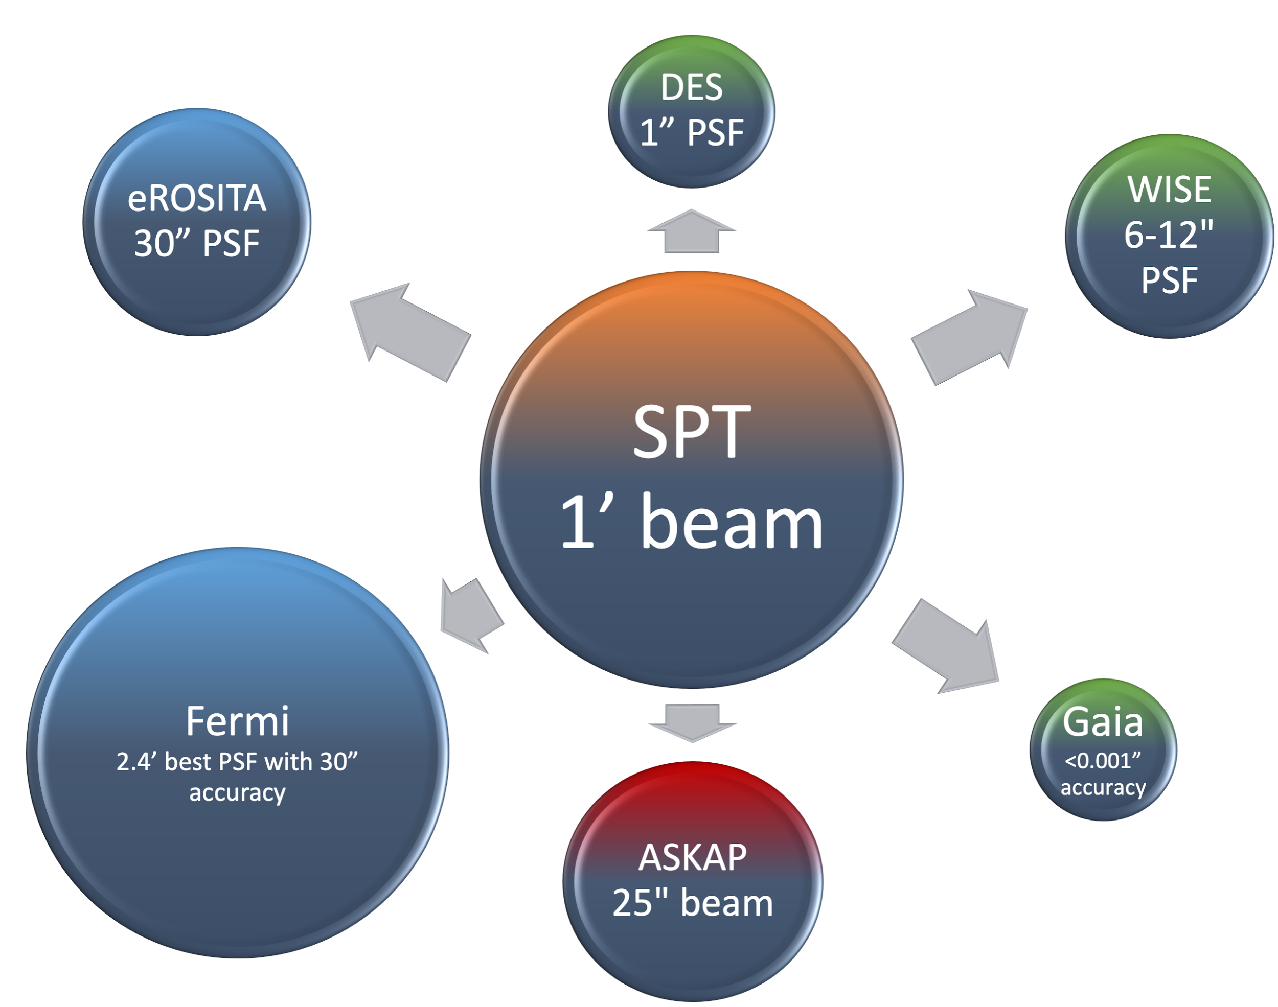
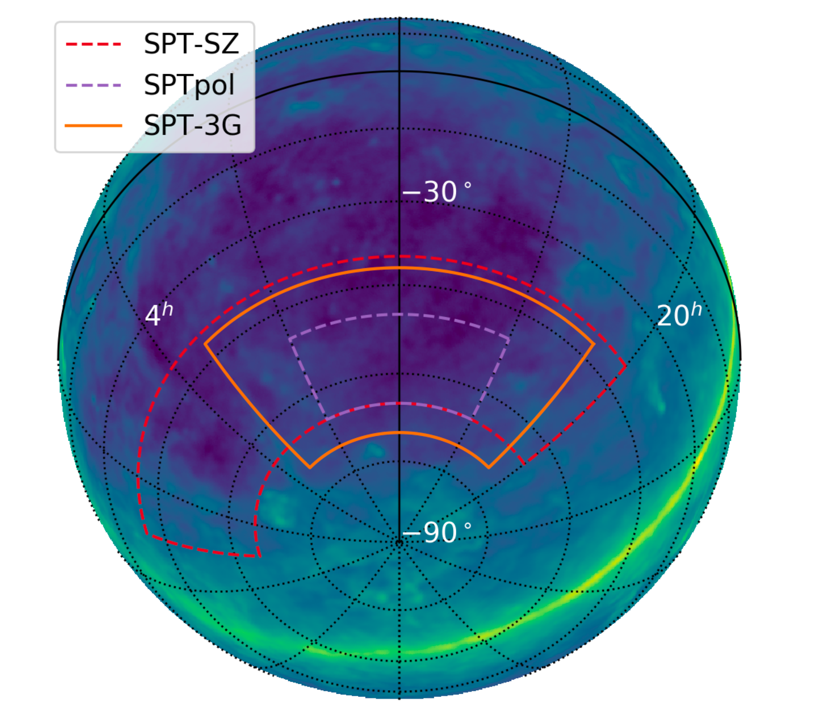

Millimeter Point Source Association
Characterize sources detected at millimeter wavelengths
Develop a forward model for the emission
Fast Bayesian inference including prior from forward model to associate sources at other wavelengths.

Slide 3
Millimeter Point Source Association
~4500 sources in the first South Pole Telescope catalog (SPT-SZ)
~30000 sources in the new SPT-3G (3rd generation) catalog
~265000 sources in the same area in ASKAP [radio] catalog
~100000 in WISE band 4
ASKAP: Australian Square Kilometre Array Pathfinder
WISE: Wide-field Infrared Survey Explorer

Slide 4
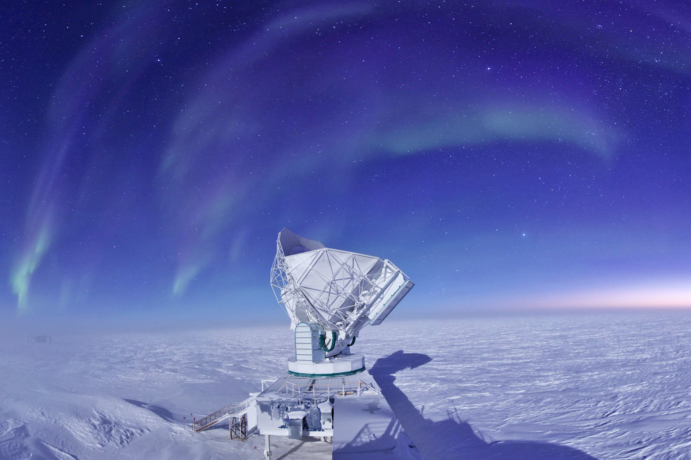
The South Pole Telescope
10 m off-axis mm-wave telescope
Observes at 1.4, 2, 3 mm + polarization
Main science goal to observe the cosmic microwave background
~1 arcminute beam (1.22*𝜆/D)
Photo credit: Jason Gallichio

Slide 5
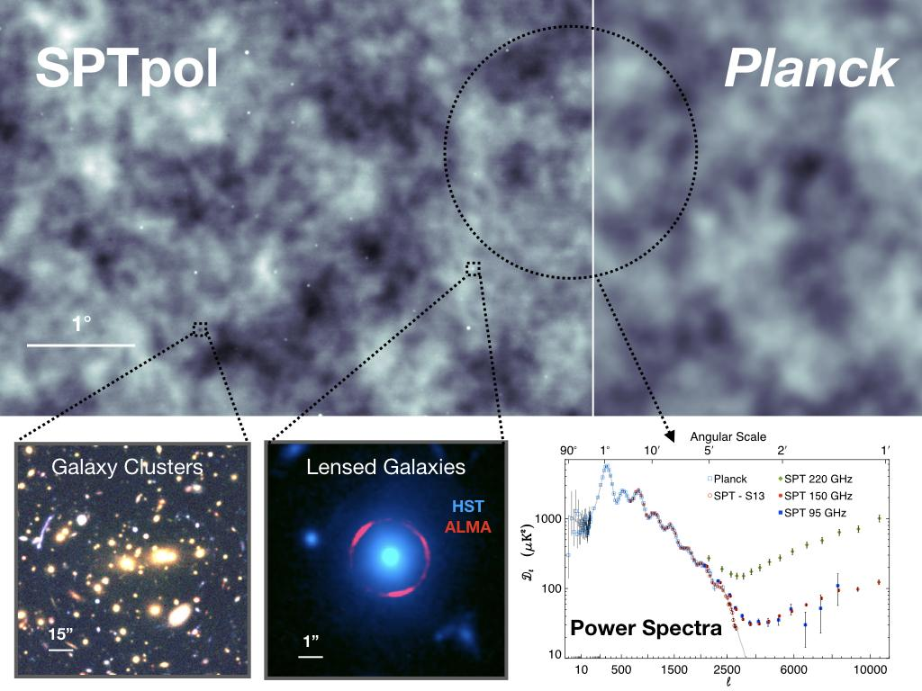
The South Pole Telescope
Dark spots -> Galaxy clusters
Emissive sources -> Galaxies/AGN
Our focus in this project is to characterize the emissive sources
https://astro.fnal.gov/science/cmbr/spt-3g/

Slide 6
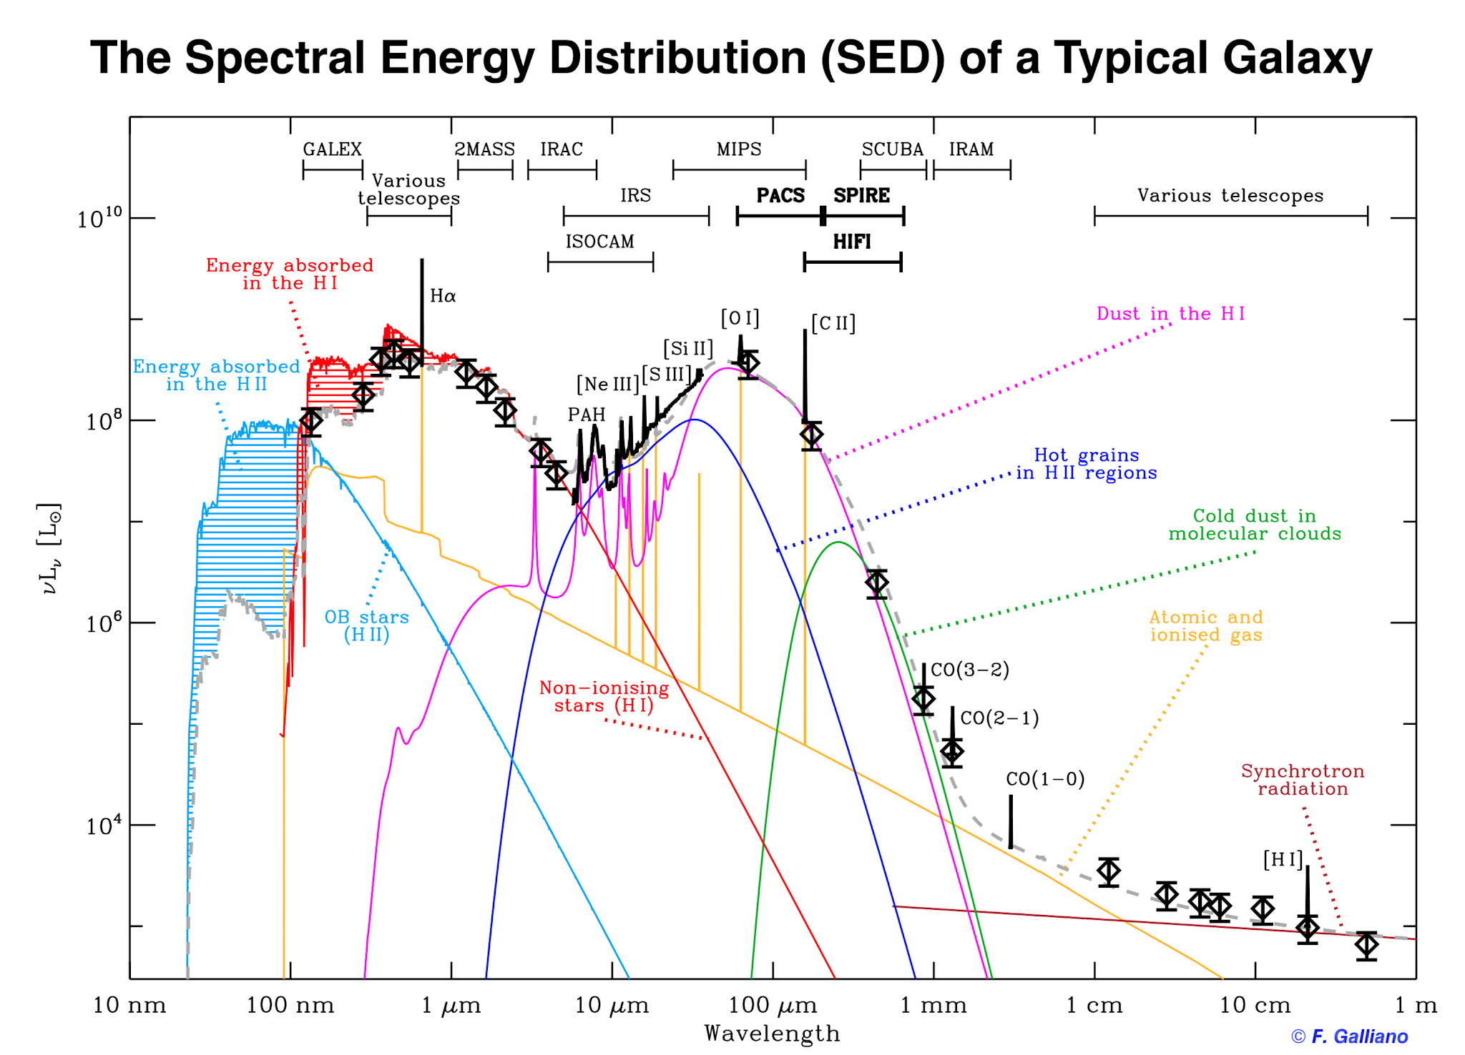
Spectral Energy Distribution of a galaxy

Slide 7
Spectral Energy Distribution of a galaxy
WISE
SPT
Herschel
ASKAP

Slide 8
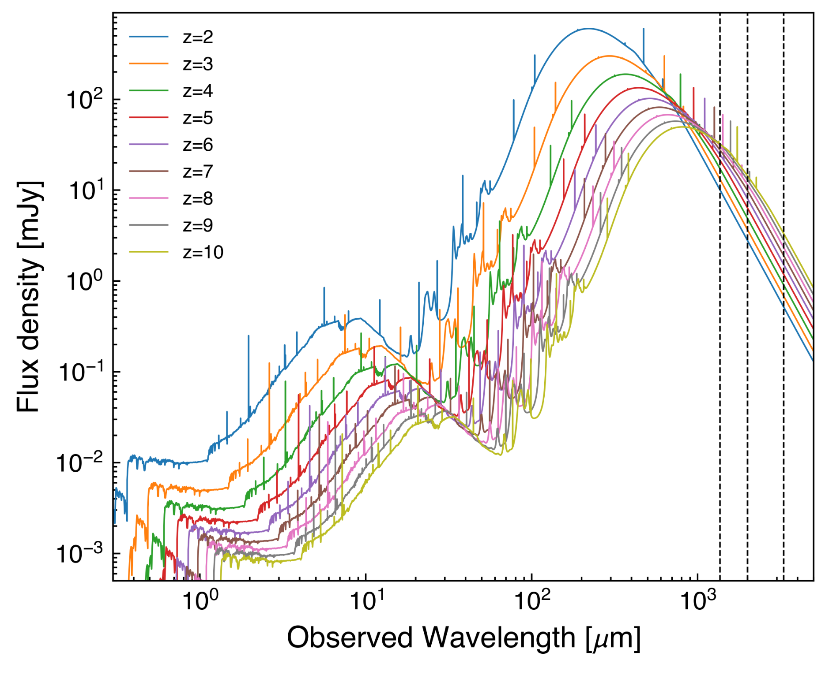
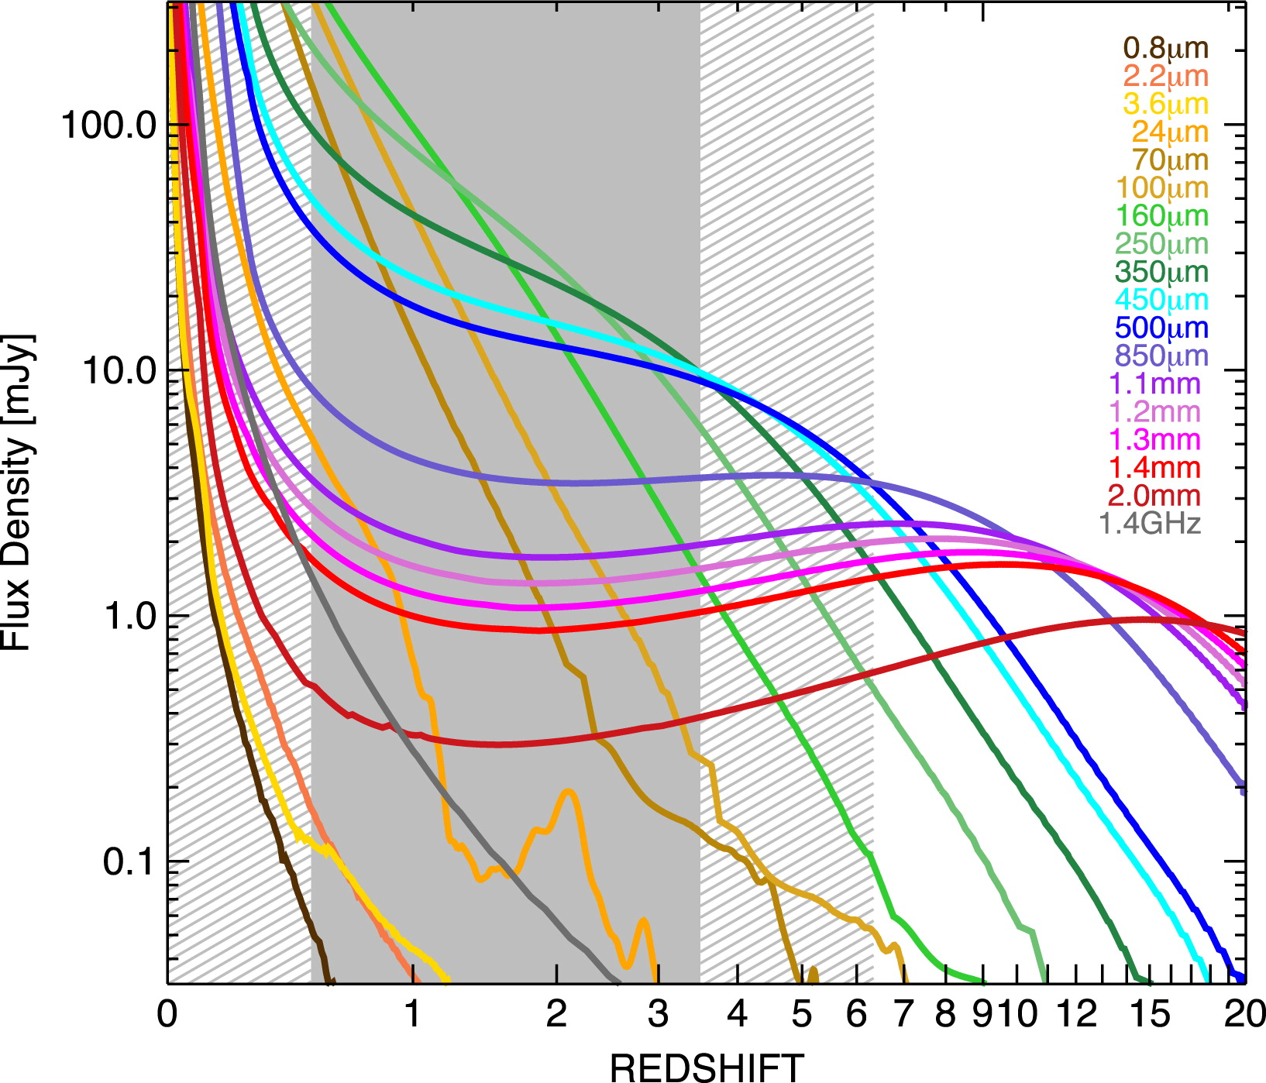
Negative k-correction
Casey et al. 2014 Figure 3
Take a star forming galaxy/ mm source and keep moving farther away.

Slide 9
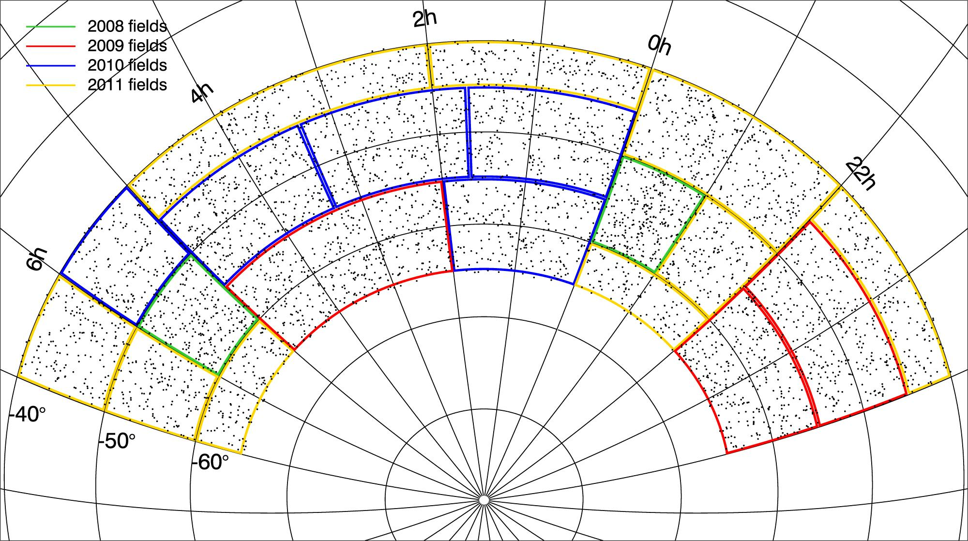
The SPT-SZ catalog
4845 sources in the first South Pole Telescope catalog (SPT-SZ)
3980 synchrotron dominated sources (80%)
865 dust dominated sources (20%)
Everett et al. 2020

Slide 10
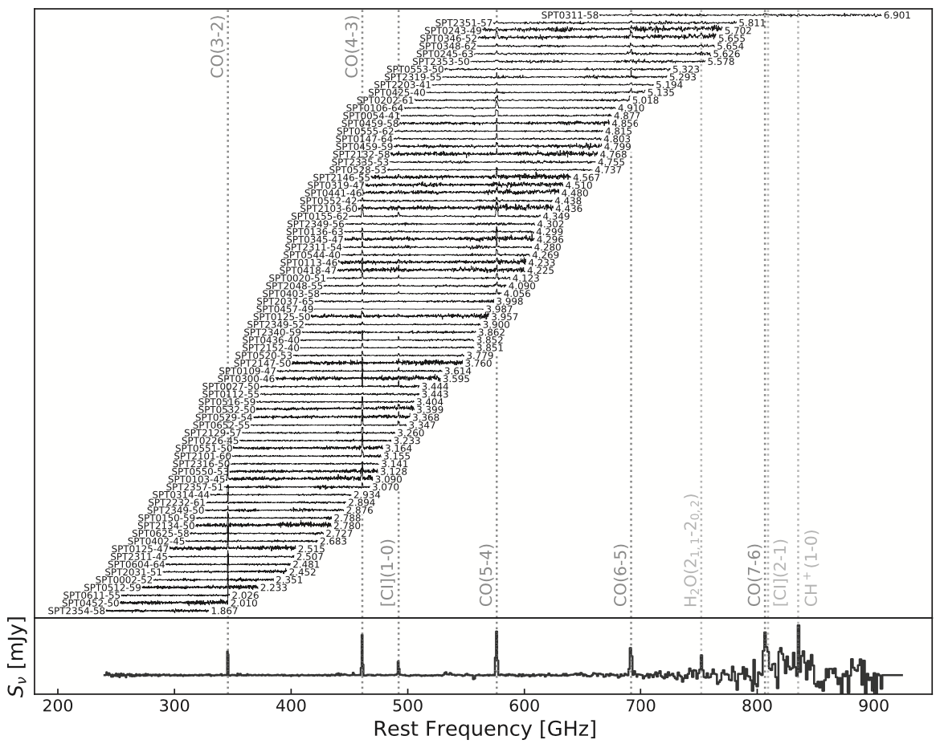
SPT selected Dusty Star Forming Galaxies
81 high-redshift dusty star forming galaxies
1.8<z<6.9
Pushing for higher redshift with SPT-3G to constrain dust production mechanisms
Quantify contribution of dusty star formation to the total star formation history of the universe
Reuter et al. 2020

Slide 11
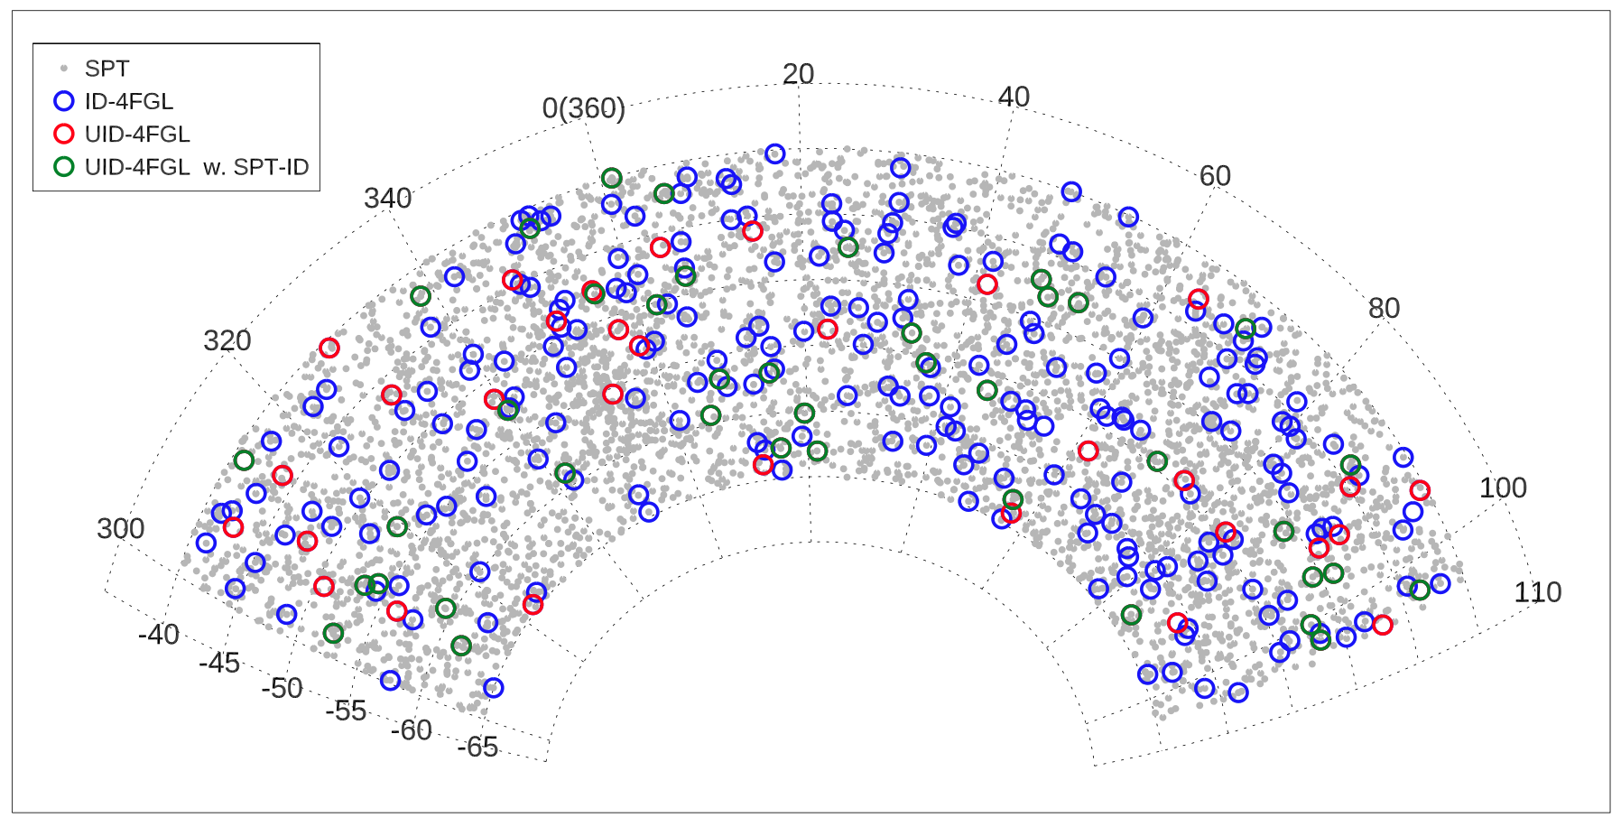
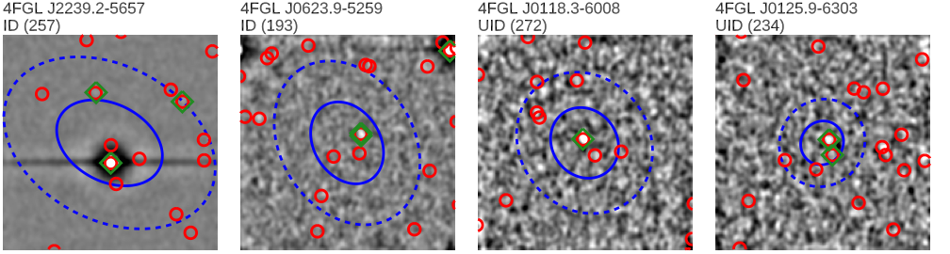
SPT selected Active Galactic Nuclei (AGN)
Identified counterparts for 40 previously unassociated Fermi γ-ray sources using frequentist approach
Demonstrated flux correlation between millimeter and γ-ray emission
Zhang et al. 2022

Slide 12
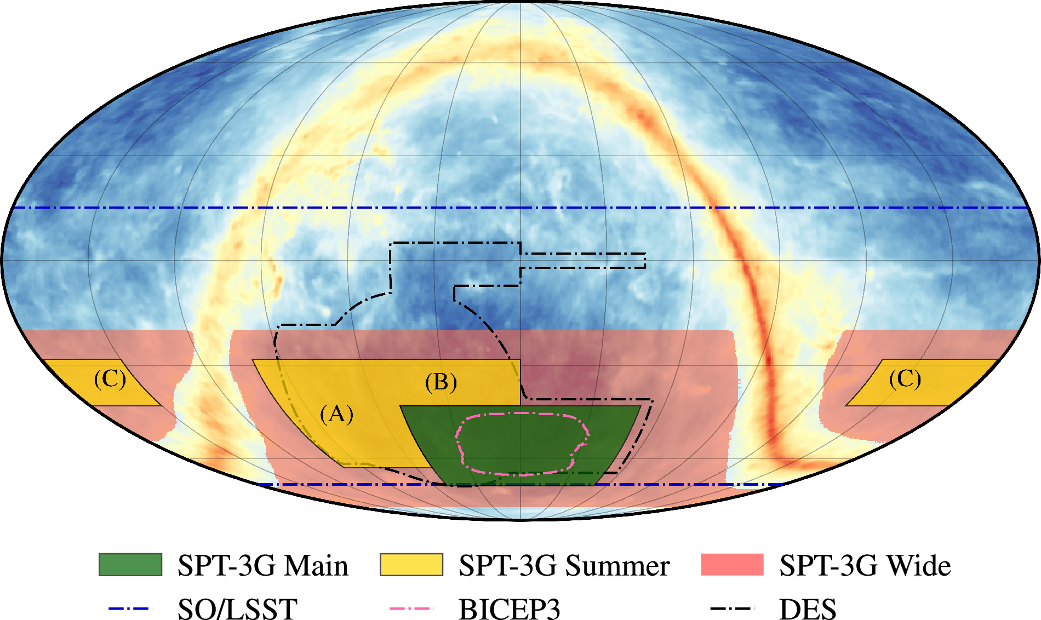
Current SPT status
1500 sq degrees of SPT-3G Main
10k sq degrees of SPT-3G Main+ Wide
Overlaps with many southern hemisphere surveys
Prabhu et al. 2024

Slide 13
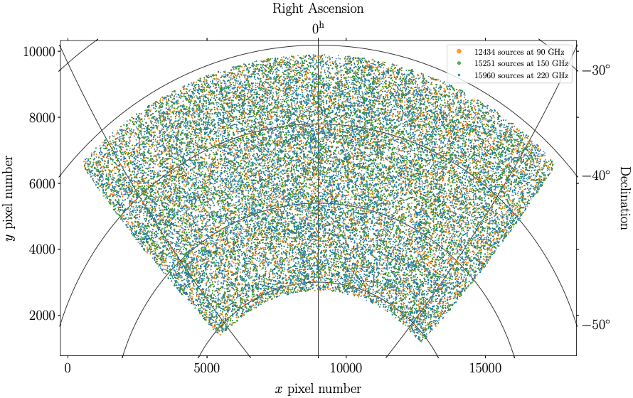
The SPT-3G Main source catalog
Based on 5 year data 2019-2023
~4x more sensitive at 1.4 mm
Change in demographics of the sources
Nearly 50-50 split between synchrotron and dust dominated sources.
Need new techniques to select high-redshift dusty star forming galaxies.
Archipley et al. in prep. 2026

Slide 14
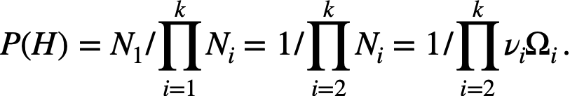
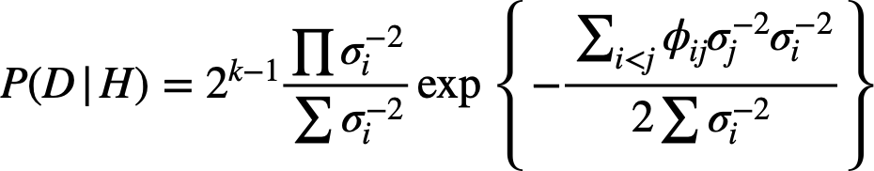
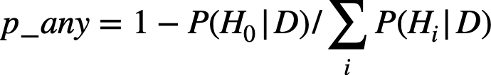
Bayesian inference for source association using NWAY
N: Number of sources.
k: Different catalogs.
P(H): Prior probability of an association.
ν: Source density.
Ω: Sky area.
P(H|D): Posterior probability.
𝜎: Position uncertainty.
p_any: Probability that source has any counterpart.
eq. (1)
eq. (2)
eq. (3)
eq. (4)
Budavári T.and Szalay A. S., 2008
Salvato, M., Buchner, J., Budavári, T., et al. 2018
Salvato, M., Wolf, J., Dwelly, T., et al. 2022

Slide 15
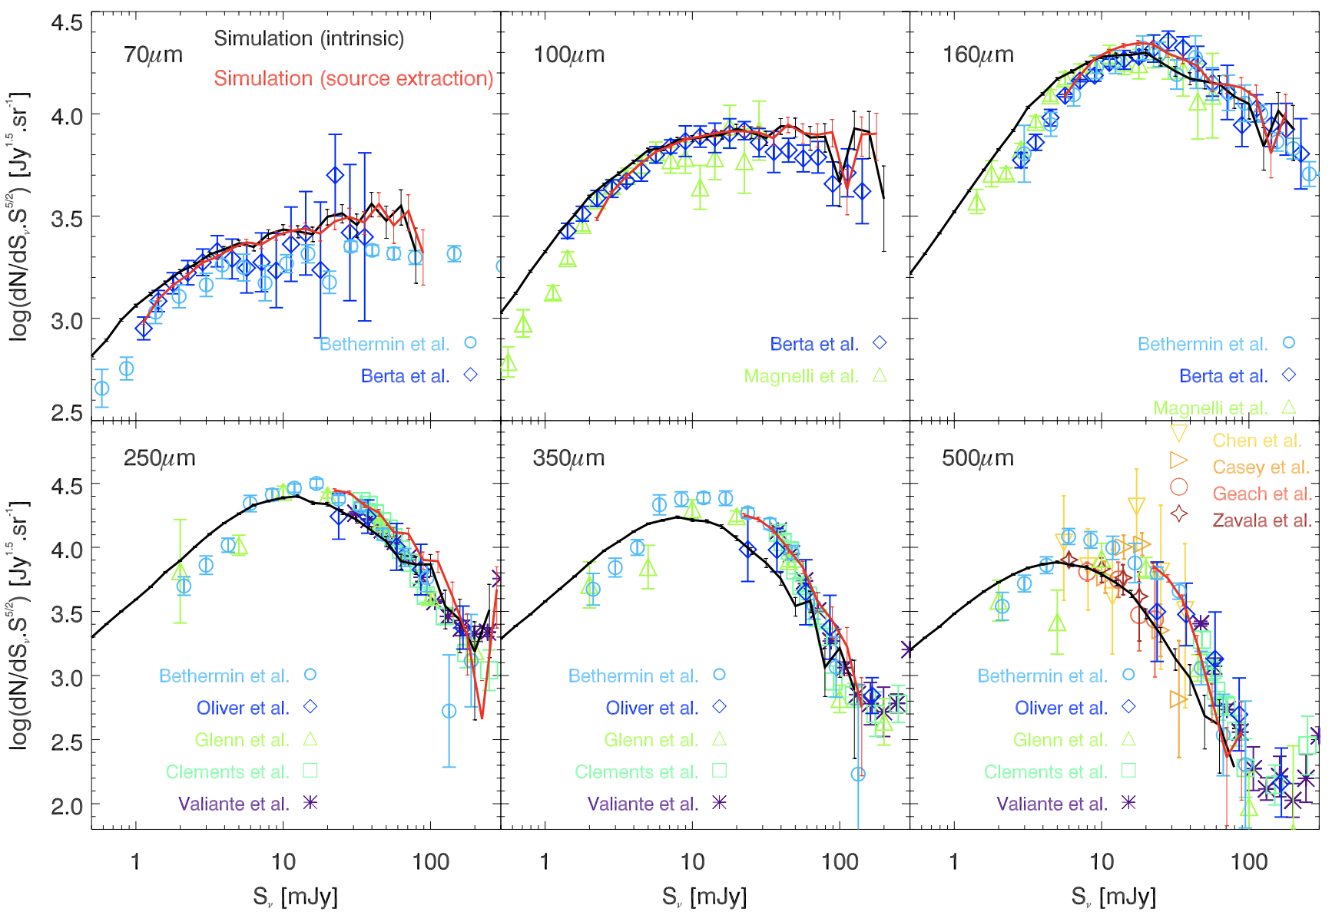
Forward model of the source catalog using SIDES
Simulated Infrared Dusty Extragalactic Sky (SIDES)
Built using Bolshoi-Planck dark-matter simulation
2 deg² simulation from IR to submillimeter
Populated via abundance matching
Reproduces observed number counts
Bethermin et al.. 2017, 2022
Notes:
Differential number counts from 70 μm to 500 μm. The counts are multiplied by S 2.5 to reduce the dynamic range of the plot and to ν
highlight the plateau at high flux densities where the Euclidian approximation is valid (e.g., Planck Collaboration Int. VII 2013). The solid black line is the prediction from our simulated catalog. The red line is derived from the extraction of sources in simulated Herschel maps using a method similar to that used by Béthermin et al. (2012a). The error bars on the prediction of the simulation are derived assuming Poisson statistics. The source extraction procedure is limited by confusion and only bright sources can be extracted reliably. From 70 μm to 160 μm, the light blue circles, the dark blue diamonds, and the green triangles are the Spizter counts of Béthermin et al. (2010a), Herschel/PEP counts of Berta et al. (2011), and Herschel/GOODS counts of Magnelli et al. (2013), respectively. From 250 μm to 500 μm, the light blue circles, the dark blue diamonds, the green triangles, turquoise squares, and purple asterisks are the Herschel/SPIRE measurements of Béthermin et al. (2012c), Oliver et al. (2010), Glenn et al. (2010), Clements et al. (2010), and Valiante et al. (2016), respectively. The SCUBA2 measurements at 450 μm of Chen et al. (2013), Casey et al. (2013), Geach et al. (2013), and Zavala et al. (2017) are shown using gold down-facing triangles, orange right-facing triangles, red open circles, and brown stars, respectively.

Slide 16
Goal of this project
Forward model
Bayesian inference for source association
Differentiable compiler
Generate source catalog at multiple wavelengths. Build on the existing simulation (SIDES) and add new features.
Probability of a source to be associated with sources in catalogs across the electromagnetic spectrum
Using Reactant to optimize the forward modeling and bayesian inference we get fast outputs
Automating Bayesian inference for (mm) source association
The flow chart should work for other catalogs provided appropriate prior is generated using a forward model.
Notes:
More compatible with Julia refer to Billy
Easier to combine with hardware

Slide 17
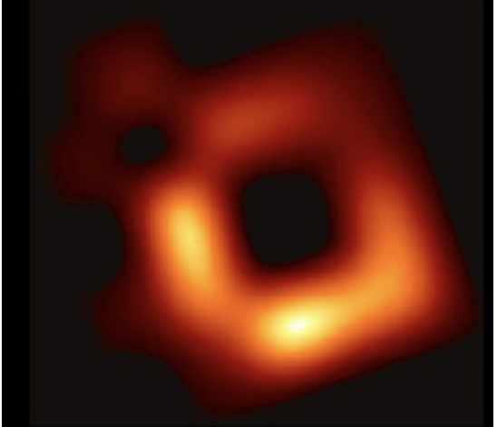
Bayesian Inference is great….but expensive!
Bayesian inference infers unknown from data
Useful as it combines data + prior knowledge,
even when data are limited or noisy!
However, parameter space can be large, and inference needs lots of forward model runs
(often with gradients)!

Slide 18
Bayesian Inference is great….but expensive!
Bayesian inference infers unknown from data
Useful as it combines data + prior knowledge,
even when data are limited or noisy!
However, parameter space can be large, and inference needs lots of forward model runs
(often with gradients)!
Reconstructed image of M87 ~1 week on cluster

Slide 19
Bayesian Inference is great….but expensive!
Bayesian inference infers unknown from data
Useful as it combines data + prior knowledge,
even when data are limited or noisy!
However, parameter space can be large, and inference needs lots of forward model runs
(often with gradients)!
Reconstructed image of M87 ~1 week on cluster
result = None
best_loss = float('inf')
for _ in range(N):
parameters = random()
loss = grad(forward)(parameters)
if loss < best_loss:
best_loss = loss
result = parameters

Slide 20
Bayesian Inference is great….but expensive!
Bayesian inference infers unknown from data
Useful as it combines data + prior knowledge,
even when data are limited or noisy!
However, parameter space can be large, and inference needs lots of forward model runs
(often with gradients)!
Reconstructed image of M87 ~1 week on cluster
result = None
best_loss = float('inf')
for _ in range(N):
parameters = random()
loss = grad(forward)(parameters)
if loss < best_loss:
best_loss = loss
result = parameters
Expensive

Slide 21
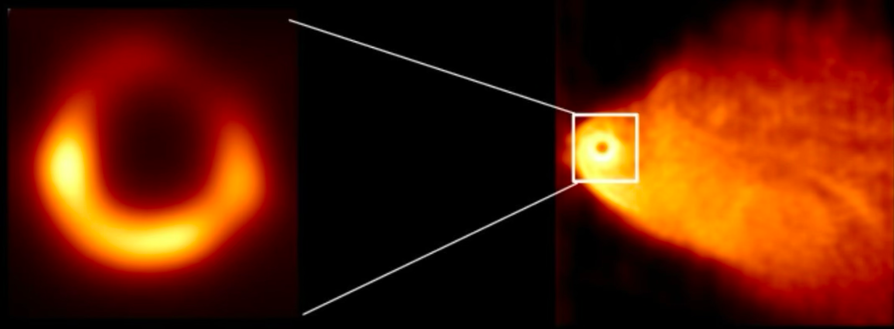
Bayesian Inference is great….but expensive!
Bayesian inference infers unknown from data
Useful as it combines data + prior knowledge,
even when data are limited or noisy!
However, parameter space can be large, and inference needs lots of forward model runs
(often with gradients)!
With Enzyme differentiation:
1 hour on 1 thread
result = None
best_loss = float('inf')
for _ in range(N):
parameters = random()
loss = grad(forward)(parameters)
if loss < best_loss:
best_loss = loss
result = parameters
Expensive

Slide 22
Code You Want to Write != Code You Want to Run
Scientific (and particularly astronomy) code is often written to resemble the fundamental equations to ensure correctness.
Direct execution of the mathematical theory may often result in unnecessary work and suboptimal mapping to the hardware which must execute it.
Even when this is taken into account, the code must be constantly re-written for each type and generation of hardware (CPU, 3090 GPU, 4090 GPU, 5090 GPU, TPUv1, TPUv2, …)

Slide 23
Code You Want to Write != Code You Want to Run
Missing Algorithmic Optimizations
  Example: expensive op factored out!
Linear Algebra Optimizations
  diag(X) * Y + Z → X ⊙ slice(Y) + Z
Hardware optimizations
  Rewrite to kernel which runs on devices 1, 2, 3, …, N, …
float[100][100] X;
for(i=1:10_000) {
float alpha = rand();
loss = cholesky(alpha * X)
if(loss < best) update();
}

Slide 24
Code You Want to Write != Code You Want to Run
Missing Algorithmic Optimizations
  Example: expensive op factored out!
Linear Algebra Optimizations
  diag(X) * Y + Z → X ⊙ slice(Y) + Z
Hardware optimizations
  Rewrite to kernel which runs on devices 1, 2, 3, …, N, …
float[100][100] X;
for(i=1:10_000) {
float alpha = rand();
loss = sqrt(alpha) *
cholesky(X)
if(loss < best) update();
}

Slide 25
Code You Want to Write != Code You Want to Run
Missing Algorithmic Optimizations
  Example: expensive op factored out!
Linear Algebra Optimizations
  diag(X) * Y + Z → X ⊙ slice(Y) + Z
Hardware optimizations
  Rewrite to kernel which runs on devices 1, 2, 3, …, N, …
float[100][100] X;
Y = cholesky(X);
for(i=1:10_000) {
float alpha = rand();
loss = sqrt(alpha) * Y;
if(loss < best) update();
}

Slide 26
Code You Want to Write != Code You Want to Run
Missing Algorithmic Optimizations
  Example: expensive op factored out!
Linear Algebra Optimizations
  diag(X) * Y + Z → X ⊙ slice(Y) + Z
Hardware optimizations
  Rewrite to kernel which runs on devices 1, 2, 3, …, N, …
// Some example rules
x + 0 -> x
transpose(transpose(x)) -> x
// push slices up(reduce work)
slice(add(a,b)) -> add(slice(a),slice(b))
// push pads down(reduce work)
mul(pad(x,0),y) -> pad(mul(x,slice(y)),0)
x,y = tensor<10000xf32>
a = dot(x,y)
b = mul(a,z)
c = dot(b[0:10],4)
return c;

Slide 27

Code You Want to Write != Code You Want to Run
Missing Algorithmic Optimizations
  Example: expensive op factored out!
Linear Algebra Optimizations
  diag(X) * Y + Z → X ⊙ slice(Y) + Z
Hardware optimizations
  Rewrite to kernel which runs on devices 1, 2, 3, …, N, …
// Some example rules
x + 0 -> x
transpose(transpose(x)) -> x
// push slices up(reduce work)
slice(add(a,b)) -> add(slice(a),slice(b))
// push pads down(reduce work)
mul(pad(x,0),y) -> pad(mul(x,slice(y)),0)
x,y = tensor<10000xf32>
a = dot(x,y)
b = mul(a,z)
c = dot(b[0:10],4)
return c;
x,y = tensor<10000xf32>
a = dot(x,y)
b = mul(a[0:10],z[0:10])
c = dot(b,4)
return c;

Slide 28
Code You Want to Write != Code You Want to Run
#define CEIL_DIV(M, N) (((M) + (N)-1) / (N))
template <const int BM, const int BN, const int BK, const int TM>
__global__ void sgemm1DBlocktiling(int M, int N, int K, float alpha,
const float *A, const float *B, float beta,
float *C) {
const uint cRow = blockIdx.y;
const uint cCol = blockIdx.x;
const int threadCol = threadIdx.x % BN;
const int threadRow = threadIdx.x / BN;
// allocate space for the current blocktile in SMEM
__shared__ float As[BM * BK];
__shared__ float Bs[BK * BN];
// Move blocktile to beginning of A's row and B's column
A += cRow * BM * K;
B += cCol * BN;
C += cRow * BM * N + cCol * BN;
// todo: adjust this to each thread to load multiple entries and
// better exploit the cache sizes
assert(BM * BK == blockDim.x);
assert(BN * BK == blockDim.x);
const uint innerColA = threadIdx.x % BK; // warp-level GMEM coalescing
const uint innerRowA = threadIdx.x / BK;
const uint innerColB = threadIdx.x % BN; // warp-level GMEM coalescing
const uint innerRowB = threadIdx.x / BN;
// allocate thread-local cache for results in registerfile
float threadResults[TM] = {0.0};
// outer loop over block tiles
for (uint bkIdx = 0; bkIdx < K; bkIdx += BK) {
// populate the SMEM caches
As[innerRowA * BK + innerColA] = A[innerRowA * K + innerColA];
Bs[innerRowB * BN + innerColB] = B[innerRowB * N + innerColB];
__syncthreads();
// advance blocktile
A += BK;
B += BK * N;
...
// calculate per-thread results
for (uint dotIdx = 0; dotIdx < BK; ++dotIdx) {
// we make the dotproduct loop the outside loop, which facilitates
// reuse of the Bs entry, which we can cache in a tmp var.
float tmpB = Bs[dotIdx * BN + threadCol];
for (uint resIdx = 0; resIdx < TM; ++resIdx) {
threadResults[resIdx] +=
As[(threadRow * TM + resIdx) * BK + dotIdx] * tmpB;
}
}
__syncthreads();
}
// write out the results
for (uint resIdx = 0; resIdx < TM; ++resIdx) {
C[(threadRow * TM + resIdx) * N + threadCol] =
alpha * threadResults[resIdx] +
beta * C[(threadRow * TM + resIdx) * N + threadCol];
}
}
Missing Algorithmic Optimizations
  Example: expensive op factored out!
Linear Algebra Optimizations
  diag(X) * Y + Z → X ⊙ slice(Y) + Z
Hardware optimizations
  Rewrite to kernel which runs on devices 1, 2, 3, …, N, …

Slide 29


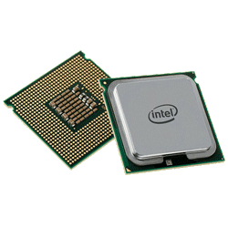
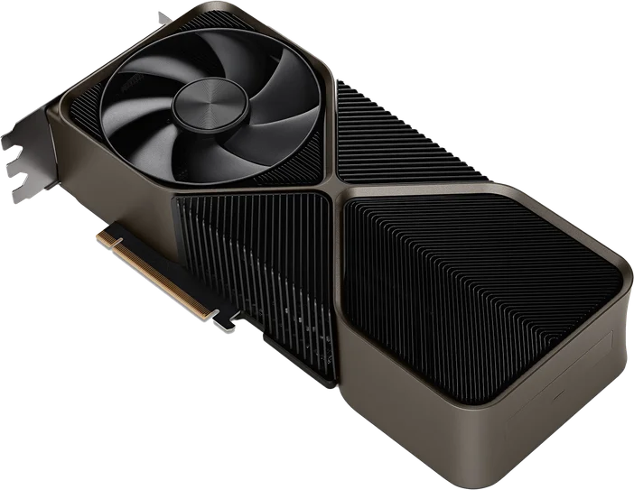
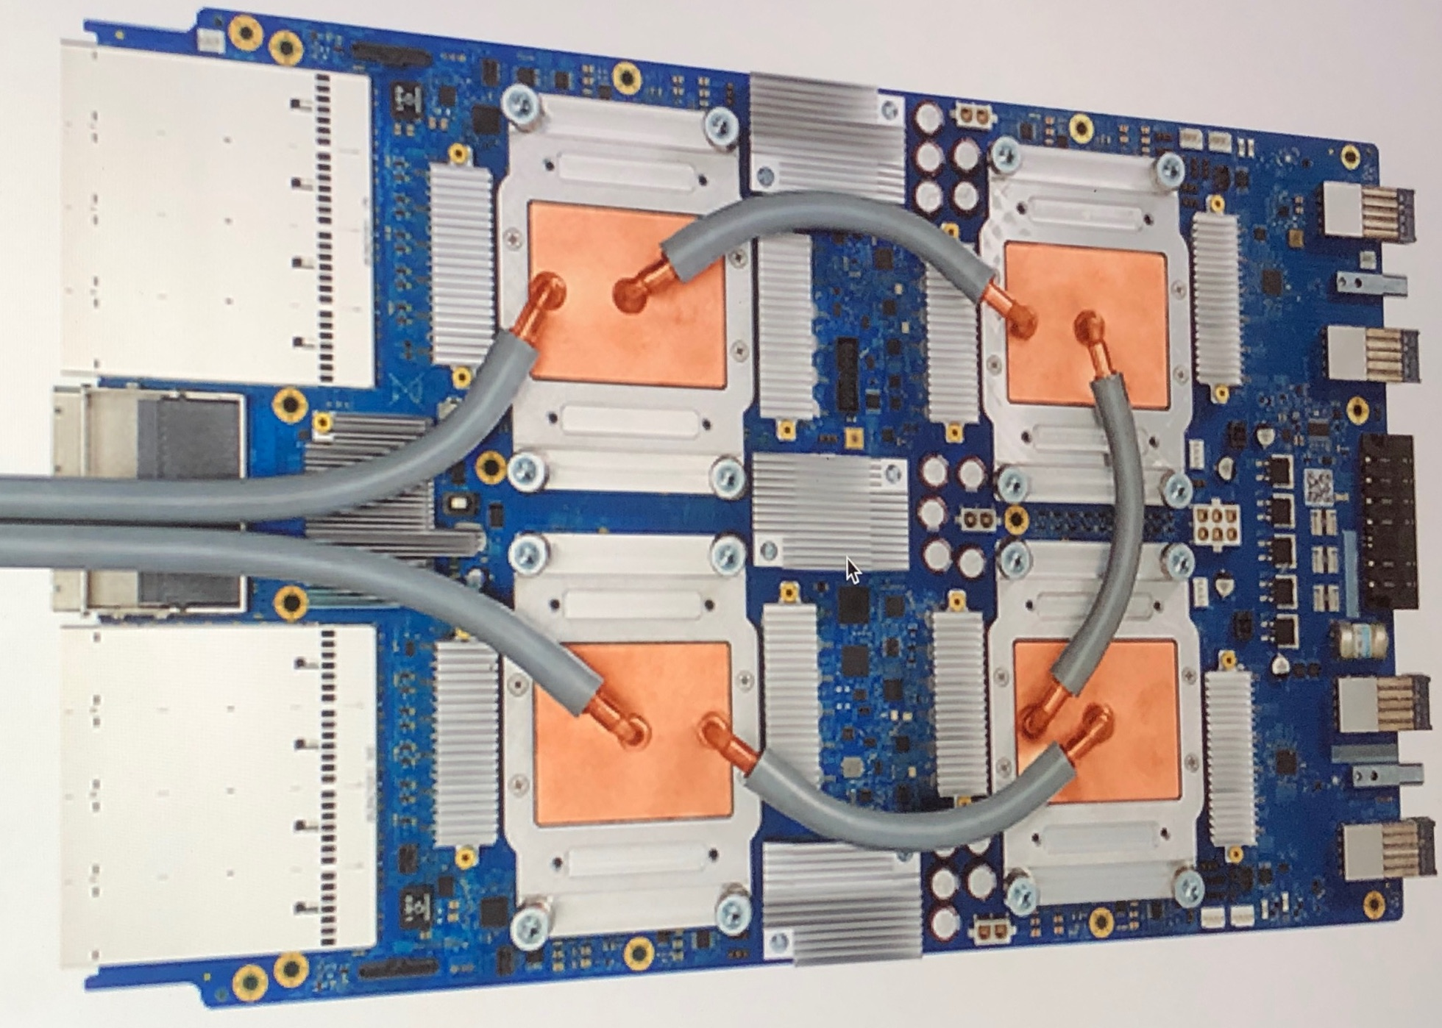
Our Solution: Automatically Synthesize Efficient Code
Reactant Compiler
(C++, Julia, Python)
Bayesian Dialect
enzyme.sample, …
Domain specific operations & analyses
Generate MLIR
Lowering + Enzyme AD
+ Tensor Optimizations
for i in axes(A, 1)
tmp[i] = 0
for j in axes(A, 2)
tmp[i] += A[i, j] * x[j]
end
for j in axes(A, 2)
y[j] += A[i, j] * tmp[i]
end
end
Hardware-Specific Codegen
+ Optimization
Optimization passes

Slide 30
Our Solution: Automatically Synthesize Efficient Code
Reactant Compiler
(C++, Julia, Python)
Bayesian Dialect
enzyme.sample, …
Domain specific operations & analyses
Generate MLIR
Lowering + Enzyme AD
+ Tensor Optimizations
for i in axes(A, 1)
tmp[i] = 0
for j in axes(A, 2)
tmp[i] += A[i, j] * x[j]
end
for j in axes(A, 2)
y[j] += A[i, j] * tmp[i]
end
end
Hardware-Specific Codegen
+ Optimization
Optimization passes

Slide 31
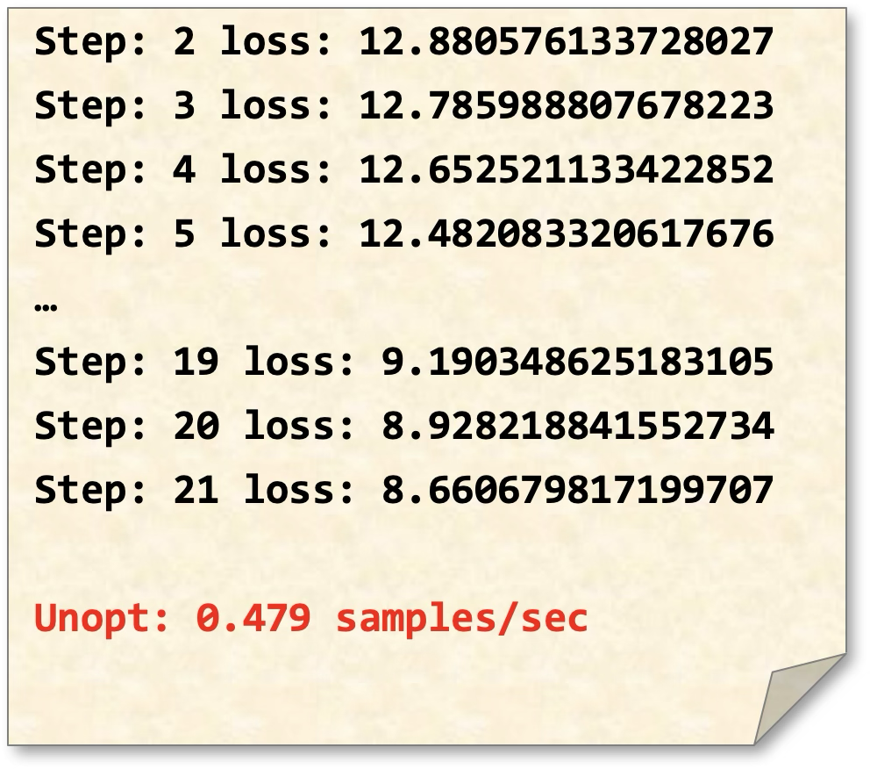
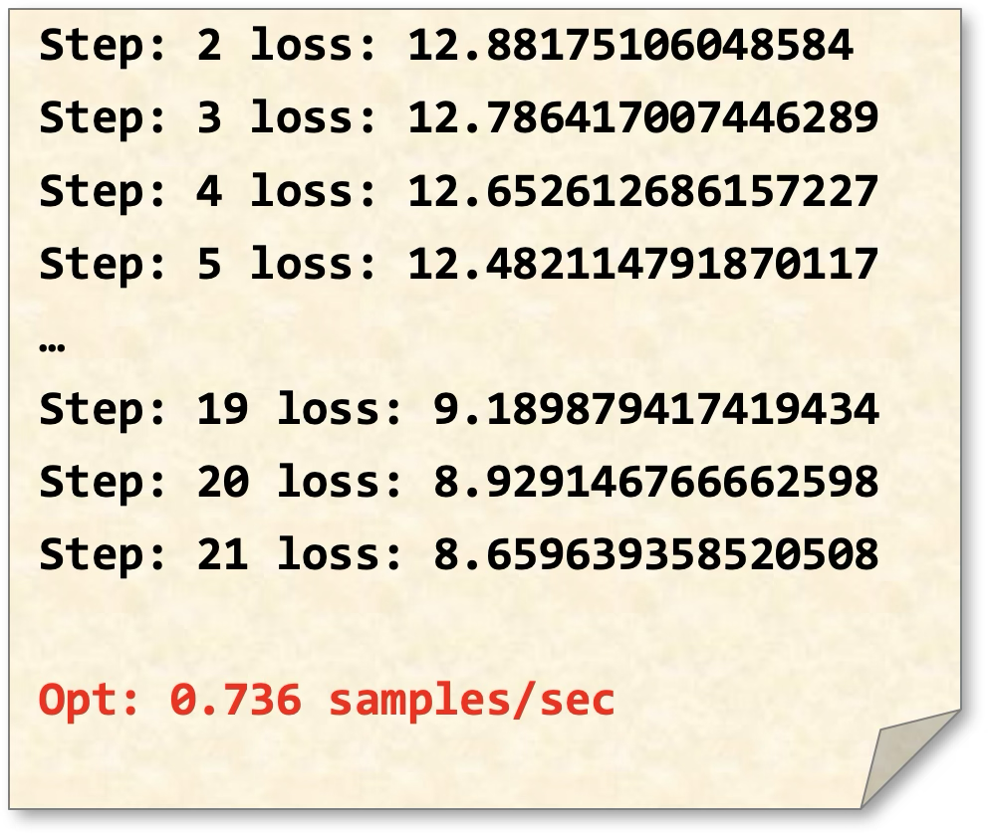
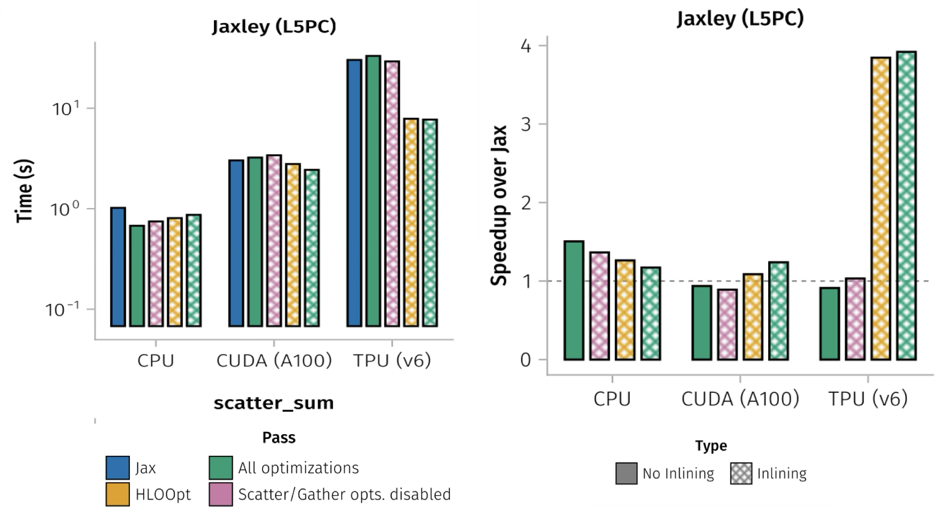
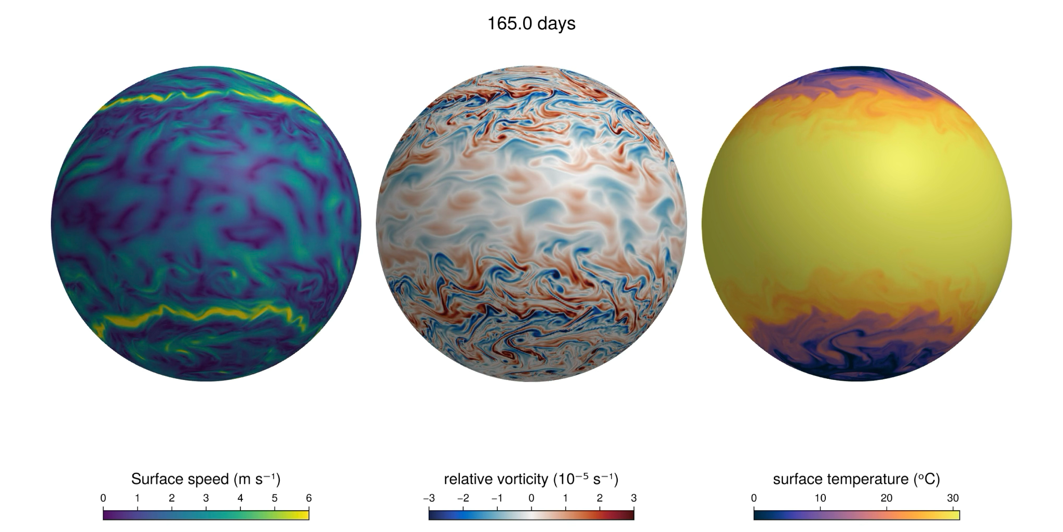
Reactant Performance Gains Outside Astronomy
Linear-algebra specific optimizations made a significant impact on training performance of a production LLM
  53% speedup of a run with 32x accelerators
  14-18.5% speedup for single accelerator
Jaxley Biophysical Models Speedups (1.15x speedup on CPU, 1.33x speedup on A100, 3.92x speedup on TPU v6)
Climate Model (31.8x on CPU, 4.4x on GPU)

Slide 32
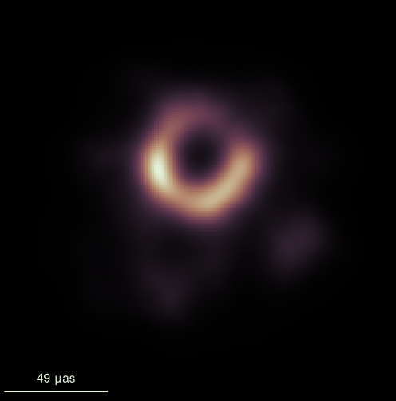
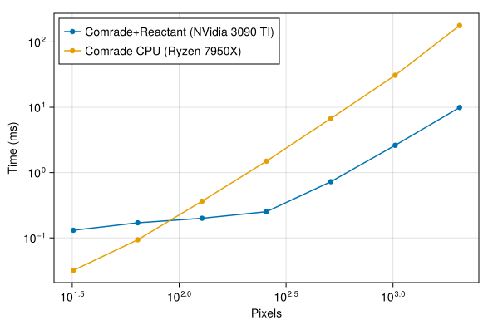
Reactant Bayesian Inference on Astronomy Code
Made with Reactant + EnzymeMLIR
End-to-end compilation of EHT imaging pipeline with Reactant, capable of reproducing original results
Successful end-to-end execution on accelerators
Preliminary analysis shows substantial improvements in speed for images with high resolution
  >15x for 2k images on a single consumer GPU (NVIDIA 3090 @ Float64)

Slide 33
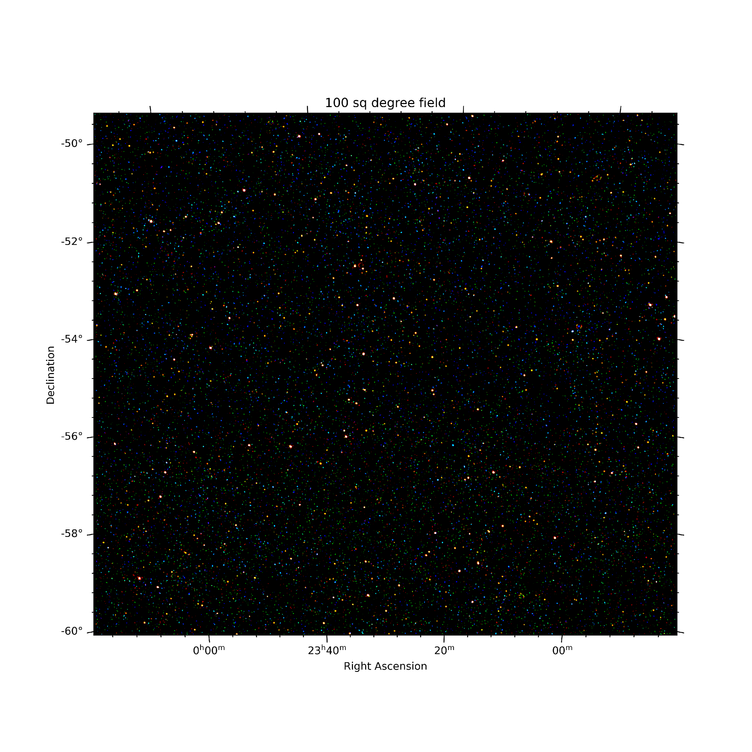
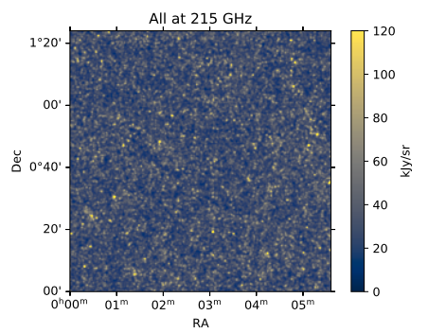
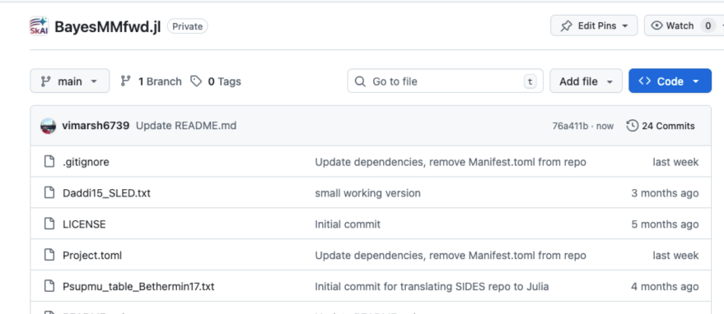
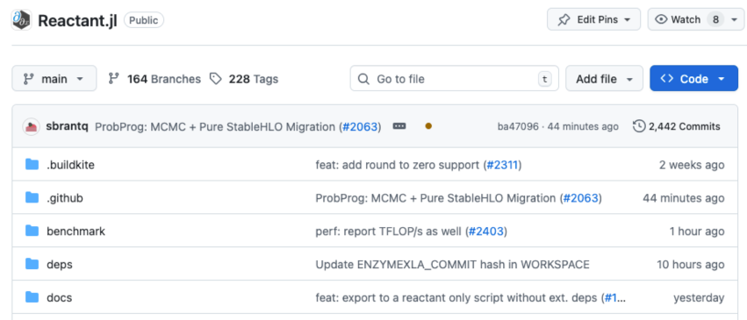
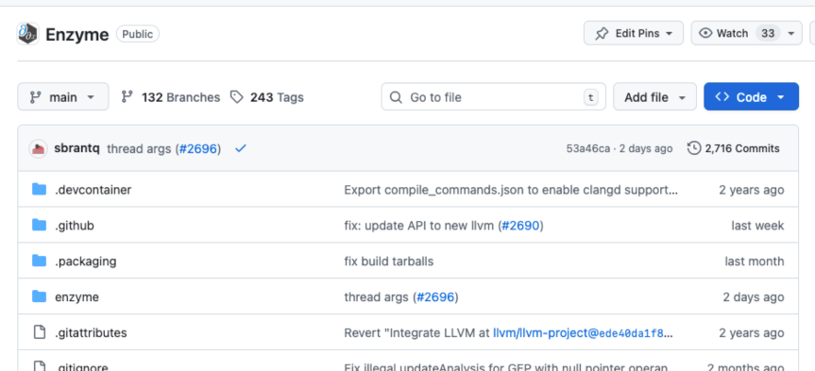
End-to-End Status of the Project
Successful end-to-end compilation and execution of forward model
Successful end-to-end compilation and execution of gradient
Reactant-compiled model beats prior workloads by an order of magnitude thanks to auto-parallelization and linear algebra transformations
Integration of HMC in progress
Generate mock galaxy catalog
Add a Spectral Energy Distribution to each galaxy
Calculate fluxes in each filter of interest
Notes:
BayesMMfwd Benchmark Results
Generated: 2026-02-10 22:04:23
Dataset: data/SIDES_Bethermin2017_short2.csv (1000 galaxies)
Backend: cpu
Seed: 1234
Metric Time (s)
----------------------------------------------------
process! (Julia cold JIT) 2.301411
process! (Julia warm JIT) 0.031544
process! (Reactant cold run) 0.422247
process! (Reactant warm run) 0.014666
Derived ratios
----------------------------------------------------
Julia cold/warm: 72.958x
Reactant cold/warm: 28.791x
Warm Reactant/Julia: 0.465x

Slide 34
Goal of this project
Forward model [standalone publication]
  Use dark matter halo models
  Assign a Spectral Energy Distribution (SED) to each halo above a certain star formation rate
  Simulate mock catalogs at different wavelengths (IR-mm)
  Add radio emission to each source/ generate radio catalog
Integration
  Translate forward model code to julia
  Make code compatible with Reactant
  Translate source association bayesian inference code to julia
Integration (contd.)
  Check source association code compatibility with Reactant
Reactant Compiler
  Differentiation on Tensors
  Linear Algebra Optimizations
  Accelerator Backend - CPU, CUDA, TPU, ROCM
  Bayesian Inference
    Parallel Markov Chains
    Sample-Invariant Code Motion
    Dimensionality Reduction
    Auto Block Decomposition
    More Advanced Algorithms
Done
In Progress
To Do
Notes:
More compatible with Julia refer to Billy
Easier to combine with hardware

Slide 35
Success Metrics + Targets
Develop and release optimized forward model software to the community
  Ability to generate mock catalogs at varying depths across the wavelengths and large area of sky
Develop and release Bayesian inference source association code.
Identify high-redshift sources in the full catalog as well as other interesting sources
Implement automatic generation of efficient backward models
  GPU acceleration for complex source associations
Implement algorithmic, linear algebra, hardware optimizations
  Scalable Bayesian inference on full catalogs with consumer-grade hardware
Notes:
More compatible with Julia refer to Billy
Easier to combine with hardware

Slide 36
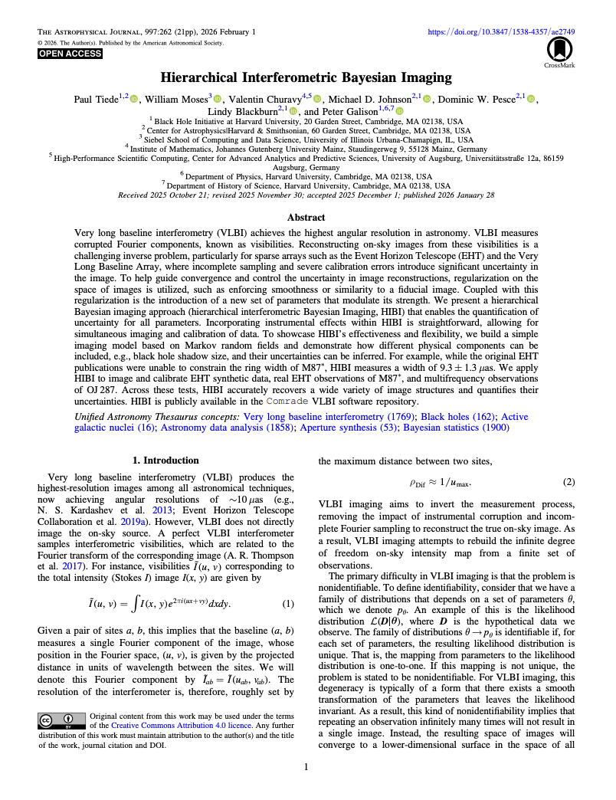
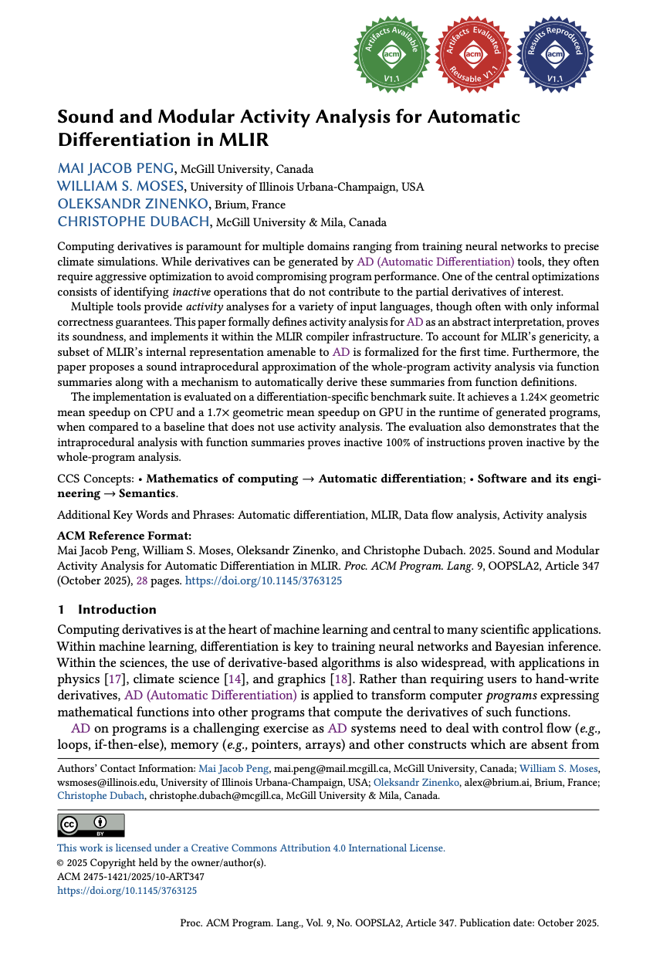
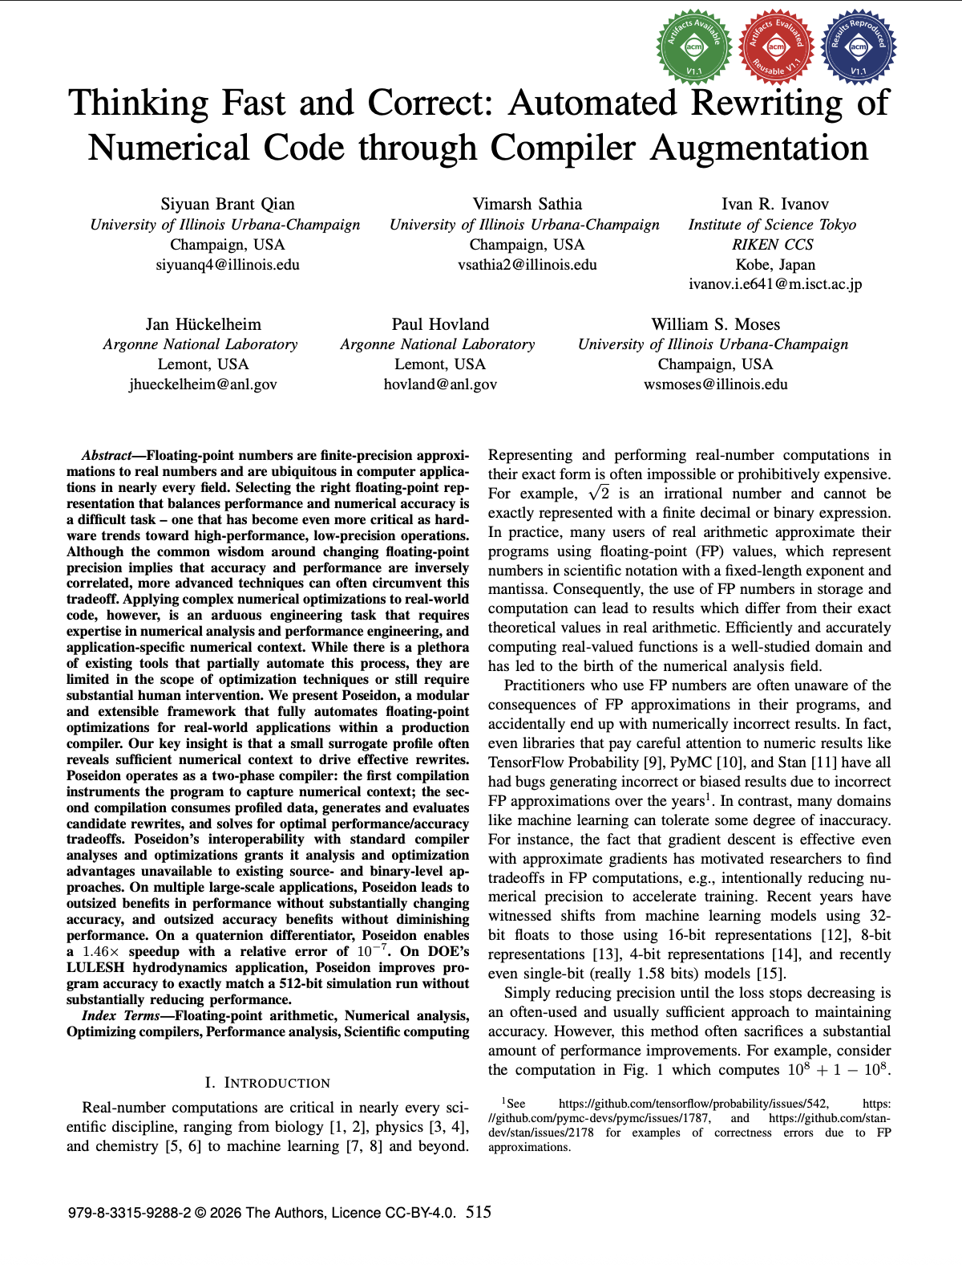

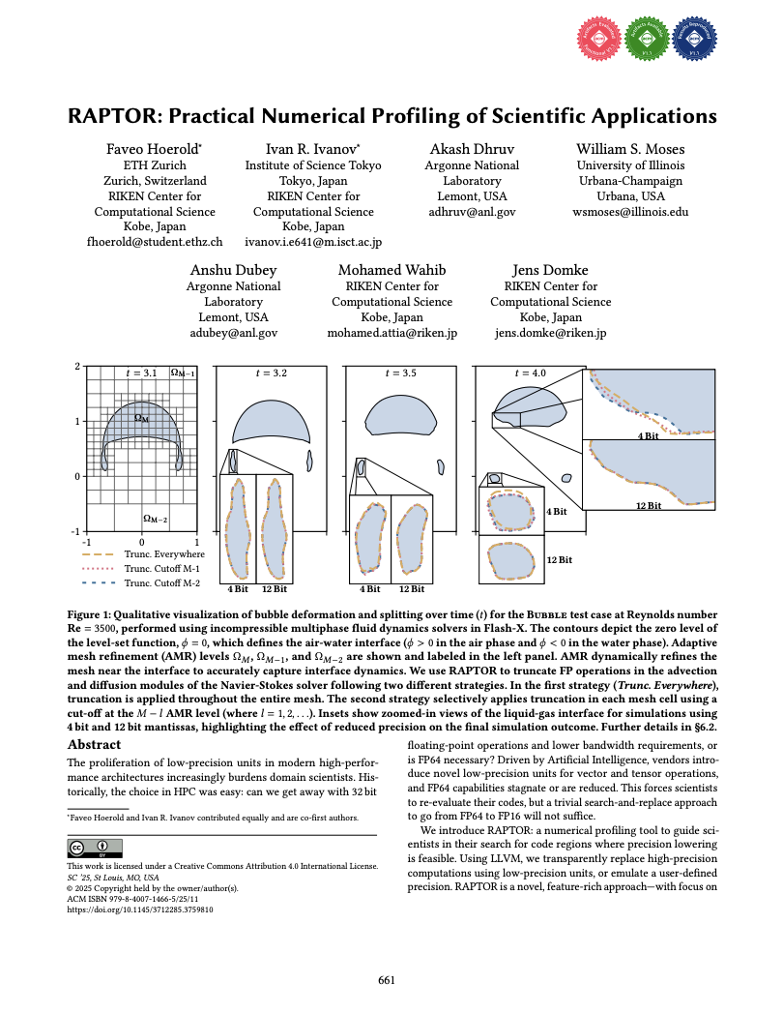
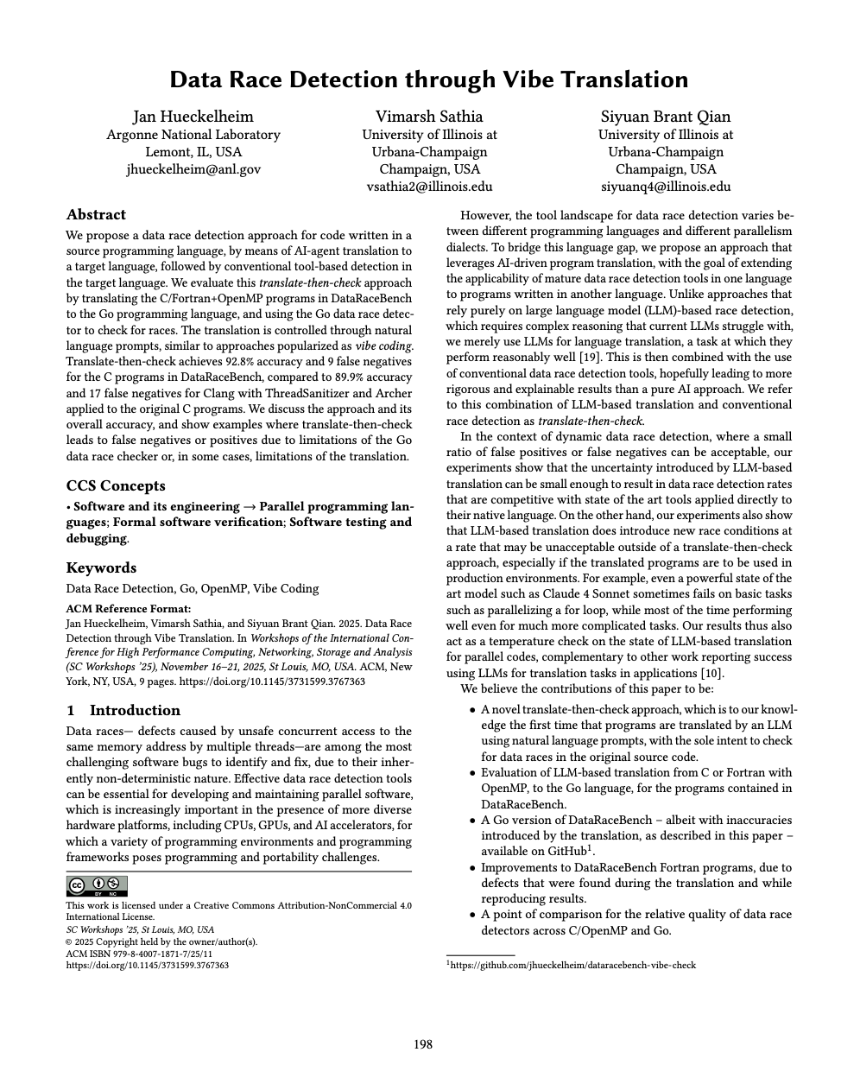
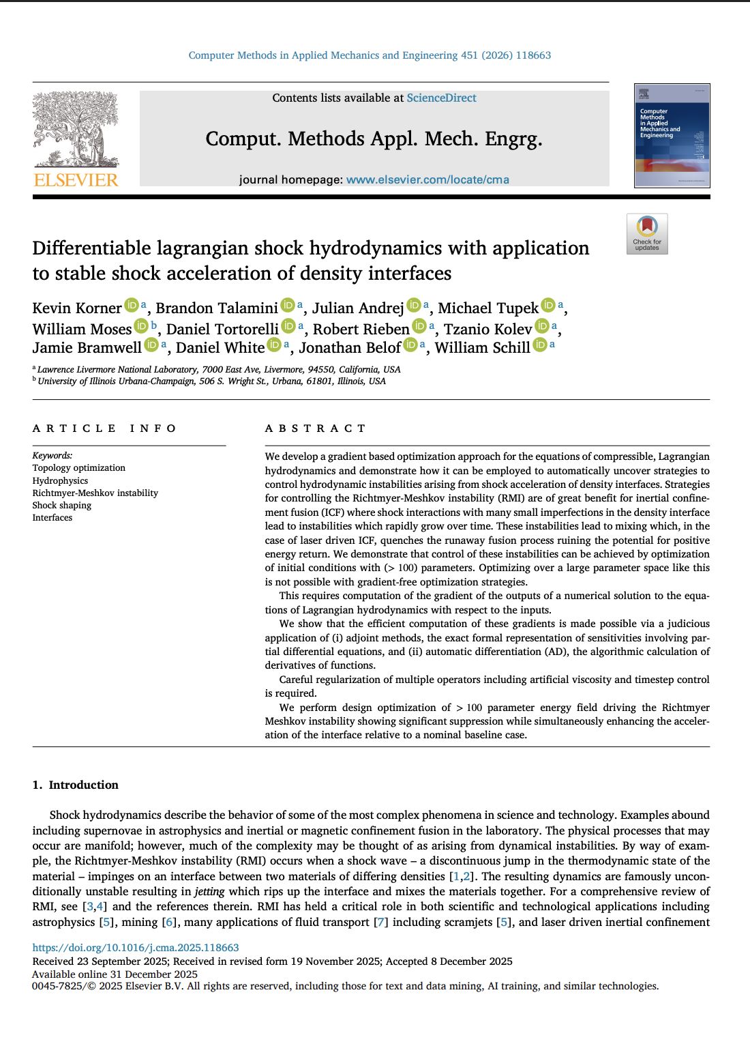
Wins from the past six months
7 papers: (2 @ OOPSLA’25, 1 @ SC’25, 1 @ SCCorrectness, 1 @ CGO’26; 1 @ Astrophysical Journal, 1 @ Computer Methods in Applied Mechanics Journal)
Distinguished Paper at CGO
Best Reproducibility Advancement at SC
SIAM Supercomputing Early Career Prize
Notes:
More compatible with Julia refer to Billy
Easier to combine with hardware

Slide 37
Roadblocks and Challenges
No major significant theoretical challenges
Biggest challenges mostly on software engineering:
  More software engineering support is always helpful (and help us push things forward more quickly!)
  Access to continuous integration infrastructure (in particular AMD GPUs)
  Some of the distributed communication libraries nccl/rccl variants have strange nondeterministic timeouts at higher node counts (512 GPUs+)
Advice on forward models related to different AGN types welcome.

Slide 38
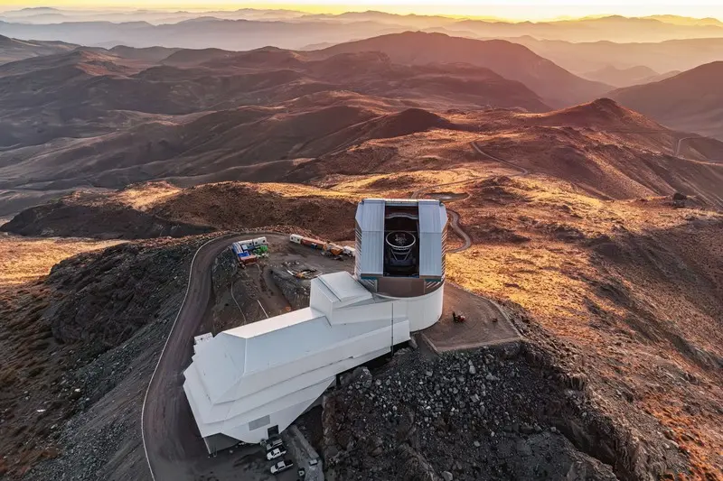
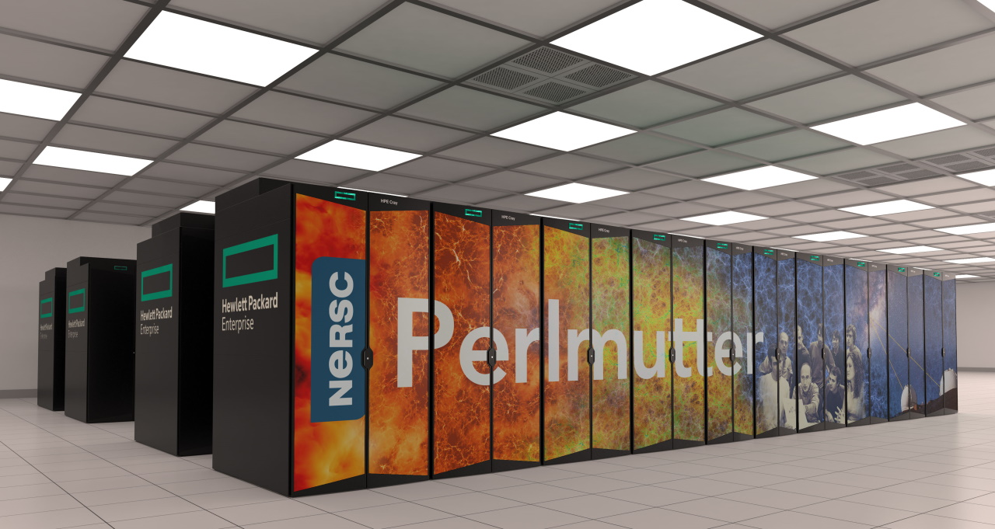
Future scalability
Implement automatic Bayesian source associations for mm transients.
  Need a model for mm emission mechanism for transient sources
  This will be helped by building a dataset of simultaneously observed transients in millimeter and optical/IR.
The fast Bayesian souce association code can be scaled to crossmatch/deblend sources in crowded fields. Rubin-LSST can benefit by combining datasets at multiple wavelengths using Bayesian inference (currently simple distance based matching is implemented in DP1).
Support distributed computation (with automatic distribution algorithms), more advanced sampling techniques, and bayesian-specific optimizations

Slide 39
End-to-End Status of the Project
Successful end-to-end compilation and execution of forward model
Successful end-to-end compilation and execution of gradient
Reactant-compiled model beats prior workloads by an order of magnitude thanks to auto-parallelization and linear algebra transformations
Integration of HMC in progress
Generate mock galaxy catalog
Add a Spectral Energy Distribution to each galaxy
Calculate fluxes in each filter of interest
Notes:
BayesMMfwd Benchmark Results
Generated: 2026-02-10 22:04:23
Dataset: data/SIDES_Bethermin2017_short2.csv (1000 galaxies)
Backend: cpu
Seed: 1234
Metric Time (s)
----------------------------------------------------
process! (Julia cold JIT) 2.301411
process! (Julia warm JIT) 0.031544
process! (Reactant cold run) 0.422247
process! (Reactant warm run) 0.014666
Derived ratios
----------------------------------------------------
Julia cold/warm: 72.958x
Reactant cold/warm: 28.791x
Warm Reactant/Julia: 0.465x

Slide 40
Backward slide
Forward model …
We want efficient backward models that compute parameters given observations
This requires exploring a high-dimensional parameters space efficiently

Slide 41
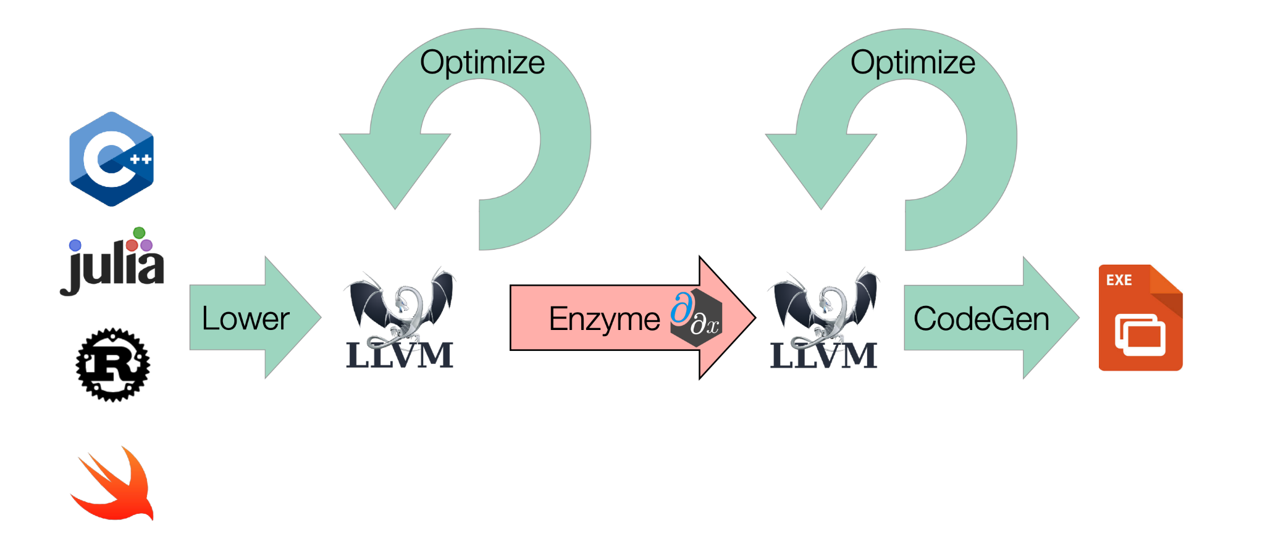
Automatic Generation of Backward Model
  Goal: Build first-class probabilistic programming with solvers in Reactant
  Reactant: an alternative Julia compiler into MLIR that delivers domain-specific optimizations and GPU/TPU acceleration
  No-U-Turn-Sampler available on GitHub: EnzymeAD/Reactant.jl

Slide 42
100 deg² of SPT-3G sources
95 GHz
150 GHz
220 GHz
2k SPT sources.
200k Herschel (FIR) sources.
225k MeerKAT (radio) sources.

Slide 43
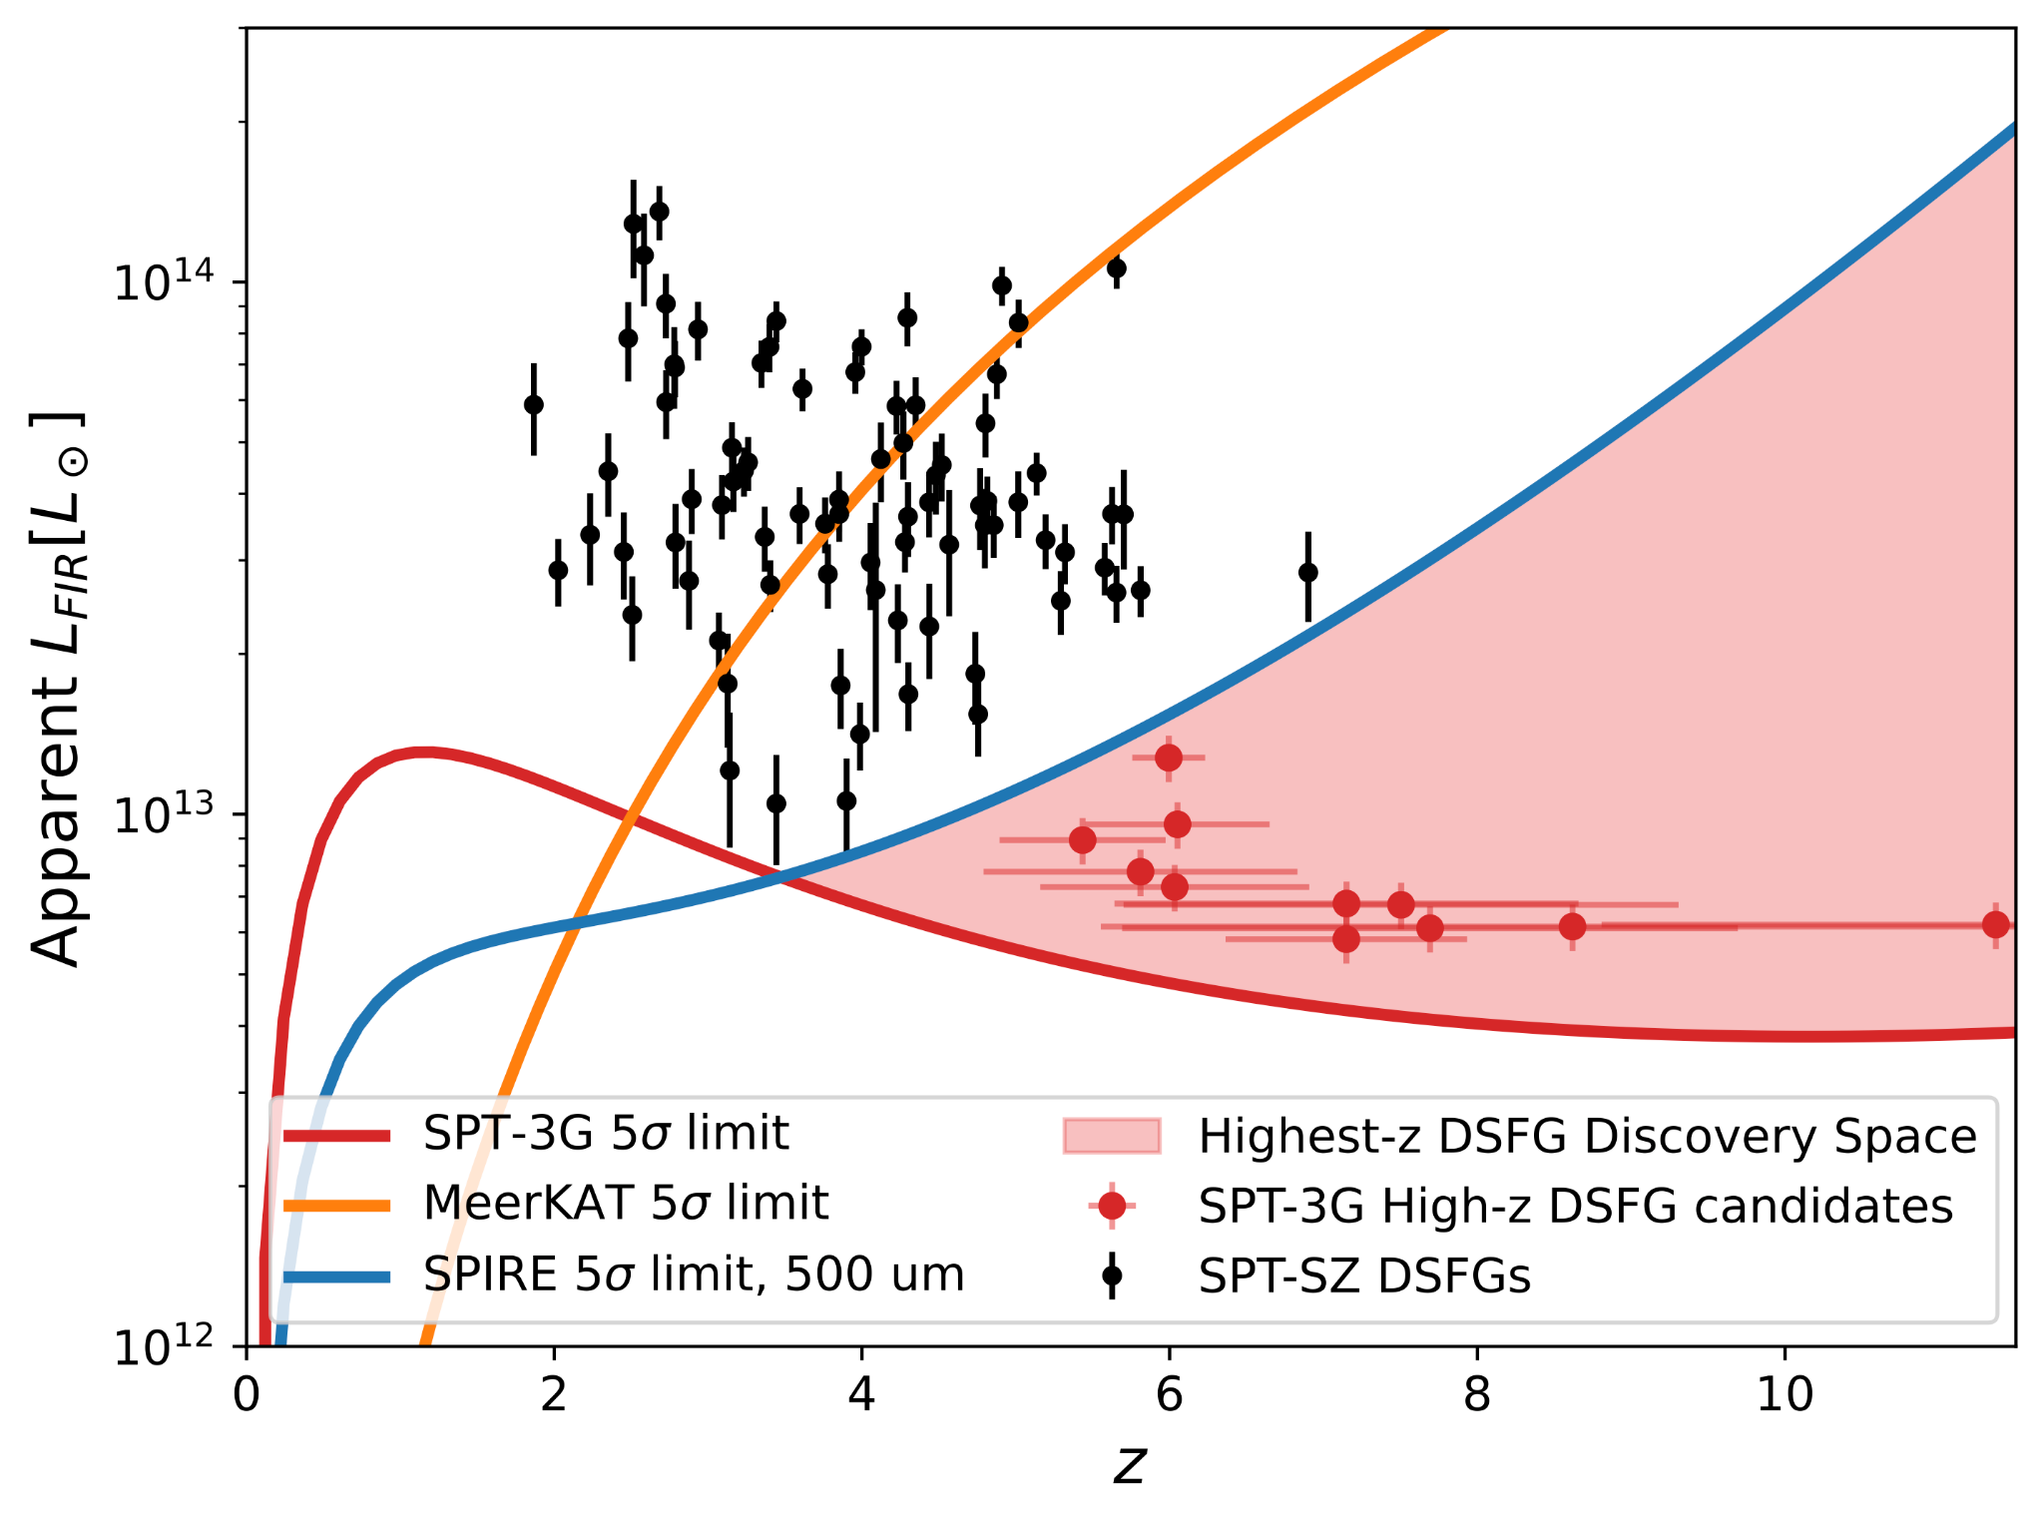
Search for the most distant dusty star forming galaxy
78 candidate sources found to have no other matches
11 very high redshift candidates selected after visual inspection
ALMA program approved for spectroscopic confirmation

Slide 44
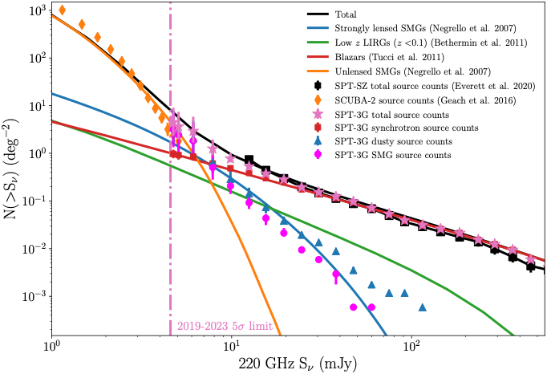
Astro+AI Gameplan
Part 1: First 20 months
Automate Bayesian inference for source associations [Astro+AI]
What we need?
  Forward models amenable to differentiable and probabilistic programming
How?
  We can use empirical source population models to create mock mm-wave catalogs and associate a SED to each source.
  Train forward model using these mock catalogs.

Slide 45
AI Gameplan
Natively combining Differentiation with Optimization has been quite successful
  Automatically generate backwards pass, previously hand-written
  Performance improvements enable new science

Slide 46
AI Gameplan
Natively combining Differentiation with Optimization has been quite successful
  Automatically generate backwards pass, previously hand-written
  Performance improvements enable new science
Automating solvers (i.e. bayesian inference) is more complicated
  Uses differentiation for continuous variables, but our solver must also handle discrete decisions and higher-level algorithms
  Goal: Build first-class probabilistic programming with solver into the compiler (enabling optimization, discrete choices, hybrid neural+classical solvers, etc)

Slide 47
AI Methods & Approaches
Methods & Approaches (5-7 minutes AI side only)
What methods are being used?
Focus on the AI or computational techniques applied (e.g., machine learning models, natural language processing, simulations).
Why these methods?
Briefly explain why these approaches are suitable for the problem and how they compare to other approaches.
If not commonly used: how do they work at a high level?
Avoid technical jargon—use intuitive explanations or diagrams to illustrate the process. Make sure you define any acronyms!
With regard to any AI models in it would be great if speakers could note specifically:
What the inputs/outputs are,
What the usual or baseline approach is,
Where that breaks down,
And how the developed approach improves on that.

Slide 48
Status of the Project
Current Status & Results (5 minutes)
What is the current status?
Share preliminary results or insights, emphasizing what is novel or has been unexpected. This is not meant to necessarily include all work that has been performed. Where is the project at this moment?
What are the project’s goals and success metrics?
Define what success looks like—scientific breakthroughs, practical applications, etc.
What are the next research targets?
Outline the upcoming phases of the project and what you hope to learn or achieve.

Slide 49
Roadblocks and Challenges
Challenges (10 minutes, designed to spur discussion/additional connection across SkAI)
What challenges have emerged?
Discuss technical, conceptual, or collaborative hurdles—especially those that arise in astro-AI interdisciplinary space.
Where could you use advice?
SkAI has a wide array of expertise and experience. Please use this opportunity to request input and make connections where they can benefit the project.
Do you see any new opportunities unfolding?
Highlight new opportunities, unexpected applications, or broader impacts.

Slide 50
Reactant Compiler
(C++, Julia, Python)
Bayesian Dialect
enzyme.sample, …
Domain specific operations & analyses
Generate MLIR
Lowering + Enzyme AD
+ Tensor Optimizations
for i in axes(A, 1)
tmp[i] = 0
for j in axes(A, 2)
tmp[i] += A[i, j] * x[j]
end
for j in axes(A, 2)
y[j] += A[i, j] * tmp[i]
end
end
Hardware-Specific Codegen
+ Optimization

