Slide 1
Progress & Challenges of Multiphysics at Exascale: Thermo-Chemo-Mechanics Response of Hypersonics Thermal Protection Systems
Raul Radovitzky William Moses

Slide 2
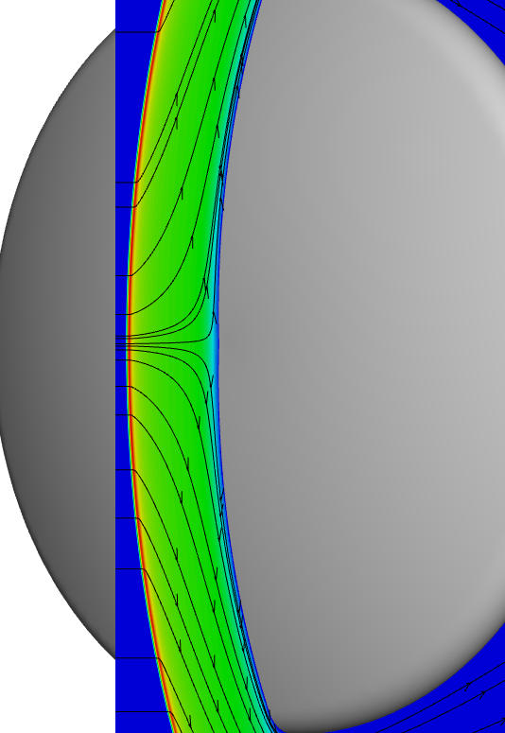
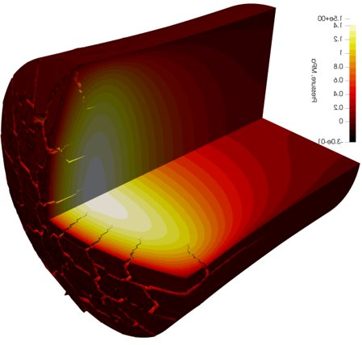
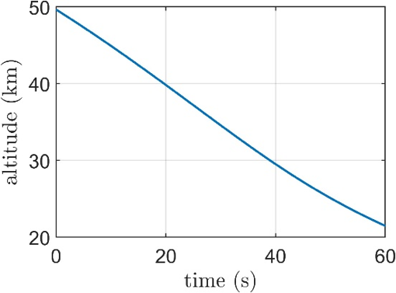
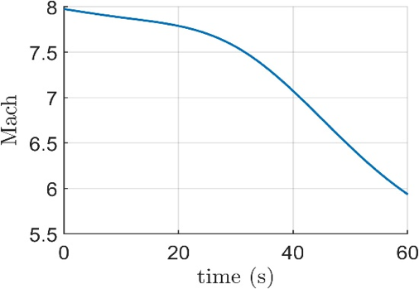
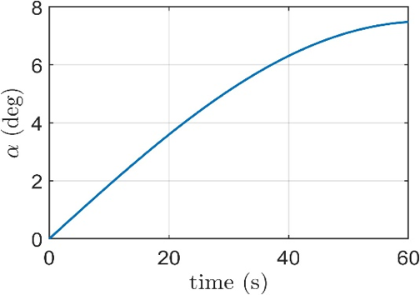
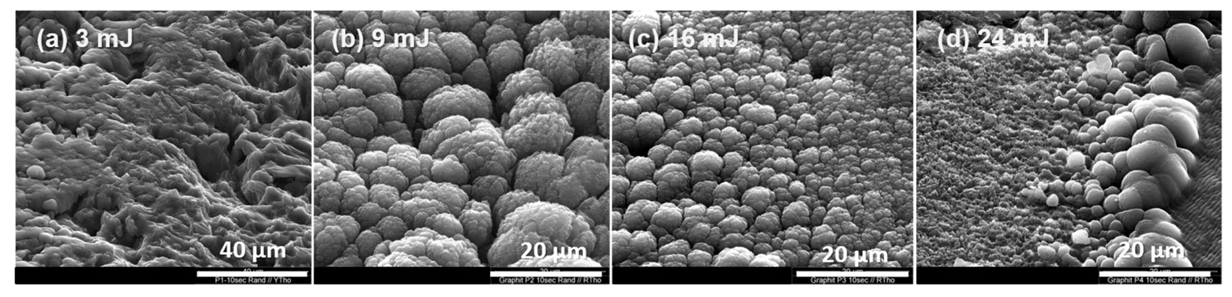
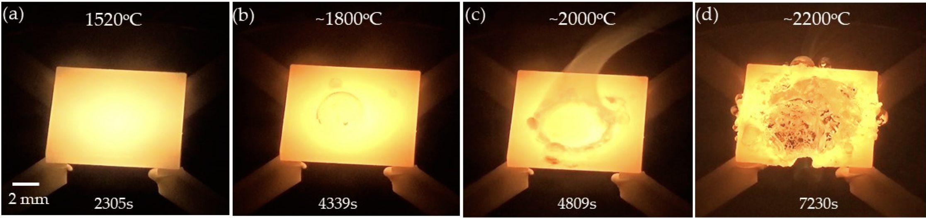
Our overarching application
Predictive exascale simulation of a complete model heat shield system during atmospheric reentry along a prescribed trajectory
Fully coupled end-to-end aero-thermo-chemo-mechanics response, with focus on material degradation and failure: C ablation, SiC oxidation/nitridation
Novel AI/ML, UQ, and CS to enable full-physics exascale simulations
SEM images of graphite targets irradiated with four different pulse energies: (a) 3 mJ, (b) 9 mJ, (c) 16 mJ and (d) 24 mJ. Irradiation time: 10 s/150 pulses. Sierra-Trillo et al, 2022
Steam oxidation test for CVD-SiC/SiC composites using the laser heating facility (LAHF). Pham et al 2021
Notes:
For a TPS (thermal protection system) Extreme environment also puts simulation in unchareted territory in many cases. For example:
Reaction pathways can be very different from low temperature
Harmonic approximation for rate calculations may not be reliable close to material melting point
Previously developed empirical potentials may not be relevant

Slide 3
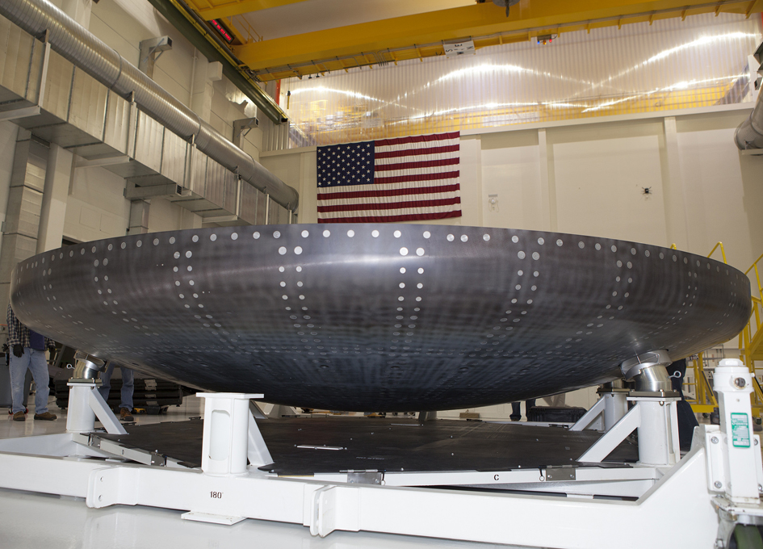
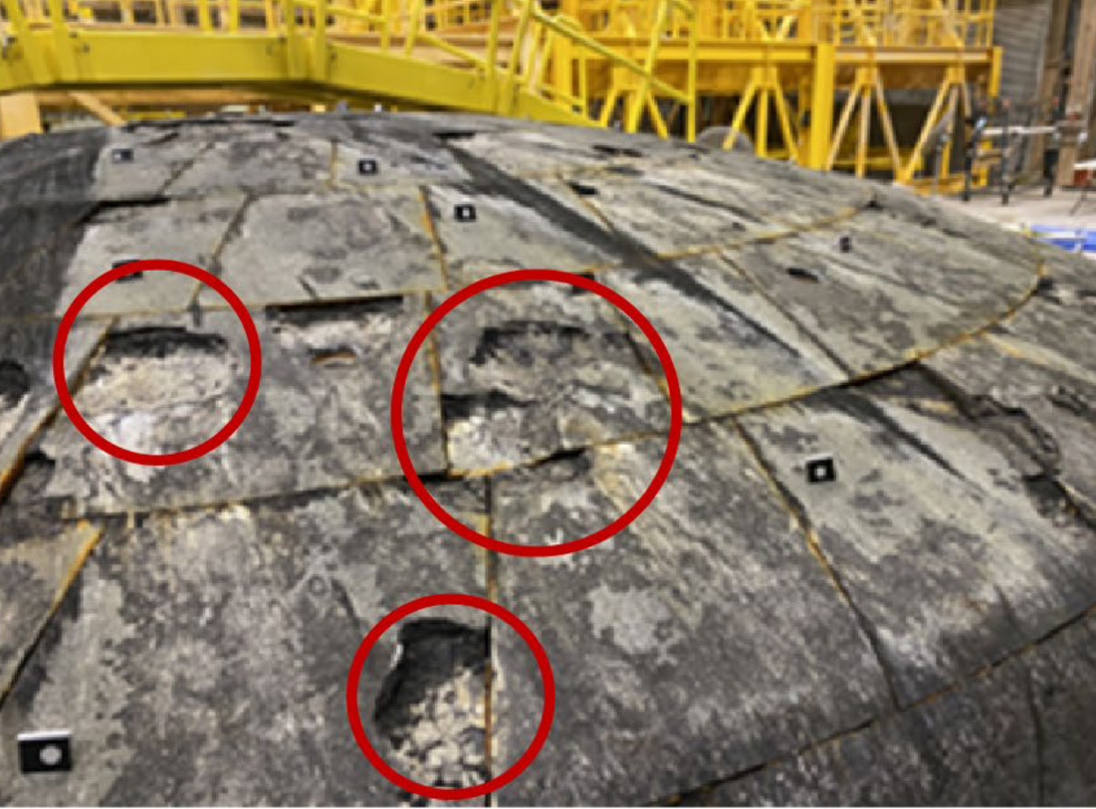
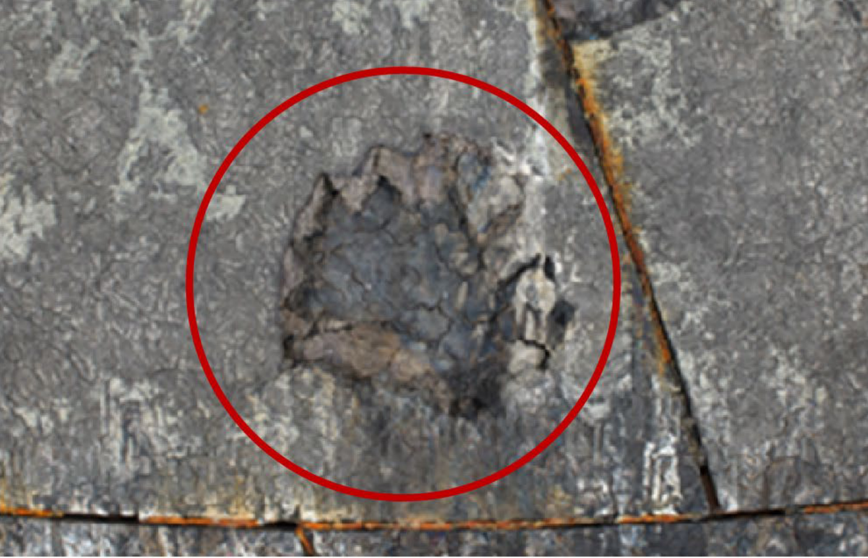
Motivation for our overarching application
Unexpected failure modes in Orion Heat Shield TPS
NASA Identifies Cause of Artemis I Orion Heat Shield Char Loss (12/05/2024) https://www.nasa.gov/missions/artemis/nasa-identifies-cause-of-artemis-i-orion-heat-shield-char-loss/ ‘‘… Using Avcoat material response data from Artemis I, the investigation team was able to replicate the Artemis I entry trajectory environment — a key part of understanding the cause of the issue — inside the arc jet facilities at NASA’s Ames Research Center in California. They observed that during the period between dips into the atmosphere, heating rates decreased, and thermal energy accumulated inside the heat shield’s Avcoat material. This led to the accumulation of gases that are part of the expected ablation process. Because the Avcoat did not have permeability, internal pressure built up, and led to cracking and uneven shedding of the outer layer…”

Slide 4
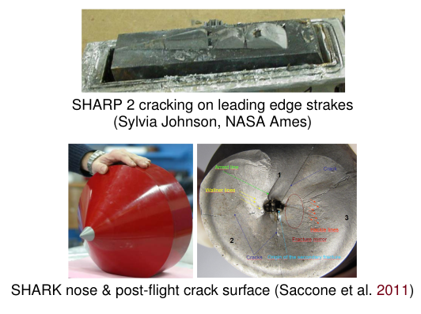
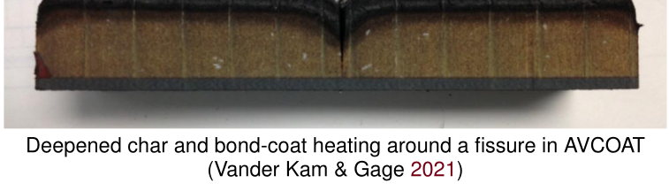
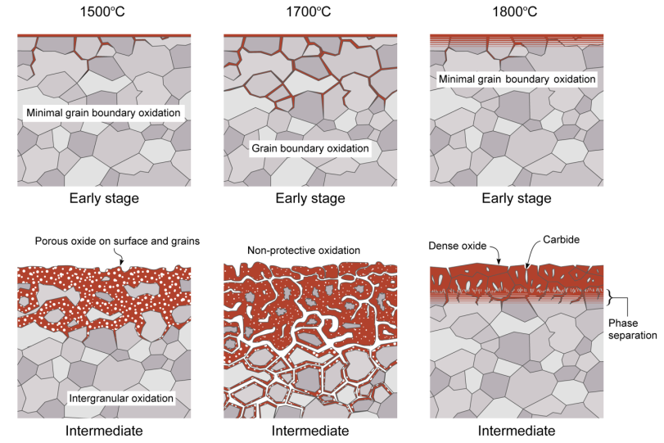
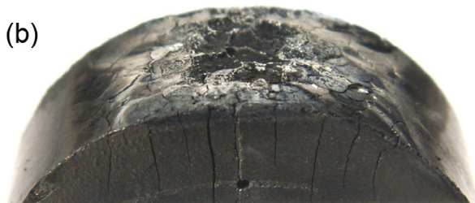


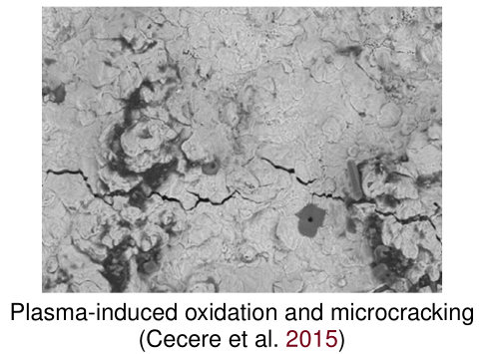
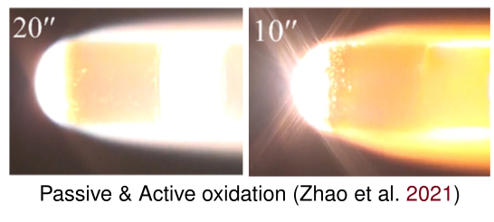
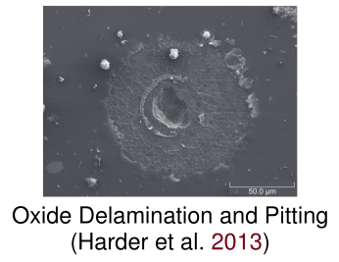
Wide range of material failure mechanisms caused by complex coupled thermo-chemo-mechanical processes

Slide 5

Pyrolysis of P50 Cork. Courtesy of Prof. Koo and his TPS research group at UT Austin.

Slide 6
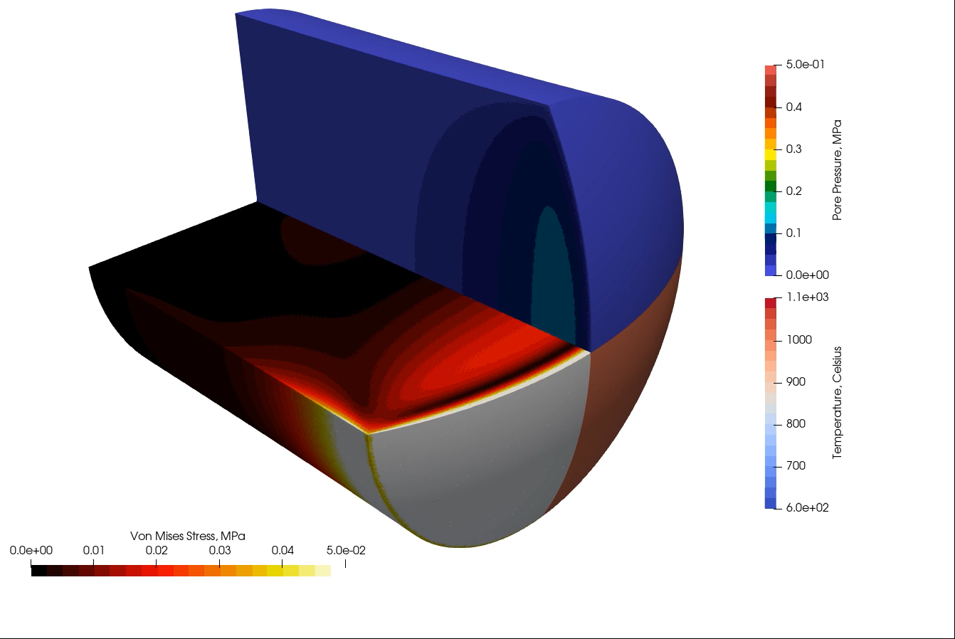
Large-Scale Simulations: 370 Million Degrees of Freedom on Dane
Monolithic thermochemistry
Two component decomposition
(Goldstein, 1965)
Newton's method with PETSc
Additive Schwartz & GAMG on 1120 subdomains
Solid mechanics
Linear poroelasticity (Terzaghi, 1925)
Fracture (Pickard, 2026)
Dynamic relaxation solver
(Pickard et al. 2023)
7.4 Million 10-node tetrahedral elements (5 DOF/node)

Slide 7

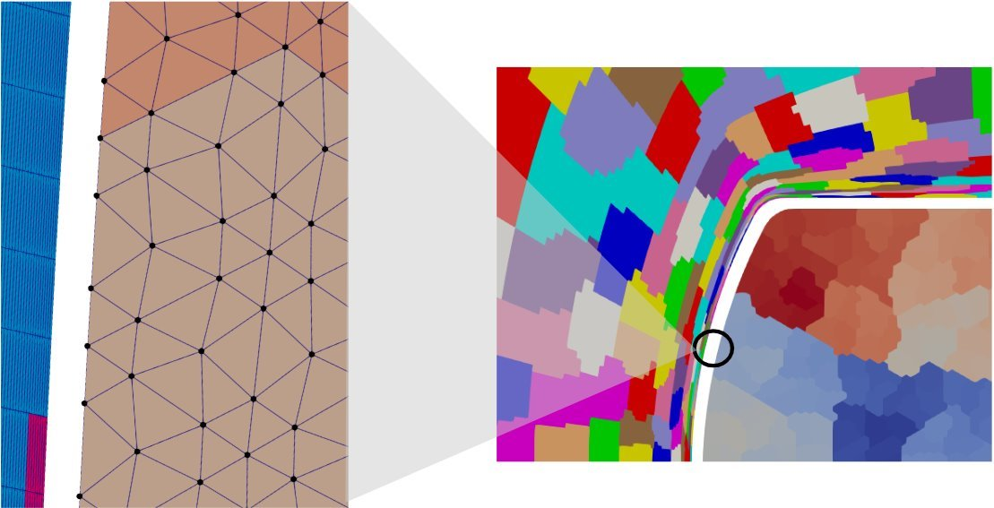
Scaling Challenges in Different Axes
Resolution
Make the simulation time and memory efficient
Leverage clusters of accelerators
Complexity
Multiphysics coupling, scientific equations
Non-matching meshes and partitions
Multiscale material response: AI/ML (surrogates)
Multiple Simulations
Predictive algorithms (like UQ) require many runs
Gradients are required!

Slide 8
Scaling Challenges in Different Axes
Resolution
Make the simulation time and memory efficient
Leverage clusters of accelerators
Complexity
Multiphysics coupling, scientific equations
Non-matching meshes and partitions
Multiscale material response: AI/ML (surrogates)
Multiple Simulations
Predictive algorithms (like UQ) require many runs
Gradients are required!

Slide 9
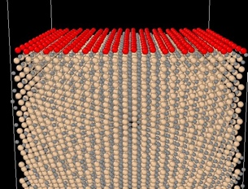
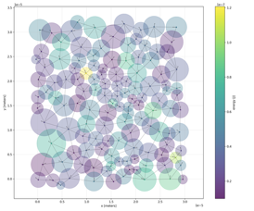





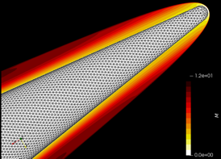





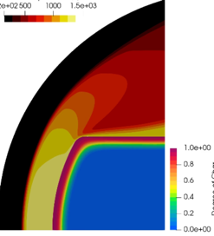



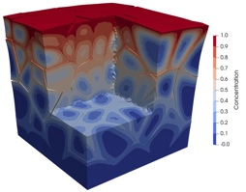

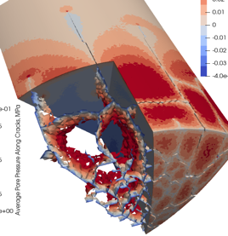


CHEFSI Simulation Stack
Languages
Lb
& SPARTA
e3nn
Lb
ML interatomic potentials
precomputed vehicle trajectory
aero-thermo-chemistry
SmartSolve
classical MD
(atomistic scale)
gas-material interaction model
e3nn
aero-thermo-chemo-mechanics
upscaling
Lb
microstructure
simulations
(mesoscale)
thermo-chemo-mechanics
e3nn, MDR
Compilers and runtimes
upscaling
Exascale hardware
Pervasive VVUQ

Slide 10
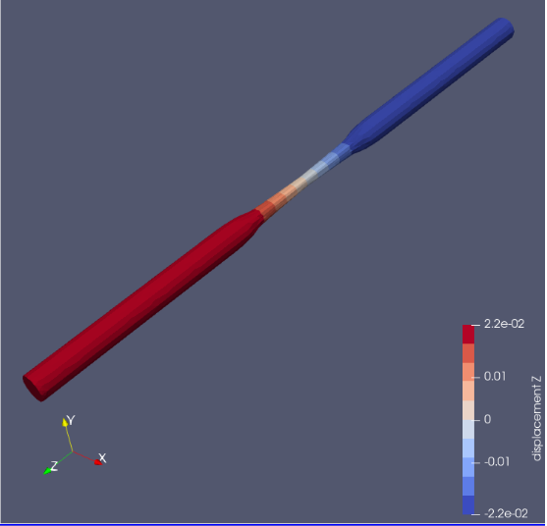
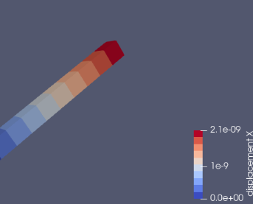
ΣMIT on GPU using Kokkos
Ported Explicit Dynamics and Dynamic Relaxation solvers.
Speedup of 30X for Linear Elastic.
Less gain in plasticity code (13X for J2Linear) due to warp divergence. Not sure how to port log and exp of matrices for updates in large deformation plasticity.
Got ΣMIT running on Dane.

Slide 11
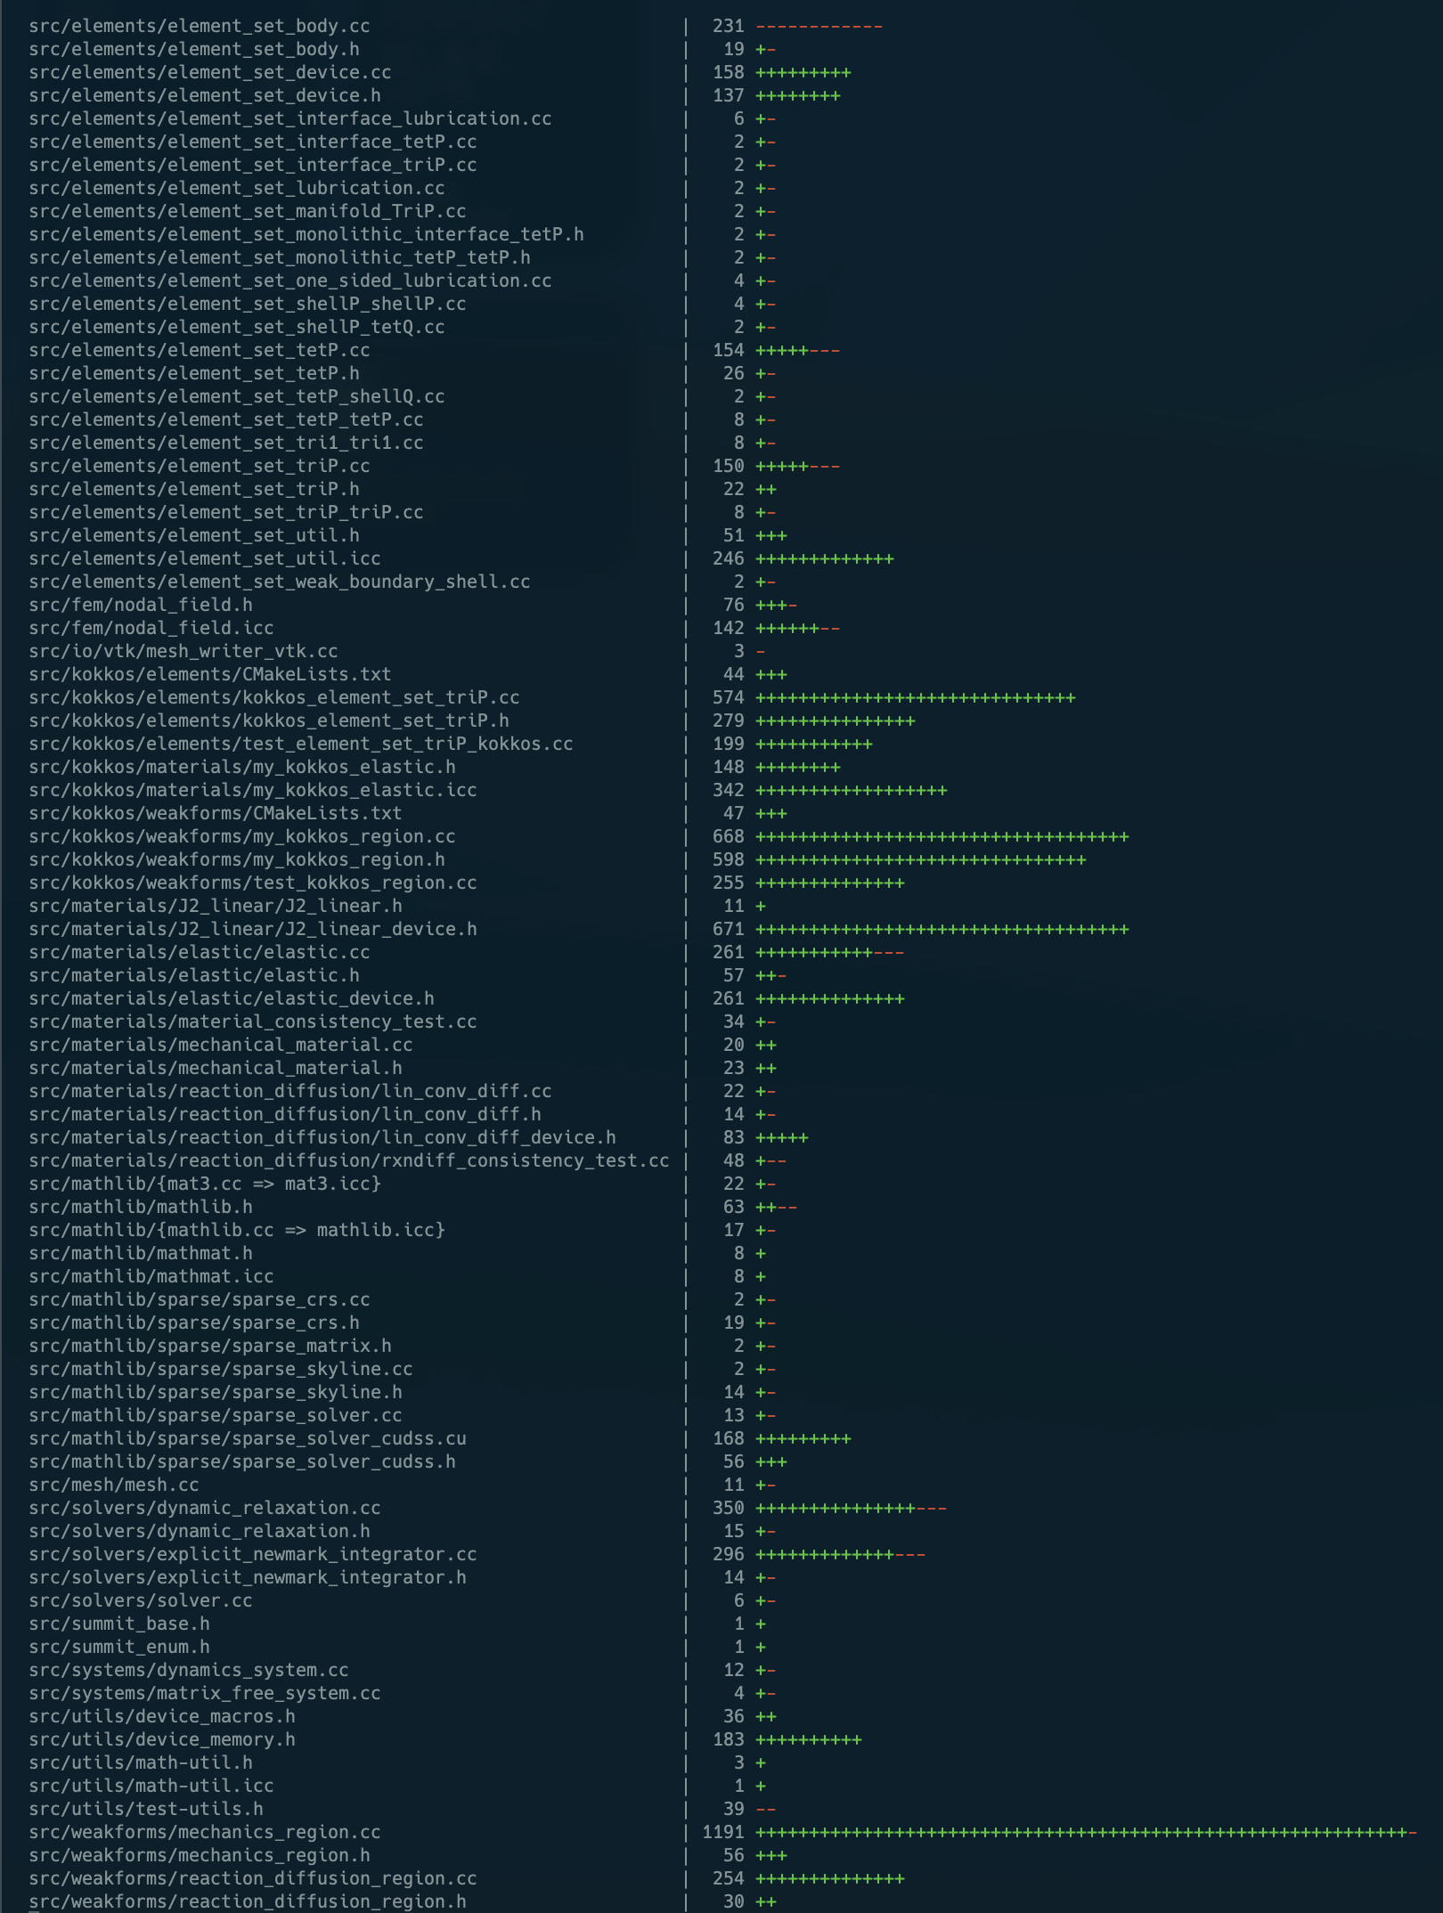
ΣMIT on GPU using Kokkos
Problem: Porting just this part of ΣMIT’s codebase required almost fully rewriting it.
Approximately 7500 lines added or modified in the main source files alone.
Porting more of ΣMIT’s solvers, systems, materials, etc. will require more rewriting.
Even with AI coding agents, such extensive rewriting is risky.
Can we avoid such extensive rewriting?
Git statistics for ΣMIT Kokkos branch

Slide 12

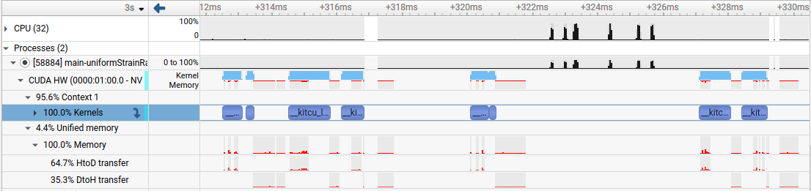
ΣMIT on GPU using Kitsune
We used Kitsune to make part of this Cilk parallelization run on a GPU just by adding some compiler flags.
Some early success, but performance needs work.
Kitsune NVIDIA & AMD GPU support
Some computation is still on CPU.
Moving data between CPU and GPU hurts the performance of both.
Some parallel loops are running on the GPU.
Nsight profile on local test machine.

Slide 13
Current GPU-ΣMIT blockers
void summit::commonInterfaceMechanicsRegion::Residual( NodalField<real> const& u, NodalField<real> const& u0, real dt, bool update, CommunicationManager const& commManager, NodalField<real>& residual) { // ... // allocate memory for the local displacement (previous and current) static std::vector<real> _ul; _ul.resize(residual_dim); cilk::span_holder<real> ul(_ul); static std::vector<real> _u0l; _u0l.resize(residual_dim); cilk::span_holder<real> u0l(_u0l); static std::vector<real> _rl; _rl.resize(residual_dim); cilk::span_holder<real> rl(_rl); // ******************* PART I: Prepare residual ******************* // loop over the elements of the element set #pragma cilk grainsize 1 cilk_for (size_t ei(0); ei != _element_set->elements(); ++ei) { elem_t e(ei); // extract local part of unknown _element_set->Localize(u, e, ul); _element_set->Localize(u0, e, u0l); // compute elementary residual ElementaryConstitutive(e, dt, update, ul, u0l, Pavg_JumpU.local(e, quad_t(0))); } // ... }
What’s needed to make this parallelization work on GPUs?
void summit::InterfaceMechanicsRegion::ElementaryConstitutive( elem_t e, real dt, bool update, std::span<real> const ul, std::span<real> const u0l, real* TJ) { // ... // integrate over quadrature points for (quad_t q(0); q < _element_set->nquad(); ++q) { // constitutive update of the left element LeftConstitutiveUpdate(e, q, ul, dt, P_L_new_span, F_L_new_span, internal_L_new_span, _C_L_red.data()); // constitutive update of the right element RightConstitutiveUpdate(e, q, ul, dt, P_R_new_span, F_R_new_span, internal_R_new_span, _C_R_red.data()); // ... } }
Support parallel reductions
Future problem: Memory footprint for larger simulations
Deal with virtual functions

Slide 14
Computing Hardware is No Longer For Everybody

Slide 15
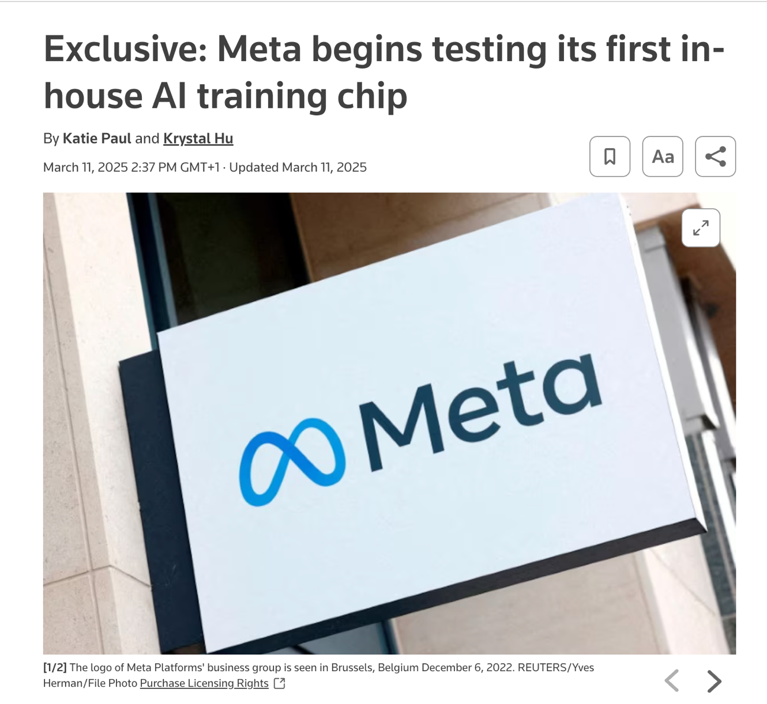

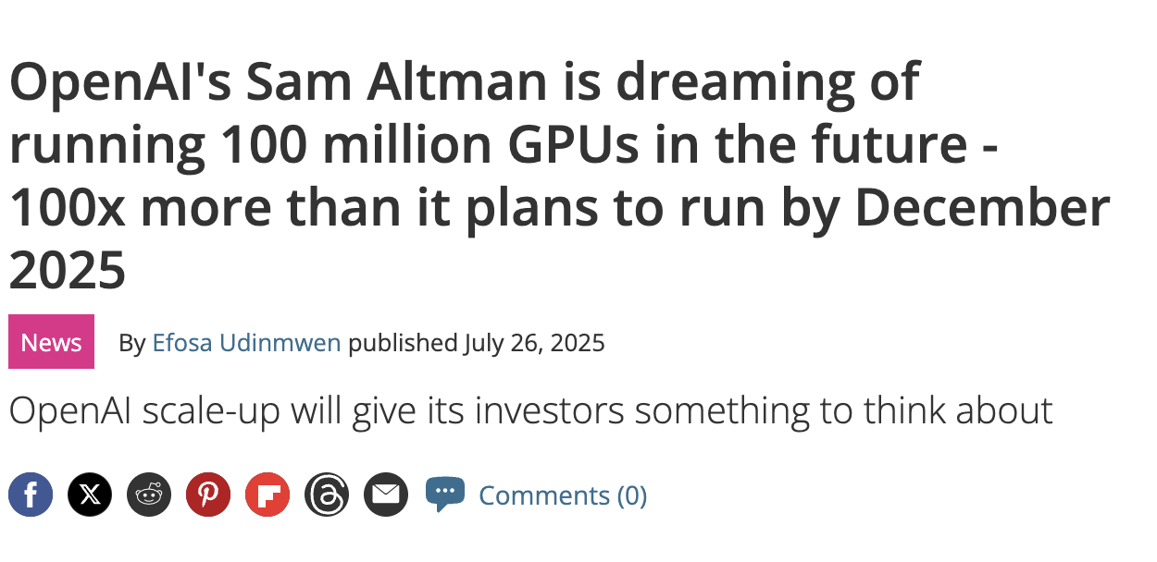
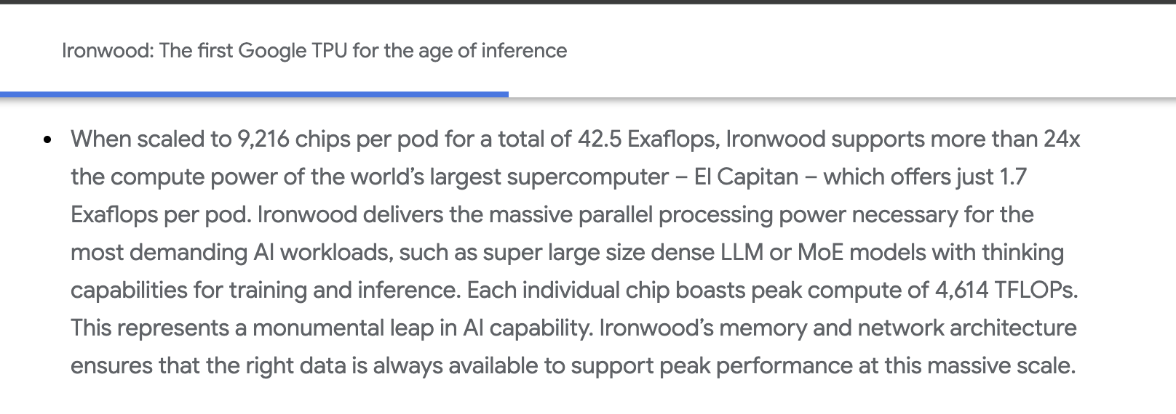
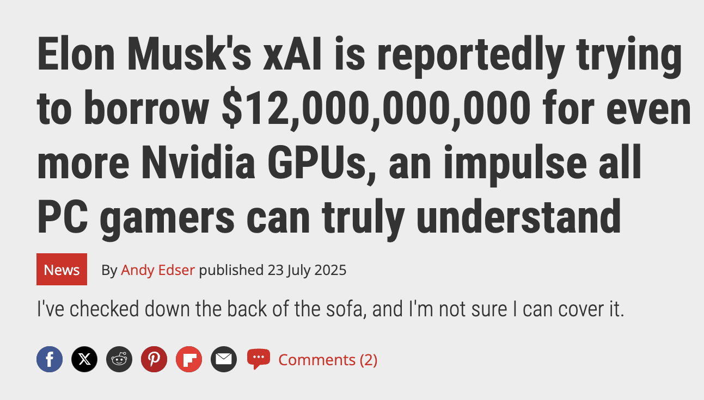

Computing Hardware is No Longer For Everybody

Slide 16
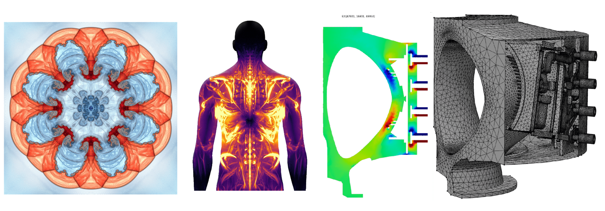
Scientific Computing Today
Scientists do not write TPU* code
__global__
void AddNodeForcesFromElems_kernel( Index_t numNode,
Index_t padded_numNode,
const Int_t* nodeElemCount,
const Int_t* nodeElemStart,
const Index_t* nodeElemCornerList,
const Real_t* fx_elem,
const Real_t* fy_elem,
const Real_t* fz_elem,
Real_t* fx_node,
Real_t* fy_node,
Real_t* fz_node,
const Int_t num_threads)
{
int tid=blockDim.x*blockIdx.x+threadIdx.x;
if (tid < num_threads)
{
Index_t g_i = tid;
Int_t count=nodeElemCount[g_i];
Int_t start=nodeElemStart[g_i];
Real_t fx,fy,fz;
fx=fy=fz=Real_t(0.0);
for (int j=0;j<count;j++)
{
Index_t pos=nodeElemCornerList[start+j]; // Uncoalesced access here
fx += fx_elem[pos];
fy += fy_elem[pos];
fz += fz_elem[pos];
}
fx_node[g_i]=fx;
fy_node[g_i]=fy;
fz_node[g_i]=fz;
}
}

Slide 17
Scientific Computing Today
Scientists do not write TPU* code
BIG (MFEM library alone is 737K LOC)
__global__
void AddNodeForcesFromElems_kernel( Index_t numNode,
Index_t padded_numNode,
const Int_t* nodeElemCount,
const Int_t* nodeElemStart,
const Index_t* nodeElemCornerList,
const Real_t* fx_elem,
const Real_t* fy_elem,
const Real_t* fz_elem,
Real_t* fx_node,
Real_t* fy_node,
Real_t* fz_node,
const Int_t num_threads)
{
int tid=blockDim.x*blockIdx.x+threadIdx.x;
if (tid < num_threads)
{
Index_t g_i = tid;
Int_t count=nodeElemCount[g_i];
Int_t start=nodeElemStart[g_i];
Real_t fx,fy,fz;
fx=fy=fz=Real_t(0.0);
for (int j=0;j<count;j++)
{
Index_t pos=nodeElemCornerList[start+j]; // Uncoalesced access here
fx += fx_elem[pos];
fy += fy_elem[pos];
fz += fz_elem[pos];
}
fx_node[g_i]=fx;
fy_node[g_i]=fy;
fz_node[g_i]=fz;
}
}

Slide 18
Scientific Computing Today
Scientists do not write TPU* code
BIG (MFEM library alone is 737K LOC)
Templated
__global__
void AddNodeForcesFromElems_kernel( Index_t numNode,
Index_t padded_numNode,
const Int_t* nodeElemCount,
const Int_t* nodeElemStart,
const Index_t* nodeElemCornerList,
const Real_t* fx_elem,
const Real_t* fy_elem,
const Real_t* fz_elem,
Real_t* fx_node,
Real_t* fy_node,
Real_t* fz_node,
const Int_t num_threads)
{
int tid=blockDim.x*blockIdx.x+threadIdx.x;
if (tid < num_threads)
{
Index_t g_i = tid;
Int_t count=nodeElemCount[g_i];
Int_t start=nodeElemStart[g_i];
Real_t fx,fy,fz;
fx=fy=fz=Real_t(0.0);
for (int j=0;j<count;j++)
{
Index_t pos=nodeElemCornerList[start+j]; // Uncoalesced access here
fx += fx_elem[pos];
fy += fy_elem[pos];
fz += fz_elem[pos];
}
fx_node[g_i]=fx;
fy_node[g_i]=fy;
fz_node[g_i]=fz;
}
}

Slide 19
Scientific Computing Today
Scientists do not write TPU* code
BIG (MFEM library alone is 737K LOC)
Templated
Not in Python
__global__
void AddNodeForcesFromElems_kernel( Index_t numNode,
Index_t padded_numNode,
const Int_t* nodeElemCount,
const Int_t* nodeElemStart,
const Index_t* nodeElemCornerList,
const Real_t* fx_elem,
const Real_t* fy_elem,
const Real_t* fz_elem,
Real_t* fx_node,
Real_t* fy_node,
Real_t* fz_node,
const Int_t num_threads)
{
int tid=blockDim.x*blockIdx.x+threadIdx.x;
if (tid < num_threads)
{
Index_t g_i = tid;
Int_t count=nodeElemCount[g_i];
Int_t start=nodeElemStart[g_i];
Real_t fx,fy,fz;
fx=fy=fz=Real_t(0.0);
for (int j=0;j<count;j++)
{
Index_t pos=nodeElemCornerList[start+j]; // Uncoalesced access here
fx += fx_elem[pos];
fy += fy_elem[pos];
fz += fz_elem[pos];
}
fx_node[g_i]=fx;
fy_node[g_i]=fy;
fz_node[g_i]=fz;
}
}

Slide 20
Scientific Computing Today
Scientists do not write TPU* code
BIG (MFEM library alone is 737K LOC)
Templated
Not in Python
Sometimes* in CUDA
__global__
void AddNodeForcesFromElems_kernel( Index_t numNode,
Index_t padded_numNode,
const Int_t* nodeElemCount,
const Int_t* nodeElemStart,
const Index_t* nodeElemCornerList,
const Real_t* fx_elem,
const Real_t* fy_elem,
const Real_t* fz_elem,
Real_t* fx_node,
Real_t* fy_node,
Real_t* fz_node,
const Int_t num_threads)
{
int tid=blockDim.x*blockIdx.x+threadIdx.x;
if (tid < num_threads)
{
Index_t g_i = tid;
Int_t count=nodeElemCount[g_i];
Int_t start=nodeElemStart[g_i];
Real_t fx,fy,fz;
fx=fy=fz=Real_t(0.0);
for (int j=0;j<count;j++)
{
Index_t pos=nodeElemCornerList[start+j]; // Uncoalesced access here
fx += fx_elem[pos];
fy += fy_elem[pos];
fz += fz_elem[pos];
}
fx_node[g_i]=fx;
fy_node[g_i]=fy;
fz_node[g_i]=fz;
}
}
template <>
struct RajaCuWrap<3>
{
template <const int BLCK = MFEM_CUDA_BLOCKS, typename DBODY>
static void run(const int N, DBODY &&d_body,
const int X, const int Y, const int Z, const int G)
{
RajaCuWrap3D(N, d_body, X, Y, Z, G);
}
};

Slide 21
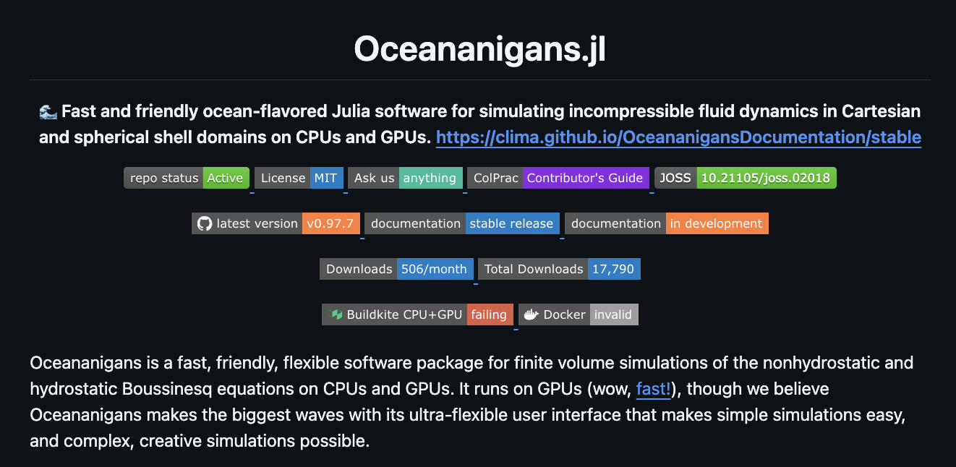
Looking More Deeply at Scientific Code
function stencil_kernel(y, x)
i = threadIdx().x + (blockIdx().x - 1) * blockDim().x
if i <= length(x) - 2
y[i] = x[i] - 2 * x[i + 1] + x[i + 2]
end
end
function model(...)
@cuda threads=... blocks=... stencil_kernel(y, x)
@cuda threads=... blocks=... stencil_kernel(x, y)
end
1
-2
1
> 277 such kernels

Slide 22
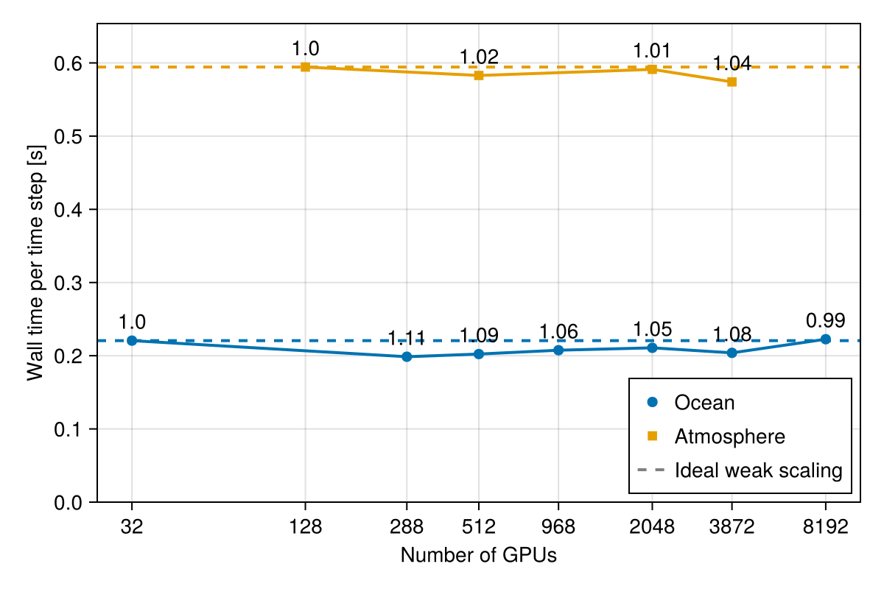
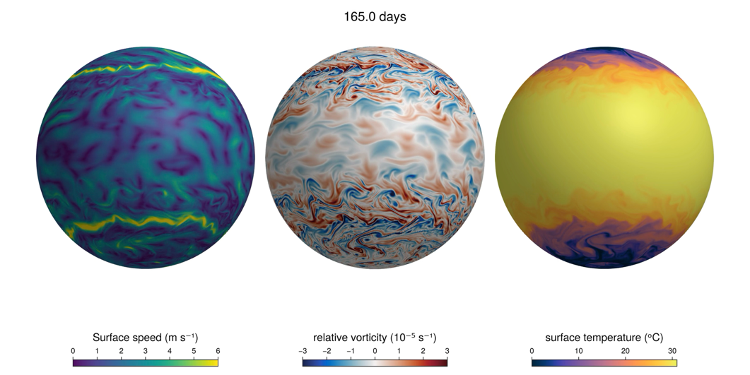
CUDA To StableHLO
function stencil_kernel(y, x)
i = threadIdx().x + (blockIdx().x - 1) * blockDim().x
if i <= length(x) - 2
y[i] = x[i] - 2 * x[i+1] + x[i+2]
end
end
function model(...)
@cuda threads=... blocks=... stencil_kernel(y, x)
@cuda threads=... blocks=... stencil_kernel(x, y)
end
Automatically ported state-of-the-art single-device version of climate code
8,192 NVIDIA GPUs (DOE Perlmutter, Alps)
1,679 Google TPUs v6e (918 TFLOPS each)
Communication optimizations are key!
Good Single-Node Perf
Vanilla Model: 272.0seconds
Tensor Optims: 11.5seconds
Compilation
define void @julia_difference_kernel_890({}* %y, {}* %x) {
top:
%3 = call i32 @llvm.nvvm.read.ptx.sreg.tid.x()
%4 = add nuw nsw i32 %3, 1
...
br i1 %.not, label %common.ret, label %L31
}
Raising
Raising
func.func @kernel(%y : memref<100xf64>, %x : memref<100xf64>) {
affine.parallel %arg1 = 0 to 100 {
%x1 = affine.load %x[%arg1]
%x2 = affine.load %x[%arg1 + 1]
...
affine.store %sum, %y[%arg1]
}
}
Multi-Dimensionalization
Multi-Dimensionalization
Multi-Dimensionalization
%x1 = stablehlo.slice %x[1:98]
%x2 = stablehlo.slice %x[2:99]
%mul = stablehlo.multiply %x2, tensor<2.0>
%add = stablehlo.add %x1, %mu
Optimization
res = stablehlo.convolve %x, tensor<[1.0, -4.0, 6.0, -4.0, 1.0]>

Slide 23


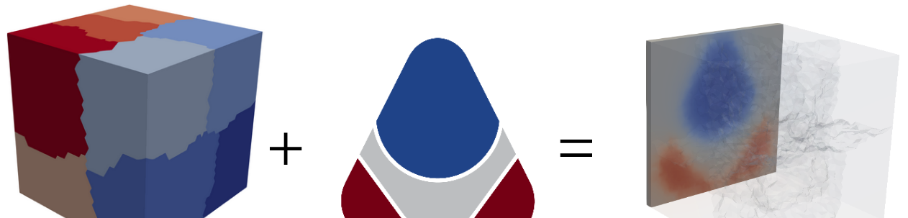
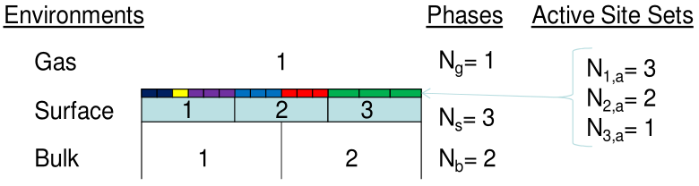
Challenges in MultiPhysics Codes
More complex Multi-Physics doesn’t match modern ML workflows
ML frameworks cannot do irregular ghost region without padding
Kinetic Interface Transport and Exchange on Surfaces (KITESURF)
Parallel partitioning with non-matching meshes
Demonstration of preliminary coupling of KITESurf with ΣMIT
Bulk heat
conduction
Nonequilibrium gas surface interaction formalism
(Marschall & MacLean)
Temperature received
from KITESurF

Slide 24
Leverage ML Kernel DSLs without the ML Framework
Tu, Jiqun, et al. ‘Accelerating High-Order Finite Element Simulations at Extreme Scale with FP64 Tensor Cores’. arXiv Preprint arXiv:2603. 09038, 2026.
Cui, Cu. ‘Acceleration of Tensor-Product Operations with Tensor Cores’. ACM Transactions on Parallel Computing, vol. 11, no. 4, ACM New York, NY, 2024, pp. 1–24.
Kusakabe, Ryota, et al. ‘GPU-Accelerated Sparse Matrix Vector Product Based on Element-by-Element Method for Unstructured FEM Using OpenACC’. 2022 Workshop on Accelerator Programming Using Directives (WACCPD), IEEE, 2022, pp. 52–61.
Collin, Teodoro Fields, et al. ‘Extensible Programmatic Specification of Finite Element Methods’. Under Submission To ACM Transactions on Graphics, 2025.
Notes:
So I have a rather strange solution for this
My idea is a mathematical model of the discrete aspects of high level FEM - a precise semantics for the various global objects in this program
I’ve submitted some of this and there is a poster
My goal in it is to explain the model so you can see how a flow chart like this might capture a lot of different global FEM operations

Slide 25
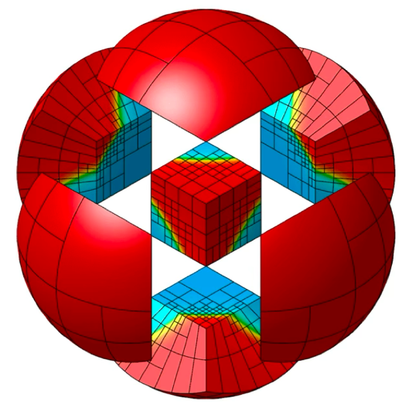
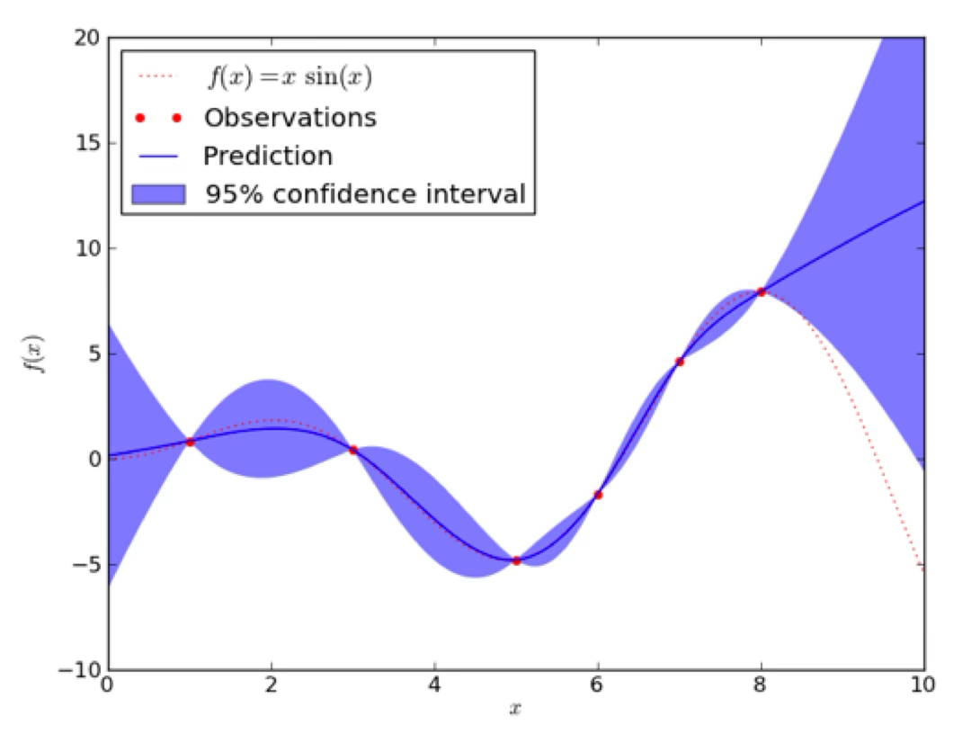
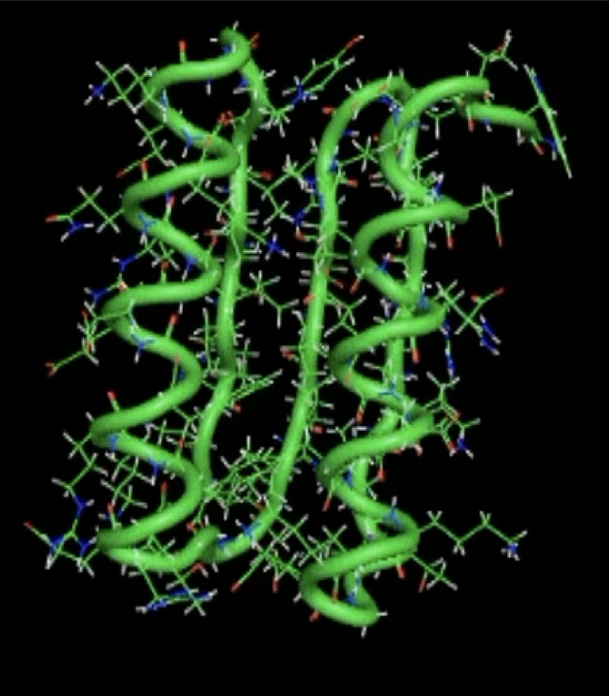
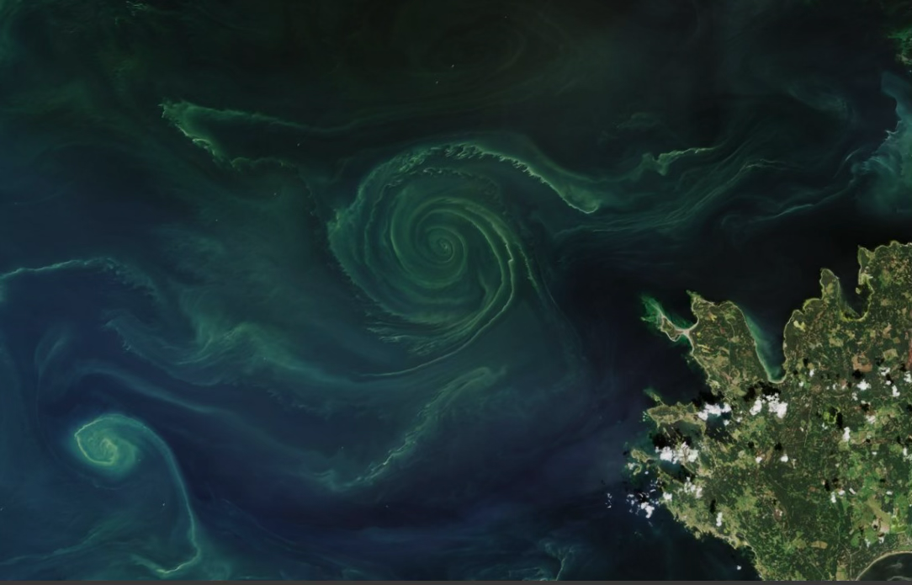
Differentiation: Connecting Science and AI
Derivatives are key to both scientific computing and machine learning
Scientific Computing: UQ, Differential Equation, Error Analysis
Machine Learning: Back-Propagation, Bayesian Inference
Links Science+AI: Compute the derivative of an application to leverage surrogate models, calibrate to observations, predict optimal forecast

Slide 26
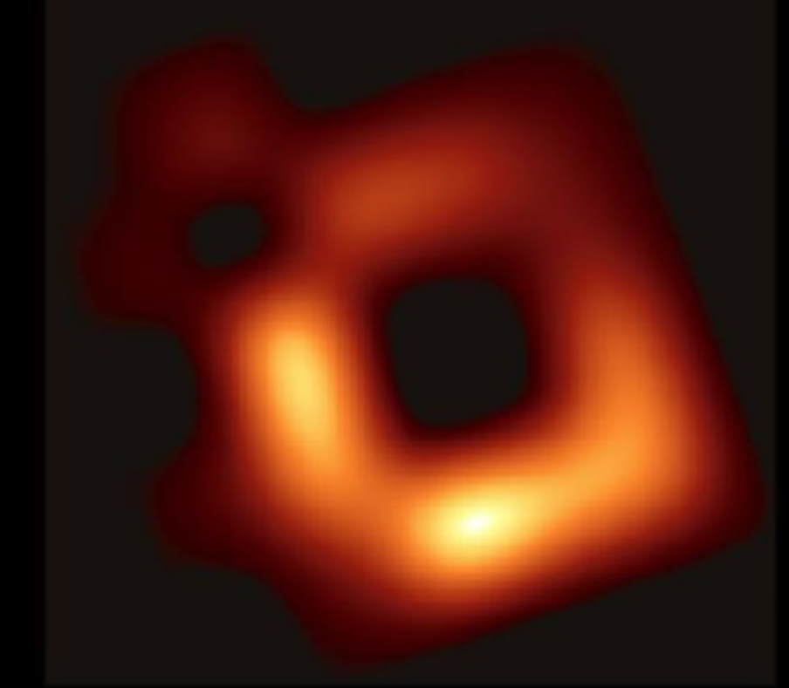
Differentiation is Expensive
In AI and science, derivative computations are the most costly and difficult to use algorithms
Reconstructed image of M87 ~1 week on cluster
Majority runtime is derivative

Slide 27

Differentiation is Expensive
In AI and science, derivative computations are the most costly and difficult to use algorithms
Reconstructed image of M87 ~1 week on cluster
Majority runtime is derivative
With Enzyme differentiation: 1 hour on 1 thread

Slide 28
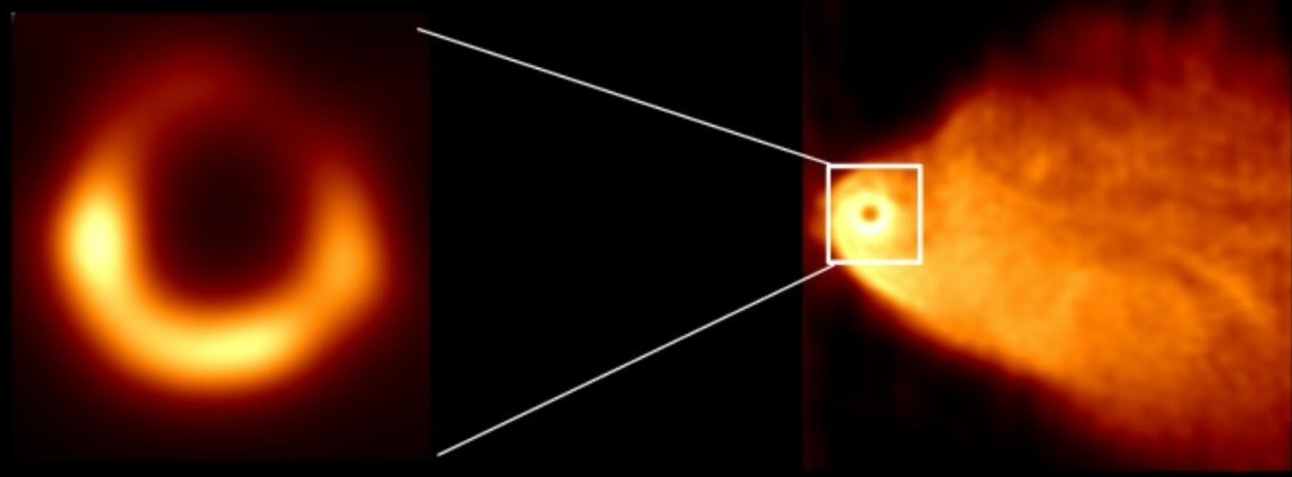
Differentiation is Expensive
In AI and science, derivative computations are the most costly and difficult to use algorithms
Reconstructed image of M87 ~1 week on cluster
Majority runtime is derivative
With Enzyme differentiation: 1 hour on 1 thread
100x resolution increase

Slide 29
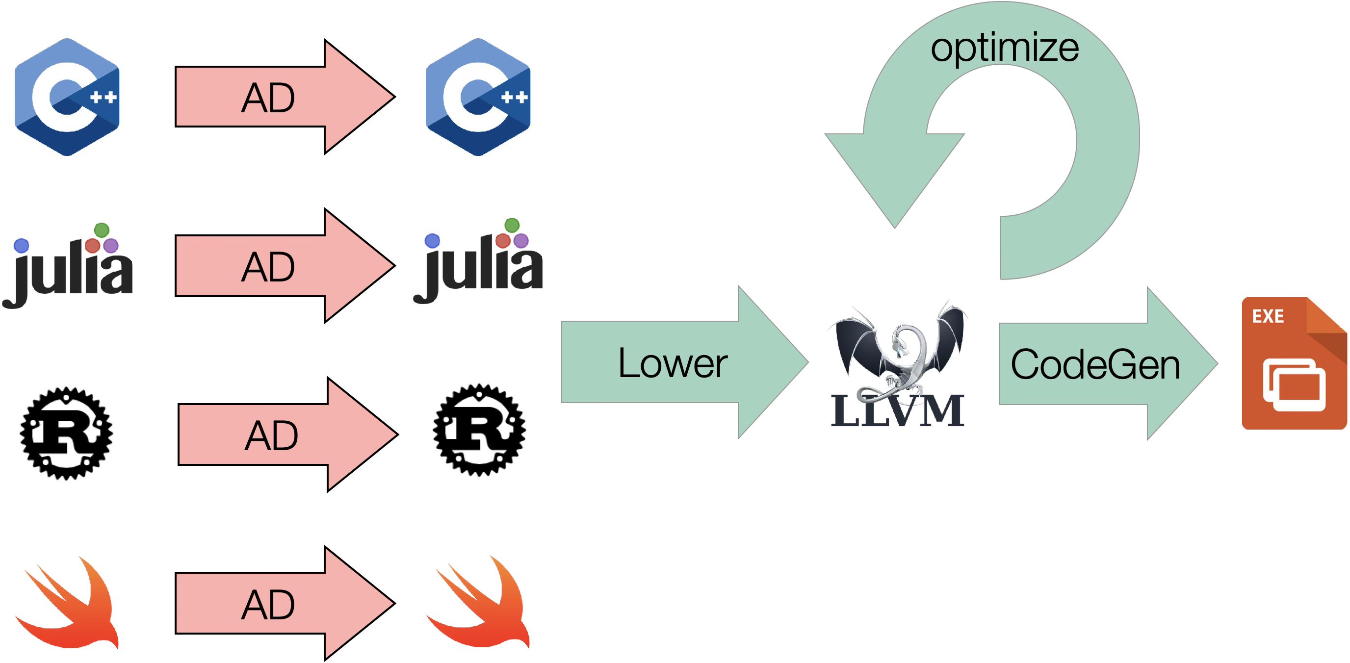
Existing Automatic Differentiation Pipelines

Slide 30
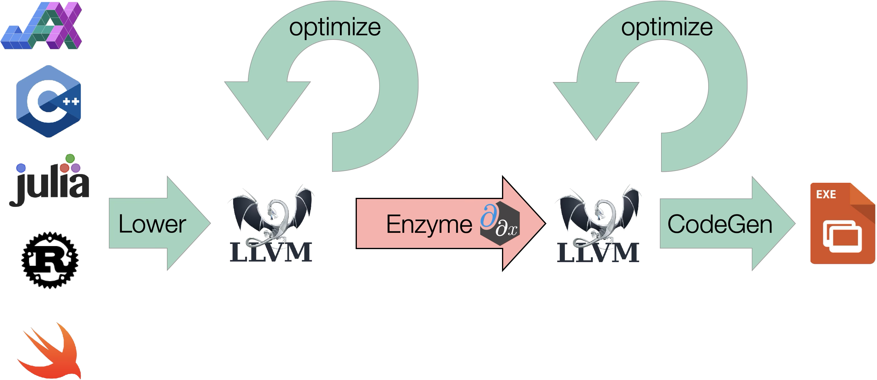
Enzyme Approach: compiler-based differentiation
AD within the compiler lets us work on optimized code!

Slide 31

Case Study: EnzymeAD + ΣMIT Integration
Enzyme can successfully differentiate kernels in ΣMIT
For gent-compressible test (min of 4 runs))
Tangent Speedup – 11.1x
Stress Speedup – 0.76x
 | Tangent (us) |  |  | Stress (us)
 | Analytical | Numerical | Enzyme | Analytical | Numerical | Enzyme
Min | 20.100 | 4.490 | 1.810 | 0.190 | 2.020 | 0.250
Trial 1 | 20.260 | 4.620 | 2.010 | 0.190 | 2.020 | 0.260
Trial 2 | 20.670 | 4.520 | 1.890 | 0.220 | 2.089 | 0.260
Trial 3 | 23.730 | 4.980 | 1.840 | 0.220 | 2.060 | 0.290
Trial 4 | 20.100 | 4.490 | 1.810 | 0.220 | 2.090 | 0.250
// Within summit::MaterialConsistencyTest<MaterialType>::TestStress std::vector<real> dq(nInt, 0.0);
dq[_potentialIndex] = 1.0;
__enzyme_autodiff<void>((void*)wrap_Constitutive<MaterialType>,
enzyme_const, &_material,
enzyme_const, F0,
enzyme_dup, F, P_enz,
enzyme_const, P,
enzyme_dupnoneed, nullptr, dq.data());

Slide 32

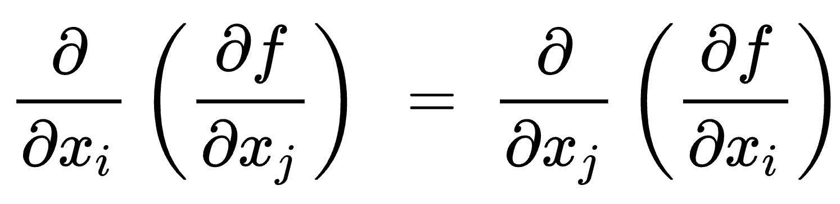
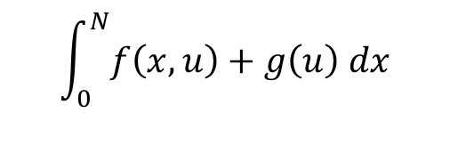
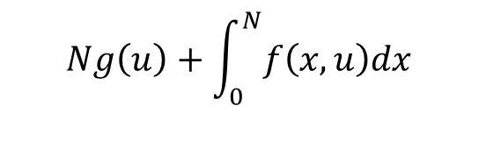
High-Level Structure of Scientific Code
$$\int_{0}^{N}{f\left(x,u\right)+g\left(u\right) dx}$$
$$Ng\left(u\right)+\int_{0}^{N}{f\left(x,u\right)dx}$$
Multi-Physics code has structure that would be amenable to optimization
Mainstream compilers cannot perform these optimizations
High-level optimizations are critical to derivative (and primal) performance
void norm(double n, double u) {
struct args_t args = { &out };
__odeint_run(body, args, 0, n);
}
double body(args_t args, double x) {
double u = *args.out;
return f(x, u) + g(u);
}
X

Slide 33
Summary: Challenges of Scaling MultiPhysics
How do we speed up solvers?
How do we take advantage of (distributed) GPUs?
How can FEM software leverage ML infrastructure?
How do we improve derivatives and floating-point performance?
How do we apply new insights to legacy software?

Slide 34
Summary: Challenges of Scaling MultiPhysics
How do we speed up solvers?
How do we take advantage of (distributed) GPUs?
How can FEM software leverage ML infrastructure?
How do we improve derivatives and floating-point performance?
How do we apply new insights to legacy software?
Automation through compiler technology
Retain high-level properties throughout the software stack
Co-design between computer scientists and physical scientists!

Slide 35


Summary: Challenges of Scaling MultiPhysics
How do we speed up solvers?
How do we take advantage of (distributed) GPUs?
How can FEM software leverage ML infrastructure?
How do we improve derivatives and floating-point performance?
How do we apply new insights to legacy software?
Automation through compiler technology
Retain high-level properties throughout the software stack
Co-design between computer scientists and physical scientists!

