Slide 1

Polygeist: C++ Frontend for MLIR
William S. Moses
wmoses@mit.edu
LLVM HPC @ SC
Nov 2022

Slide 2







William S. Moses
wmoses@mit.edu
Lorenzo Chelini
l.chelini@tue.nl
Ruizhe Zhao
rz3515@ic.ac.uk
Alex Zinenko
zinenko@google.com
Ivan R. Ivanov
Tokyo Tech
Jens Domke
Riken
Toshio Endo
Tokyo Tech
Johannes Doerfert
ANL
Notes:
Hi everyone, I'm William Moses and I'm Ruizhe Zhao, and we'll be presenting our work on Polygeist, a polyhedral C and C++ compiler built on MLIR.

Slide 3


The Current Compilation Pipeline
void set(int *arr, int val) {
for(int i=0; i<10; i++){
arr[2*i] = val;
}
}
Optimize
Parse
Lowering
CodeGen
Clang AST
FunctionDecl set 'void (int *, int)'
ForStmt
DeclStmt
`-VarDecl used i 'int' cinit
`-IntegerLiteral 'int’ 0
BinaryOperator 'bool' '<'
|-ImplicitCastExpr 'int' <LValueToRValue>
| `-DeclRefExpr 'int' lvalue Var 0x563e22a396b8 'i' 'int'
`-IntegerLiteral 'int' 10
UnaryOperator 'int' postfix '++'
`-DeclRefExpr 'int' lvalue Var 0x563e22a396b8 'i' 'int’
…
define void @_Z3setPii(i32* %0, i32 %1) {
br label %4
3: ; preds = %4
ret void
4: ; preds = %2, %4
%5 = phi i64 [ 0, %2 ], [ %8, %4 ]
%6 = shl i64 %5, 1
%7 = getelementptr inbounds i32, i32* %0, i64 %6
store i32 %1, i32* %7
%8 = add i64 %5, 1
%9 = icmp eq i64 %8, 10
br i1 %9, label %3, label %4
}
Notes:
Enter ML or multi-level IR, a recent compiler representation able to simultaneously represent, optimize, and convert between different levels of abstraction, including loops, parallel reductions, polyhedral-inspired affine memory operations, and low-level instructions that fully cover LLVM.

Slide 4
Losing High Level Structure
LLVM, while general enough to represent any program, must represent all parts of a program in a single, low-level IR
  Loses control flow constructs (if, for, etc)
  Hides parallelism behind runtime calls (and for GPU in a separate module)
  High-level semantics & properties cannot be represented and are lost.
void foo(DataStructure& x) {
print(size(x));
insert(x);
print(size(x));
}
define void @foo(ptr %x) {
%2 = call @size(ptr %x)
call @print(i32 %2)
call @insert(ptr %x)
; %3 = add i32 %2, 1
%3 = call @size(ptr %x)
call @print(i32 %3)
ret void
}
Notes:
Enter ML or multi-level IR, a recent compiler representation able to simultaneously represent, optimize, and convert between different levels of abstraction, including loops, parallel reductions, polyhedral-inspired affine memory operations, and low-level instructions that fully cover LLVM.

Slide 5

The MLIR Framework
MLIR is a recent compiler infrastructure designed for reuse and extensibility
Rather than providing a predefined set of instructions and types, MLIR operates on collections of dialects that contain sets of interoperable user-defined operations, attributes and types
Anyone can define their own optimizable dialect/operation, with a large set of existing dialects (structured control flow, affine, GPU, quantum, fully homomorphic encryption, circuits, LLVM, and more!)
Notes:
Enter ML or multi-level IR, a recent compiler representation able to simultaneously represent, optimize, and convert between different levels of abstraction, including loops, parallel reductions, polyhedral-inspired affine memory operations, and low-level instructions that fully cover LLVM.

Slide 6
Polygeist^{[1,2]} Pipeline
Raise & Optimize
Optimize
Parse
Clang
AST
Lowering
Lowering
CodeGen
Generic C and C++ frontend that generates "standard” and user-defined MLIR (templates, classes, unions, etc. all supported)
Raising transformations for raising "standard" MLIR to high-level
Collection of high-level optimization passes (general mem2reg, parallel optimizations)
Polyhedral optimization via novel optimizations and integrating prior tools (Pluto, CLooG) into MLIR
Parallel/GPU optimizations & transformations
[1] Polygeist: Raising C to Polyhedral MLIR; Moses, Chelini, Zhao, and Zinenko. PACT ’21.
[2] High-Performance GPU-to-CPU Transpilation and Optimization via High-Level Parallel Constructs; Moses, Ivanov, Domke, Endo, Doerfert, and Zinenko. PPoPP ‘23
Notes:
Enter ML or multi-level IR, a recent compiler representation able to simultaneously represent, optimize, and convert between different levels of abstraction, including loops, parallel reductions, polyhedral-inspired affine memory operations, and low-level instructions that fully cover LLVM.

Slide 7
Polygeist Frontend Example
func @set(%arg0: memref<?xi32>, %arg1: i32) {
%c0 = constant 0 : index
%0 = alloca() : memref<1xmemref<?xi32>>
store %arg0, %0[%c0] : memref<1xmemref<?xi32>>
%1 = alloca() : memref<1xi32>
store %arg1, %1[%c0] : memref<1xi32>
%c0_i32 = constant 0 : i32
%c2_i32 = constant 2 : i32
%c10_i32 = constant 10 : i32
%2 = index_cast %c10_i32 : i32 to index
scf.for %arg2 = %c0_i32 to %2 {
%3 = index_cast %arg2 : index to i32
%4 = alloca() : memref<1xi32>
store %3, %4[%c0] : memref<1xi32>
%5 = load %0[%c0] : memref<1xmemref<?xi32>>
%6 = load %4[%c0] : memref<1xi32>
%7 = muli %c2_i32, %6 : i32
%8 = index_cast %7 : i32 to index
%9 = load %1[%c0] : memref<1xi32>
store %9, %5[%8] : memref<?xi32>
}
return
}
void set(int *arr, int val) {
for(int i=0; i<10; i++){
arr[2*i] = val;
}
}
Notes:
Let’s look at a simplified example. On the left we have some sample C code that sets every other index of an array arr to a given value val.
On the right we see a slightly simplified version of the MLIR that would be generated.
Immediately we see an allocation for a stack variable that holds the value of arr (and shaded out for val). As these values can be overwritten in the function an SSA register for the argument does not suffice and is upgraded to the stack allocation seen here.
We then see the structured for loop that represents the C for loop in our original program. Note that at this point this is simply a structured and not an affine or polyhedral for loop.
We can then example how the store take place, which first requires an explicit load of the induction variable, and multiplication to compute the desired index.

Slide 8
Polygeist Raising
func @set(%arg0: memref<?xi32>, %arg1: i32) {
%c0 = constant 0 : index
%0 = alloca() : memref<1xmemref<?xi32>>
store %arg0, %0[%c0] : memref<1xmemref<?xi32>>
%1 = alloca() : memref<1xi32>
store %arg1, %1[%c0] : memref<1xi32>
%c0_i32 = constant 0 : i32
%c10_i32 = constant 10 : i32
%2 = index_cast %c10_i32 : i32 to index
scf.for %arg2 = %c0_i32 to %2 {
%3 = index_cast %arg2 : index to i32
%4 = alloca() : memref<1xi32>
store %3, %4[%c0] : memref<1xi32>
%5 = load %0[%c0] : memref<1xmemref<?xi32>>
%c2_i32 = constant 2 : i32
%6 = load %4[%c0] : memref<1xi32>
%7 = muli %c2_i32, %6 : i32
%8 = index_cast %7 : i32 to index
%9 = load %1[%c0] : memref<1xi32>
store %9, %5[%8] : memref<?xi32>
}
return
}
Notes:
Using the same example as before, we can see how raising works.
First memory allocations are eliminated by the mem2reg pass. Additional simplifications are run. Finally we raise the remaining operations to affine variants by first raising the for and subsequently the store.

Slide 9
Polygeist Raising
func @set(%arg0: memref<?xi32>, %arg1: i32) {
%c0 = constant 0 : index
%0 = alloca() : memref<1xmemref<?xi32>>
store %arg0, %0[%c0] : memref<1xmemref<?xi32>>
%1 = alloca() : memref<1xi32>
store %arg1, %1[%c0] : memref<1xi32>
%c0_i32 = constant 0 : i32
%c10_i32 = constant 10 : i32
%2 = index_cast %c10_i32 : i32 to index
scf.for %arg2 = %c0_i32 to %2 {
%3 = index_cast %arg2 : index to i32
%4 = alloca() : memref<1xi32>
store %3, %4[%c0] : memref<1xi32>
%5 = load %0[%c0] : memref<1xmemref<?xi32>>
%c2_i32 = constant 2 : i32
%6 = load %4[%c0] : memref<1xi32>
%7 = muli %c2_i32, %6 : i32
%8 = index_cast %7 : i32 to index
%9 = load %1[%c0] : memref<1xi32>
store %9, %5[%8] : memref<?xi32>
}
return
}
func @set(%arg0: memref<?xi32>, %arg1: i32) {
%c0 = constant 0 : index
%c0_i32 = constant 0 : i32
%c10_i32 = constant 10 : i32
%2 = index_cast %c10_i32 : i32 to index
scf.for %arg2 = %c0_i32 to %2 {
%3 = index_cast %arg2 : index to i32
%c2_i32 = constant 2 : i32
%7 = muli %c2_i32, %3 : i32
%8 = index_cast %7 : i32 to index
store %arg1, %arg0[%8] : memref<?xi32>
}
return
}
Mem2Reg
Notes:
Using the same example as before, we can see how raising works.
First memory allocations are eliminated by the mem2reg pass. Additional simplifications are run. Finally we raise the remaining operations to affine variants by first raising the for and subsequently the store.

Slide 10
Polygeist Raising
func @set(%arg0: memref<?xi32>, %arg1: i32) {
%c0 = constant 0 : index
%0 = alloca() : memref<1xmemref<?xi32>>
store %arg0, %0[%c0] : memref<1xmemref<?xi32>>
%1 = alloca() : memref<1xi32>
store %arg1, %1[%c0] : memref<1xi32>
%c0_i32 = constant 0 : i32
%c10_i32 = constant 10 : i32
%2 = index_cast %c10_i32 : i32 to index
scf.for %arg2 = %c0_i32 to %2 {
%3 = index_cast %arg2 : index to i32
%4 = alloca() : memref<1xi32>
store %3, %4[%c0] : memref<1xi32>
%5 = load %0[%c0] : memref<1xmemref<?xi32>>
%c2_i32 = constant 2 : i32
%6 = load %4[%c0] : memref<1xi32>
%7 = muli %c2_i32, %6 : i32
%8 = index_cast %7 : i32 to index
%9 = load %1[%c0] : memref<1xi32>
store %9, %5[%8] : memref<?xi32>
}
return
}
func @set(%arg0: memref<?xi32>, %arg1: i32) {
%c0 = constant 0 : index
%c2 = constant 2 : i32
%c10 = constant 10 : i32
scf.for %arg2 = %c0 to %c10 {
%7 = muli %c2_i32, %arg2 : index
store %arg1, %arg0[%7] : memref<?xi32>
}
return
}
Mem2Reg
Canonicalize
Notes:
Using the same example as before, we can see how raising works.
First memory allocations are eliminated by the mem2reg pass. Additional simplifications are run. Finally we raise the remaining operations to affine variants by first raising the for and subsequently the store.

Slide 11
Polygeist Raising
func @set(%arg0: memref<?xi32>, %arg1: i32) {
%c0 = constant 0 : index
%0 = alloca() : memref<1xmemref<?xi32>>
store %arg0, %0[%c0] : memref<1xmemref<?xi32>>
%1 = alloca() : memref<1xi32>
store %arg1, %1[%c0] : memref<1xi32>
%c0_i32 = constant 0 : i32
%c10_i32 = constant 10 : i32
%2 = index_cast %c10_i32 : i32 to index
scf.for %arg2 = %c0_i32 to %2 {
%3 = index_cast %arg2 : index to i32
%4 = alloca() : memref<1xi32>
store %3, %4[%c0] : memref<1xi32>
%5 = load %0[%c0] : memref<1xmemref<?xi32>>
%c2_i32 = constant 2 : i32
%6 = load %4[%c0] : memref<1xi32>
%7 = muli %c2_i32, %6 : i32
%8 = index_cast %7 : i32 to index
%9 = load %1[%c0] : memref<1xi32>
store %9, %5[%8] : memref<?xi32>
}
return
}
func @set(%arg0: memref<?xi32>, %arg1: i32) {
affine.for %arg2 = 0 to 10 {
affine.store %arg1, %arg0 [2 * %arg2] :
memref<?xi32>
}
return
}
Mem2Reg
Canonicalize
Raise to Affine
Notes:
Using the same example as before, we can see how raising works.
First memory allocations are eliminated by the mem2reg pass. Additional simplifications are run. Finally we raise the remaining operations to affine variants by first raising the for and subsequently the store.

Slide 12
Polygeist Raising
func @set(%arg0: memref<?xi32>, %arg1: i32) {
affine.for %arg2 = 0 to 10 {
affine.store %arg1, %arg0 [2 * %arg2] :
memref<?xi32>
}
return
}
void set(int *arr, int val) {
for(int i=0; i<10; i++){
arr[2*i] = val;
}
}
Notes:
Using the same example as before, we can see how raising works.
First memory allocations are eliminated by the mem2reg pass. Additional simplifications are run. Finally we raise the remaining operations to affine variants by first raising the for and subsequently the store.

Slide 13
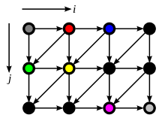
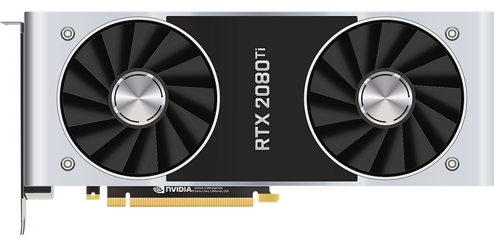
Two Case Studies
Demonstrate the benefits of a compiler-based IR with multiple abstraction levels by two case studies in Polygeist/MLIR
  Polyhedral optimization [1]
  GPU optimization and transpilation to the CPU [2]
[1] Polygeist: Raising C to Polyhedral MLIR; Moses, Chelini, Zhao, and Zinenko. PACT ’21.
[2] High-Performance GPU-to-CPU Transpilation and Optimization via High-Level Parallel Constructs;
Moses, Ivanov, Domke, Endo, Doerfert, and Zinenko. PPoPP ‘23
Notes:
Enter ML or multi-level IR, a recent compiler representation able to simultaneously represent, optimize, and convert between different levels of abstraction, including loops, parallel reductions, polyhedral-inspired affine memory operations, and low-level instructions that fully cover LLVM.

Slide 14
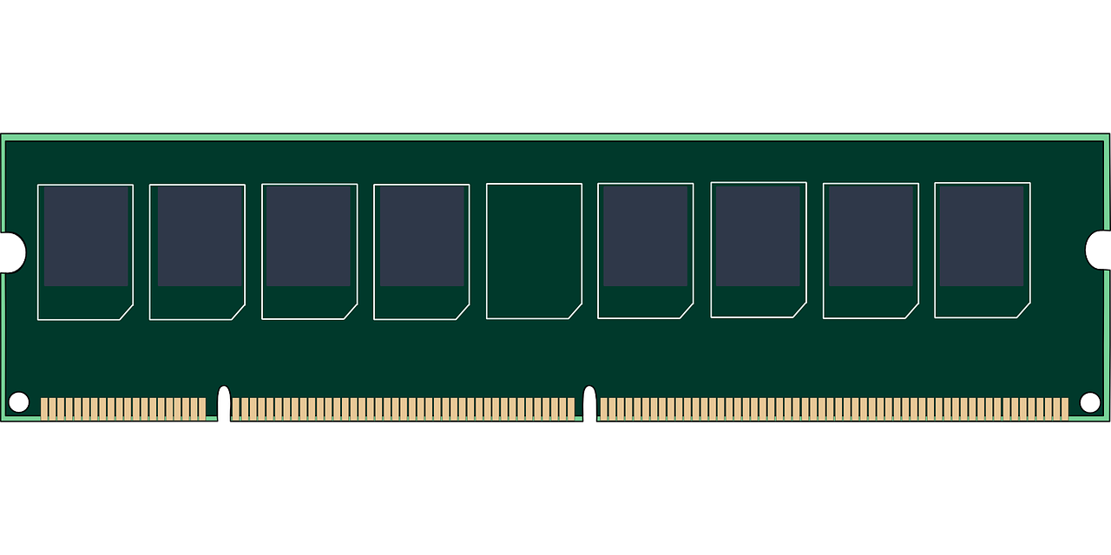
Case Study 1: The Polyhedral Model
Represent programs as a collection of computations and constraints on a multi-dimensional grid (polyhedron)
Makes it easy to analyze and specify program transformations best exploit the available hardware
  Loop restructuring for spatial/temporal locality, automatic parallelization, etc.
One of the best frameworks for optimizing compute-intensive programs like machine learning kernels or scientific simulations as well as for programming accelerators.
Notes:
Polyhedral tools have become

Slide 15

Polyhedral Compilation Today
Lower
Optimize
CodeGen
Source-Based
Transformation
Compiler-Based Transformation
Pluto, PPCG
Keeps High Level Info;
Fails On Unoptimized Code
Polly (LLVM), Graphite (GCC)
Runs Optimizations First
Attempts to Recover Structure
Notes:
Source-based tools Pluto or PPCG operate directly on C/C++ code. This enables the tool to directly recover high-level information like if’s and for’s. Its effectiveness, however, is hindered, by not applying optimization prior to polyhedral transformation. Moreover the result of the transformation must be expressed in C, which is known to be complex and lacks constructs, for example reduction loops or registers not backed by memory, or vector values.
Compiler-based tools like Polly or Graphite operate on the compiler IR, which enables it to run after optimization, thereby relieving one of the difficulties of source-based tools. However, these tools must be able to recover the high-level structure of the loops and memory accesses, often imperfectly or at a significant cost. The same common compiler optimizations, like LICM, which were needed to enable polyhedral analysis of the source-based tool, may interfere with the recovery of information in the compiler-based tool. Finally, compiler IR’s often lack constructs for parallelism or reductions produced by polyhedral transformations.

Slide 16
Polyhedral Compilation Today
Lower
Optimize
CodeGen
Source-Based
Transformation
Compiler-Based Transformation
Pluto, PPCG
Keeps High Level Info;
Fails On Unoptimized Code
Polly (LLVM), Graphite (GCC)
Runs Optimizations First
Attempts to Recover Structure
Notes:
Source-based tools Pluto or PPCG operate directly on C/C++ code. This enables the tool to directly recover high-level information like if’s and for’s. Its effectiveness, however, is hindered, by not applying optimization prior to polyhedral transformation. Moreover the result of the transformation must be expressed in C, which is known to be complex and lacks constructs, for example reduction loops or registers not backed by memory, or vector values.
Compiler-based tools like Polly or Graphite operate on the compiler IR, which enables it to run after optimization, thereby relieving one of the difficulties of source-based tools. However, these tools must be able to recover the high-level structure of the loops and memory accesses, often imperfectly or at a significant cost. The same common compiler optimizations, like LICM, which were needed to enable polyhedral analysis of the source-based tool, may interfere with the recovery of information in the compiler-based tool. Finally, compiler IR’s often lack constructs for parallelism or reductions produced by polyhedral transformations.

Slide 17
Polygeist + Polyhedral
Polygeist gets the benefits of both worlds
  Preserves the high-level (polyhedral/affine) structure of programs AND
  Optimizes & simplifies programs prior to transformations
  New polyhedral optimizations that cannot otherwise be easily expressed
Serial Programs: 80% speedup over LLVM-based; 8% speedup over source-based
Parallel Programs: 190% speedup over LLVM-based; 26% speedup over source-based
int mul2(int val) { return 2 * val; }
void set(int *arr, int val) {
for(int i=0; i<10; i++){
arr[mul2(i)] = val;
}
}
func @set(%arg0: memref<?xi32>, %arg1: i32) {
affine.for %arg2 = 0 to 10 {
affine.store %arg1, %arg0 [2 * %arg2] :
memref<?xi32>
}
return
}
Notes:
Using the same example as before, we can see how raising works.
First memory allocations are eliminated by the mem2reg pass. Additional simplifications are run. Finally we raise the remaining operations to affine variants by first raising the for and subsequently the store.

Slide 18
Case Study 2: GPUs
__global__ void normalize(int *out, int* in, int n) {
int tid = blockIdx.x;
if (tid < n)
out[tid] = in[tid] / sum(in, n);
}
void launch(int *out, int* in, int n) {
normalize<<<n>>>(d_out, d_in, n);
}
Mainstream compilers do not have a high-level representation of parallelism, making optimization difficult or impossible
This is accentuated for GPU
programs where the kernel is
kept in a separate module to
allow emission of different
assembly and synchronization
is treated as a complete optimization barrier.
Host Code
Device Code
target triple = "x86_64-unknown-linux-gnu”
define void @_Z6launchPiS_i(i32* %out,
i32* %in,
i32 %n) {
call i32 @pushCallConfiguration(…)
call i32 @cudaLaunch(@_device_stub, …)
ret void
}
target triple = ”nvptx”
define void @_Z9normalize(i32* %out,
i32* %in, i32 %n) {
%4 = call i32 @llvm.tid.x()
%5 = icmp slt i32 %4, %n
br i1 %5, label %6, label %13
6:
%8 = getelementptr i32, i32* %in, i32 %4
%9 = load i32, i32* %8, align 4
%10 = call i32 @_Z3sumPii(i32* %in, i32 %n)
%11 = sdiv i32 %9, %10
%12 = getelementptr i32, i32* %out, i32 %4
store i32 %11, i32* %12, align 4
br label %13
13:
ret void
}
Notes:
Polyhedral tools have become

Slide 19
Preserve the parallel structure
Maintain GPU parallelism in a form understandable to the compiler
Enables optimization between caller and kernel
Enable parallelism-specific optimization
__global__ void normalize(int *out, int *in, int n) {
int tid = blockIdx.x;
if (tid < n)
out[tid] = in[tid] / sum(in, n);
}
void launch(int *out, int* in, int n) {
normalize<<<n>>>(d_out, d_in, n);
}
func @_Z6launch(%out: memref<?xi32>,
%in: memref<?xi32>, %n: i32) {
%c1 = constant 1 : index
%c0 = constant 0 : index
parallel (%tid) = (%c0) to (%n) step (%c1) {
%2 = load %in[%tid]
%sum = call @_Z3sumPii(%in, %n)
%4 = divsi %2, %sum : i32
store %4, %out[%tid]
yield
}
return
}
Notes:
Polyhedral tools have become

Slide 20
Preserve the parallel structure
Maintain GPU parallelism in a form understandable to the compiler
Enables optimization between caller and kernel
Enable parallelism-specific optimization
__global__ void normalize(int *out, int *in, int n) {
int tid = blockIdx.x;
if (tid < n)
out[tid] = in[tid] / sum(in, n);
}
void launch(int *out, int* in, int n) {
normalize<<<n>>>(d_out, d_in, n);
}
func @_Z6launch(%out: memref<?xi32>,
%in: memref<?xi32>, %n: i32) {
%c1 = constant 1 : index
%c0 = constant 0 : index
%sum = call @_Z3sumPii(%in, %n)
parallel (%tid) = (%c0) to (%n) step (%c1) {
%2 = load %in[%tid]
%4 = divsi %2, %sum : i32
store %4, %out[%tid]
yield
}
return
}
Notes:
Polyhedral tools have become

Slide 21
Synchronization via Memory
_{codeA(fib(idx));}
_{sync_threads;}
_{codeB(fib(idx));}
Synchronization (sync_threads) ensures all threads within a block finish executing codeA before executing codeB
The desired synchronization behavior can be reproduced by defining sync_threads to have the union of the memory semantics of the code before and after the sync.
This prevents code motion of instructions which require the synchronization for correctness, but permits other code motion (e.g. index computation).
_{off = fib(idx);}
_{codeA(off);}
_{sync_threads;}
_{codeB(off);}
Notes:
Polyhedral tools have become

Slide 22
Synchronization via Memory
__global__ void bpnn_layerforward(...) {
__shared__ float node[HEIGHT];
__shared__ float weights[HEIGHT][WIDTH];
if ( tx == 0 )
node[ty] = input[index_in] ;
// Unnecessary Barrier #1
// None of the read/writes below the sync
// (weights, hidden)
// intersect with the read/writes above the sync
// (node, input)
__syncthreads();
// Unnecessary Store #1
weights[ty][tx] = hidden[index];
__syncthreads();
// Unnecessary Load #1
weights[ty][tx] = weights[ty][tx] * node[ty];
…
}
High-level synchronization
representation enables new
optimizations, like sync elimination.
A synchronize instruction is not
needed if the set of read/writes
before the sync don’t conflict
with the read/writes after the sync.
Notes:
Polyhedral tools have become

Slide 23
GPU Transpilation
A unified representation of parallelism enables programs in one parallel architecture (e.g. CUDA) to be compiled to another (e.g. CPU/OpenMP)
Most CPU backends do not have an equivalent block synchronization
Efficiently lower a top-level synchronization by distributing the parallel for loop around the sync, and interchanging control flow
_{parallel_for %i = 0 to N {}
_{codeA(%i);}
}
_{parallel_for %i = 0 to N {}
_{codeB(%i);}
}
_{parallel_for %i = 0 to N {}
_{codeA(%i);}
_{sync_threads;}
_{codeB(%i);}
}
Notes:
Polyhedral tools have become

Slide 24
GPU Synchronization Lowering: Control Flow
Synchronization within control flow (for, if, while, etc) can be lowered by splitting around the control flop and interchanging the parallelism.
_{parallel_for %i = 0 to N {}
_{for %j = … {}
_{codeB1(%i, %j);}
_{sync_threads;}
_{codeB2(%i, %j);}
}
}
_{for %j = … {}
_{parallel_for %i = 0 to N {}
_{codeB1(%i, %j);}
_{sync_threads;}
_{codeB2(%i, %j);}
}
}
_{for %j = … {}
_{parallel_for %i = 0 to N {}
_{codeB1(%i, %j);}
}
_{parallel_for %i = 0 to N {}
_{codeB2(%i, %j);}
}
}
Notes:
Polyhedral tools have become

Slide 25
GPU Transpilation Performance
CUDA programs transcompiled by Polygeist not only match the performance of handwritten OpenMP programs, but achieve a speedup!
  58% geomean speedup on Rodinia
  2.7x geomean speedup on PyTorch versus built-in CPU backend (also using our MocCUDA compatibility layer)

Slide 26
“Case Study 3”: Your Programs!
There are already several efforts starting using Polygeist/MLIR to leveraging the benefits of optimizable multi-level operations
  SYCL
  Circuit Compilation
  BLAS Kernels
  Databases
  …
If you’re interested in applying such techniques to your programs, please reach out!
Notes:
Polyhedral tools have become

Slide 27
Conclusion
Optimizable, multi-level operations are key to compiler extensibility and therefore performance
Polygeist/MLIR is a new Clang-based compiler that allows you to leverage this extensibility
  C/C++ frontend for MLIR
  Compiler transformations for raising MLIR to a higher-level
  Collection of high-level optimization passes (general mem2reg, etc)
  Polyhedral optimization via novel optimizations and integrating prior tools into MLIR
  Parallel/GPU optimizations & transformations
Polygeist beats existing polyhedral tools on sequential and parallel code
Polygeist can optimize and transcompile your GPU/parallel code
Supports recognizing and lowering to custom ops/dialects
LLVM incubator project, open sourced on Github, see https://polygeist.mit.edu and discuss on Discourse!

Slide 28
Acknowledgements
Thanks to Valentin Churavy, Albert Cohen, Henk Corporaal, Tobias Grosser, and Charles Leiserson for thoughtful discussions on this work.
William S. Moses was supported in part by a DOE Computational Sciences Graduate Fellowship, in part by Los Alamos National Laboratories, and in part by the United States Air Force Research Laboratory. The views and conclusions contained in this document are those of the authors and should not be interpreted as representing the official policies, either expressed or implied, of the United States Air Force or the U.S. Government.
Lorenzo Chelini is partially supported by the European Commission Horizon 2020
Ruizhe Zhao is sponsored by UKRI and Corerain Technologies Ltd. The support of the UK EPSRC is also gratefully acknowledged.
The work was supported in part by JSPS KAKENHI Grant Number JP19H04119 and in part by the Japan Society for the Promotion of Science KAKENHI Grant Number JP19H04119, and in part by the New Energy and Industrial Technology Development Organization (NEDO).

Slide 29
Conclusion
Optimizable, multi-level operations are key to compiler extensibility and therefore performance
Polygeist/MLIR is a new Clang-based compiler that allows you to leverage this extensibility
  C/C++ frontend for MLIR
  Compiler transformations for raising MLIR to a higher-level
  Collection of high-level optimization passes (general mem2reg, etc)
  Polyhedral optimization via novel optimizations and integrating prior tools into MLIR
  Parallel/GPU optimizations & transformations
Polygeist beats existing polyhedral tools on sequential and parallel code
Polygeist can optimize and transcompile your GPU/parallel code
Supports recognizing and lowering to custom ops/dialects
LLVM incubator project, open sourced on Github, see https://polygeist.mit.edu and discuss on Discourse!

Slide 30
Backup Slides

Slide 31
Text

Slide 32
Translate to OpenScop
First pre-process MLIR Affine code by previous passes
For each extracted polyhedral statement:
  Domain: get constraints from affine.for/if
  Initial Schedule: derive from region nesting and operation order
  Access: extract from affine load/stores
Store symbols in OpenScop extensions

Slide 33
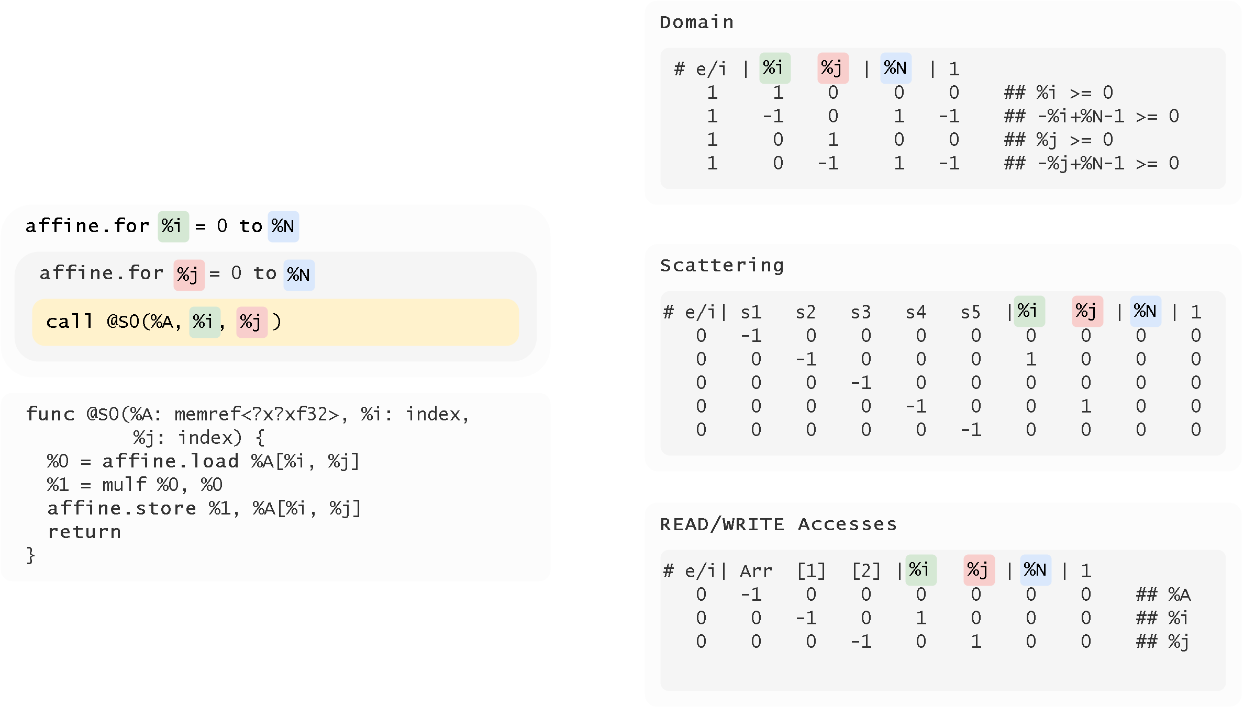
Translate to OpenScop

Slide 34
Regenerate MLIR Code
Obtain a CLooG AST from an optimized OpenScop representation
Regenerate MLIR code by traversing AST
OpenScop symbols will be translated to MLIR values or operations based on a maintained symbol table.

Slide 35


Motivation
The compiler research has recently been enamored by the MLIR framework, whose first-class polyhedral representation may provide benefits on a variety of codes
We can fully leverage decades of polyhedral research by connecting MLIR with existing polyhedral tools.
Without MLIR-versions of standard polyhedral benchmarks, one cannot perform a fair assessment
Goal of this work is to provide a fair baseline for subsequent work AND explore the potential of polyhedral optimizations that require both high level and low level information
Notes:
We’re motived to do this paper from the following perspectives.
First, compiler people are now looking at MLIR. And MLIR provides use very versatile representations. We can use them to represent polyhedral models, and that can be beneficial.
Second, there are decades of polyhedral research, and many excellent tools are built. But we haven’t been able to reuse them in MLIR for now, that is, we cannot pass MLIR code to these tools.
Third, Polybench is one of the benchmarks people use to evaluate polyhedral optimization. But they are in C. To justify our verdicts on the benefits from doing polyhedral in MLIR, we should have them properly represented in MLIR. So that we can get rid of unexpected effects and do fair assessment.
Note that this paper is not focused on using polyhedral tools to speedup MLIR. We are more concerned with how to provide a fair baseline for future work.

Slide 36
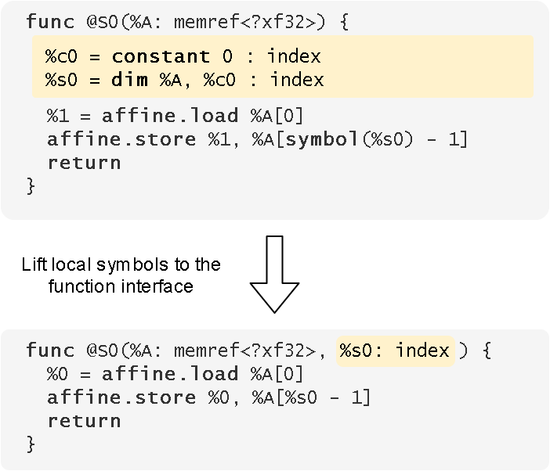
Outlining
Outline statements into functions
Function interfaces:
  Memory to access
  Lifted stack allocated symbols
Notes:
Once we've dealt with the two issues mentioned previously, we can outline the extracted statement into function.
There are two things we need to make sure about the function interface:
First, the memory that this statement accesses to should be in the interface.
And second, the symbols that being allocated on the stack, we need to lift that to the function interface.
Functions satisfying these constraints would be easier to be constructed into OpenScop and reconstruct back into MLIR.

Slide 37
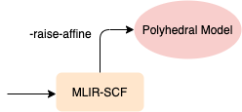
Polygeist Raising
Select statements must be represented by a C ternary operator
  C ternaries have lazy-evaluation semantics which are replicated in the generated MLIR
  Mem2Reg and code motion attempt to remove unnecessary loads within if's to generate a valid select.
prefixMax[i] = (prefixMax[i-1] >= data[i])
? prefixMax[i-1] : data[i];
%0 = index_cast %arg2 : i32 to index
%1 = subi %0, %c1 : index
%2 = load %arg0[%1] : memref<?xi32>
%3 = load %arg1[%0] : memref<?xi32>
%4 = cmpi "sgt", %2, %3 : i32
%5 = scf.if %4 -> (i32) {
%6 = load %arg0[%1] : memref<?xi32>
scf.yield %6 : i32
} else {
%6 = load %arg1[%0] : memref<?xi32>
scf.yield %6 : i32
}
store %5, %arg0[%0] : memref<?xi32>
Notes:
Some statements, require additional handling. Specifically, it is common to represent a polyhedral select statement using a C ternary operator. However, as ternaries are evaluated lazily, this results in complications. Consider the code on the left which represents a max of two values. This results in the MLIR on the right, with extraneous loads and stores and an if statement which cannot be raised to affine as it compares two data values. Polygeist remedies this through the use of mem2reg and code motion optimizations, which leaves us with the desired select statement.

Slide 38
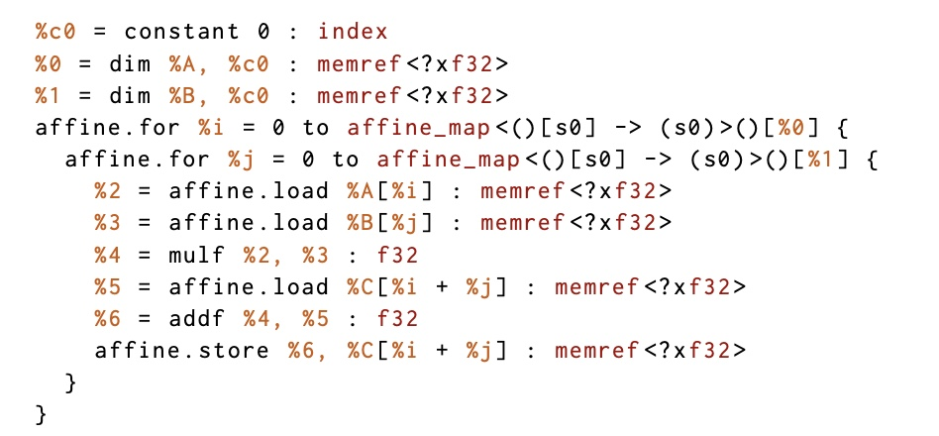
The Affine dialect
Represent SCoP with polyhedral-friendly loops and conditions
Core Affine representation
  Symbols - parameters
  Dimensions - symbol extension that accepts induction variables
  Maps - multi-dimensional function of symbols and dimensions
  Sets - integer tuples constrained by a conjunction
Notes:
Before we talk about raising, let’s define some terminology for the MLIR Affine Dialect, which represents the static control parts or SCoPs of our program.
The affine dialect has special versions of loops, ifs, loads, and stores which are guaranteed to abide by the index computation rules of the polyhedral model. An example snippet of such a program is shown on the right.
Specifically we see that the first affine for loop has an affine map as an upper bound. An affine map is a multi-dimensional function which produces valid polyhedral indices. Specifically, the affine dialect has two notions for index values. One can have a symbol which represent program parameters, and dimensions which represent induction variables, or computations thereof. The affine map has limitations on what can be used as its internal expressions – specifically one cannot multiply two dimensions (or more simply two induction variables) together, as that would fall outside the model. One can, however, multiply a dimension by a symbol, or multiply two symbols together, without issue.
Affine sets are similar to affine maps, but the produce a Boolean which is the conjuction of the given expression and used within affine if constructs.
RHS is a typical example that does matrix multiplication
An Affine code has symbols, dims, maps, and sets.

Slide 39
Polygeist Raising
func @set(%arg0: memref<?xi32>, %arg1: i32) {
%c0 = constant 0 : index
%0 = alloca() : memref<1xmemref<?xi32>>
store %arg0, %0[%c0] : memref<1xmemref<?xi32>>
%1 = alloca() : memref<1xi32>
store %arg1, %1[%c0] : memref<1xi32>
%c0_i32 = constant 0 : i32
%c10_i32 = constant 10 : i32
%2 = index_cast %c10_i32 : i32 to index
scf.for %arg2 = %c0_i32 to %2 {
%3 = index_cast %arg2 : index to i32
%4 = alloca() : memref<1xi32>
store %3, %4[%c0] : memref<1xi32>
%5 = load %0[%c0] : memref<1xmemref<?xi32>>
%c2_i32 = constant 2 : i32
%6 = load %4[%c0] : memref<1xi32>
%7 = muli %c2_i32, %6 : i32
%8 = index_cast %7 : i32 to index
%9 = load %1[%c0] : memref<1xi32>
store %9, %5[%8] : memref<?xi32>
}
return
}
func @set(%arg0: memref<?xi32>, %arg1: i32) {
affine.for %arg2 = 0 to 10 {
affine.store %arg1, %arg0[%arg2 * 2]
: memref<?xi32>
}
return
}
Notes:
Using the same example as before, we can see how raising works.
First memory allocations are eliminated by the mem2reg pass. Additional simplifications are run. Finally we raise the remaining operations to affine variants by first raising the for and subsequently the store.

Slide 40
Polyhedral Performance Differences
Polly differs from other two as it uses a different scheduler
Even when using the same scheduler, Polygeist can select a different statement set and thus schedule coming from partially optimized SSA rather than the original C.
Pluto executes significantly more (~10^11) more integer instructions on seidel-2d than Polygeist, which is ~59s at 3GHz, accounting for the gap. Can be caused by different integer optimization and the use of a proper machine type/bound simplification.
For jacobi-2d, Polygeist performs worse, stopping earlier when simplifying (75 statement copies in 40 branches), whereas Clang by default takes longer to process this but has better end vectorization.

Slide 41
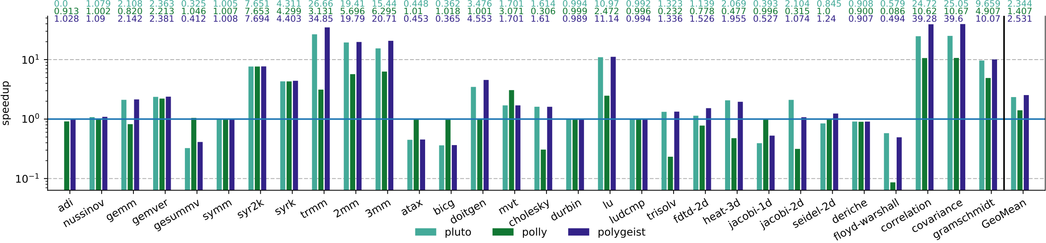
Sequential Polyhedral Comparison
Polygeist: 2.53x speedup
Pluto: 2.34x speedup
Polly: 1.41x speedup
Big gaps come from different schedules

Slide 42
Parallel Performance Differences
Same scheduling differences as sequential (Cholesky and LU are better on Pluto/Polygeist than Polly; Gemver and MVT are better on Polly)
Ludcmp and syr(2)k benefit from SSA optimizations
Polygeist is only framework that can parallelize deriche (6.9x) and symm (7.7x) by analyzing and removing the loop-carried dependency
Polygeist identifies a parallel reduction within gramschmidt (56x Polygeist, 54x Pluto, 34x Polly) and durbin (6x slowdown as few iterations)

Slide 43
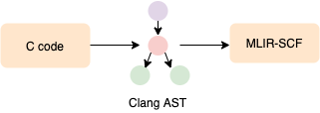
Polygeist Frontend
Ingests Clang AST to simplify parsing, semantic analysis, linkage, etc.
Each C/C++ type is defined to have a corresponding MLIR. Pointers, arrays, and some structs can use MLIR’s structured pointer or memref type, preserving sizes and multi-dimensional indexing.
  int[12][30] => memref<12x30xi32>
  float* => memref<?xf32>
Allocation and deallocation instructions converted to memref alloc/dealloc.
Control flow and loops are directly lowered to structured MLIR-equivalent operations.
Supports advanced C++ features like templates and constructors.
Notes:
Polygeist uses Clang’s abstract syntax tree as a starting point for its compiler, allowing it to use existing stable routines for parsing, semantic analysis, linkage, and so on.
Polygeist must then define the corresponding MLIR type that matches the C or C++ type. Pointers, arrays, and some structs can use MLIR’s structred memref or memory reference type, allowing Polygeist to directly preserve existing sizes and multi-dimensional indexing.
Polygeist identifies any allocation or deallocation instructions within the program and converts them to memref-appropriate equivalents.
Most control flow such as if statements can be directly lowered to structured MLIR-equivalent operations. Additional care must be take for returns, continue, and break statements as MLIR does not have constructs that enable early termination of a loop or function. To remedy this, Polygeist adds signal variables for each function and loop to denote whether such a construct is hit and subsequent instructions will not be executed. Individual statements are wrapped in an if-conditional that checks this signal variable, before execution – providing the desired C semantics.

Slide 44
Polygeist Raising
Local variables eliminated by new MLIR mem2reg pass
Canonicalizations run to simplify the code, including while => for
Raising an operation (for, if, load, store) to its affine-variant:
  Detect if index calculation is a valid affine expression
  Progressively fold index calculation into a new replacement affine operation
_{%off = muli %c2, %idx : index}
store %val, %ptr[%off] : memref<?xi32>
affine.store %val, %ptr[2 * %idx] : memref<?xi32>
Notes:
As we saw in our earlier example, directly lowered constructs are not valid polyhedral programs.
Polygeist begins by running a new mem2reg pass to eliminate local variables. Additional optimizations or canonicalizations are also applied to simplify the code, including a transformation which attempts to raise and simplify while loops into for loops with known bounds.
Polygeist then attempts to raise operations such as fors, ifs, loads, and stores to their affine variant. If Polygeist wasn’t already told to assume the operation is affine, this involves detecting if the current index calculation can be represented by an equivalent affine expression, and if so folding that index calculation into a new replacement affine operation

Slide 45
Sequential Polyhedral Comparison
Polygeist: 2.53x speedup
Pluto: 2.34x speedup
Polly: 1.41x speedup

Slide 46
Sequential Polyhedral Comparison
Polygeist: 2.53x speedup
Pluto: 2.34x speedup
Polly: 1.41x speedup
Big gaps come from different schedules

Slide 47
Sequential Polyhedral Comparison
Polygeist: 2.53x speedup
Pluto: 2.34x speedup
Polly: 1.41x speedup
24% Polygeist speedup comes from better integer operations

Slide 48
Sequential Polyhedral Comparison
Polygeist: 2.53x speedup
Pluto: 2.34x speedup
Polly: 1.41x speedup
Polygeist slower due to smaller branch-simplification timeout

Slide 49
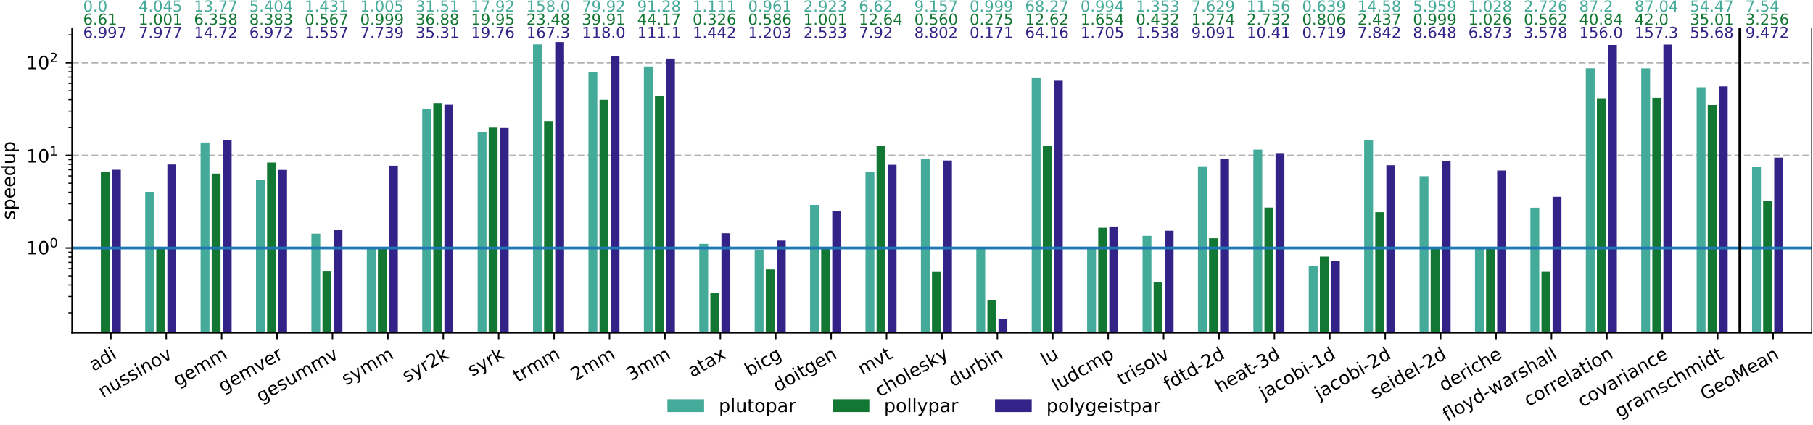
Parallel Polyhedral Comparison
Polygeist: 9.47x speedup
Pluto: 7.54x speedup
Polly: 3.26x speedup

Slide 50
Parallel Polyhedral Comparison
Polygeist: 9.47x speedup
Pluto: 7.54x speedup
Polly: 3.26x speedup
Polygeist and Polly benefit from SSA optimizations

Slide 51
Parallel Polyhedral Comparison
Polygeist: 9.47x speedup
Pluto: 7.54x speedup
Polly: 3.26x speedup
Polygeist can remove loop-carried dependency and parallelize when others cannot

Slide 52
Parallel Polyhedral Comparison
Polygeist: 9.47x speedup
Pluto: 7.54x speedup
Polly: 3.26x speedup
Polygeist can detect parallel reductions

Slide 53
A first-class representation of parallelism
Current mainstream compilers do not have a good notion or representation of parallelism
This is accentuated for GPU programs where the kernel is kept in a separate module to allow emission of different assembly
__device__ int sum(int* in, int n);
__global__ void normalize(int *out, int *in, int n) {
int tid = threadIdx.x;
if (tid < n)
out[tid] = in[tid] / sum(in, n);
}
void launch(int* out, int* in, int n) {
normalize<<<nblocks, nthreads>>>(out, in, n);
}
Notes:
Polyhedral tools have become

Slide 54
Case Study 2: GPUs
__device__ int sum(int* data, int n);
__global__ void square(int *out, int* in, int n) {
int tid = blockIdx.x;
if (tid < n)
out[tid] = in[tid] / sum(in, n);
}
void launch(int *h_out, int* h_in, int n) {
int *d_out, *d_in;
cudaMalloc(&d_out, n*sizeof(n));
cudaMalloc(&d_in, n*sizeof(n));
cudaMemcpy(d_in, h_in, n*sizeof(n), cudaMemcpyHostToDevice);
square<<<(n+31)/32, 32>>>(d_out, d_in, n);
cudaMemcpy(h_out, h_out, n*sizeof(n), cudaMemcpyDeviceToHost);
}
GPU Code
CPU Code
CPU Memory
GPU Memory
Block
Thread
Notes:
Polyhedral tools have become

Slide 55
A first-class representation of parallelism
Current mainstream compilers do not have a good notion or representation of parallelism
This is accentuated for GPU programs where the kernel is kept in a separate module to allow emission of different assembly
target triple = "x86_64-unknown-linux-gnu”
define void @_Z6launchPiS_i(i32* %out, i32* %in, i32 %n) {
call i32 @__cudaPushCallConfiguration(…)
call i32 @cudaLaunchKernel(@_device_stub, …)
ret void
}
target triple = ”nvptx”
define void @_Z9normalizePiS_i(i32* %out, i32* %in, i32 %n) {
%4 = call i32 @llvm.nvvm.read.ptx.sreg.tid.x()
%5 = icmp slt i32 %4, %n
br i1 %5, label %6, label %13
6: ; preds = %3
%8 = getelementptr inbounds i32, i32* %in, i32 %4
%9 = load i32, i32* %8, align 4
%10 = call i32 @_Z3sumPii(i32* %in, i32 %n) #5
%11 = sdiv i32 %9, %10
%12 = getelementptr inbounds i32, i32* %out, i32 %4
store i32 %11, i32* %12, align 4
br label %13
13:
ret void
}
Notes:
Polyhedral tools have become

Slide 56
GPU Synchronization Lowering
Most CPU backends (e.g. Cilk, OpenMP) do not have an equivalent & general synchronization instruction (more akin to a barrier)
Existing approaches create a heavy-weight state machine of all synchronizations that stores all values
Notes:
Polyhedral tools have become

Slide 57
GPU Synchronization Lowering: Registers
Registers defined before the synchronization and used after the synchronization must be preserved through an allocation.
If the memory semantics allow us to more efficiently recompute the value, it doesn’t need to be stored.
_{parallel_for %i = 0 to N {}
_{%off = %i + 1}
_{codeA(%off);}
_{sync_threads;}
_{codeB(%off);}
}
_{%offm = alloca N}
_{parallel_for %i = 0 to N {}
_{%off = %i + 1}
_{%offm[%i] = %off}
_{codeA(%off);}
}
_{parallel_for %i = 0 to N {}
_{codeB(%off_m%[%i]);}
}
_{parallel_for %i = 0 to N {}
_{%off = %i + 1}
_{codeA(%off);}
}
_{parallel_for %i = 0 to N {}
_{%off = %i + 1}
_{codeB(%off);}
}
Notes:
Polyhedral tools have become

Slide 58
GPU Synchronization Lowering: Registers
Registers defined before the synchronization and used after the synchronization must be preserved through an allocation.
If the memory semantics allow us to more efficiently recompute the value, it doesn’t need to be stored.
[Question] Is distributing the parallelism around the barrier the best approach?
[Question] How do we minimize the runtime of preserving registers?
  Tradeoff parallel recompute vs preserve
  Min Cut?
Notes:
Polyhedral tools have become

Slide 59
GPU Synchronization Lowering: Control Flow
Synchronization within control flow (for, if, while, etc) can be lowered by splitting around the control flop and interchanging the parallelism.
_{parallel_for %i = 0 to N {}
_{codeA(%i);}
_{for %j = … {}
_{codeB1(%i, %j);}
_{sync_threads;}
_{codeB2(%i, %j);}
}
_{codeC(%i);}
}
_{parallel_for %i = 0 to N {}
_{codeA(%i);}
_{sync_threads;}
_{for %j = … {}
_{codeB1(%i, %j);}
_{sync_threads;}
_{codeB2(%i, %j);}
}
_{sync_threads;}
_{codeC(%i);}
}
_{parallel_for %i = 0 to N {}
_{codeA(%i);}
}
_{parallel_for %i = 0 to N {}
_{for %j = … {}
_{codeB1(%i, %j);}
_{sync_threads;}
_{codeB2(%i, %j);}
}
}
_{parallel_for %i = 0 to N {}
_{codeC(%i);}
}
Notes:
Polyhedral tools have become

Slide 60
GPU Synchronization Lowering: Control Flow
Synchronization within control flow (for, if, while, etc) can be lowered by splitting around the control flop and interchanging the parallelism.
_{parallel_for %i = 0 to N {}
_{codeA(%i);}
}
_{parallel_for %i = 0 to N {}
_{for %j = … {}
_{codeB1(%i, %j);}
_{sync_threads;}
_{codeB2(%i, %j);}
}
}
_{parallel_for %i = 0 to N {}
_{codeC(%i);}
}
_{parallel_for %i = 0 to N {}
_{codeA(%i);}
}
_{for %j = … {}
_{parallel_for %i = 0 to N {}
_{codeB1(%i, %j);}
_{sync_threads;}
_{codeB2(%i, %j);}
}
}
_{parallel_for %i = 0 to N {}
_{codeC(%i);}
}
_{parallel_for %i = 0 to N {}
_{codeA(%i);}
}
_{for %j = … {}
_{parallel_for %i = 0 to N {}
_{codeB1(%i, %j);}
}
_{parallel_for %i = 0 to N {}
_{codeB2(%i, %j);}
}
}
_{parallel_for %i = 0 to N {}
_{codeC(%i);}
}
Notes:
Polyhedral tools have become

Slide 61
Text

Slide 62
Text

Slide 63

Open Research Directions
How can we optimize GPU programs?
Can we convert GPU to CPU (and vice versa)?
  Working with Riken/Tokyo Tech to port GPU to Fugaku supercomputer
What advantages can we gain
from compiler representations?
Notes:
Polyhedral tools have become

Slide 64
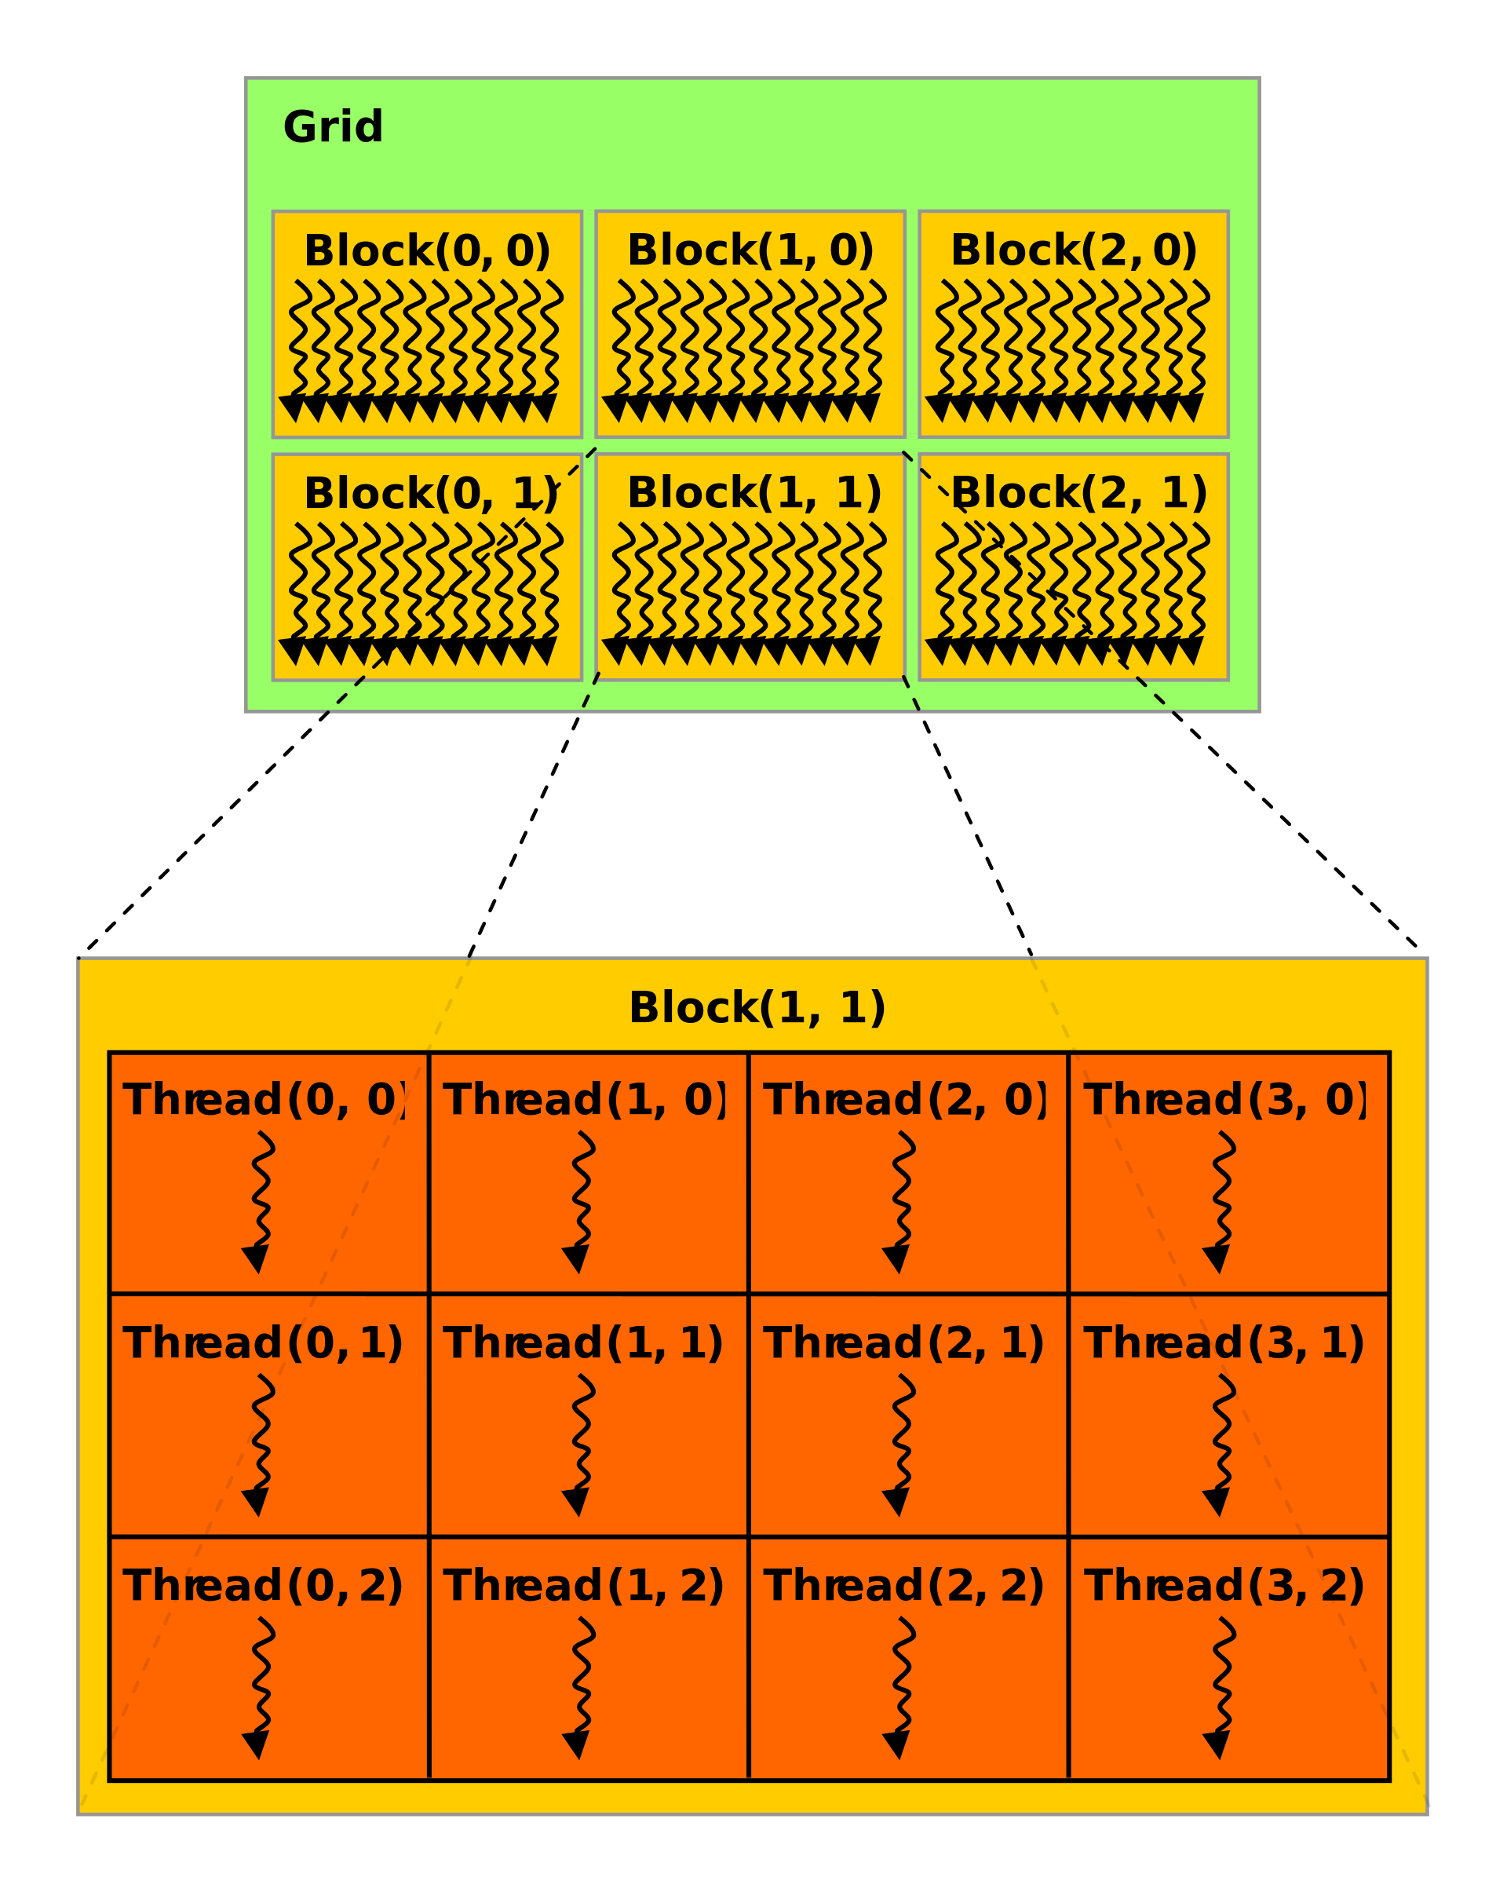
Introduction GPU Programming
GPU threads are like CPU threads in which they can run in parallel.
A group of threads (up to 32) are combined
in a block
Threads can share data and/or sync
within a block but not between blocks
All threads in a block are guaranteed
to execute at the same time (and may
run in lockstep)
Blocks are not
Notes:
Polyhedral tools have become

Slide 65
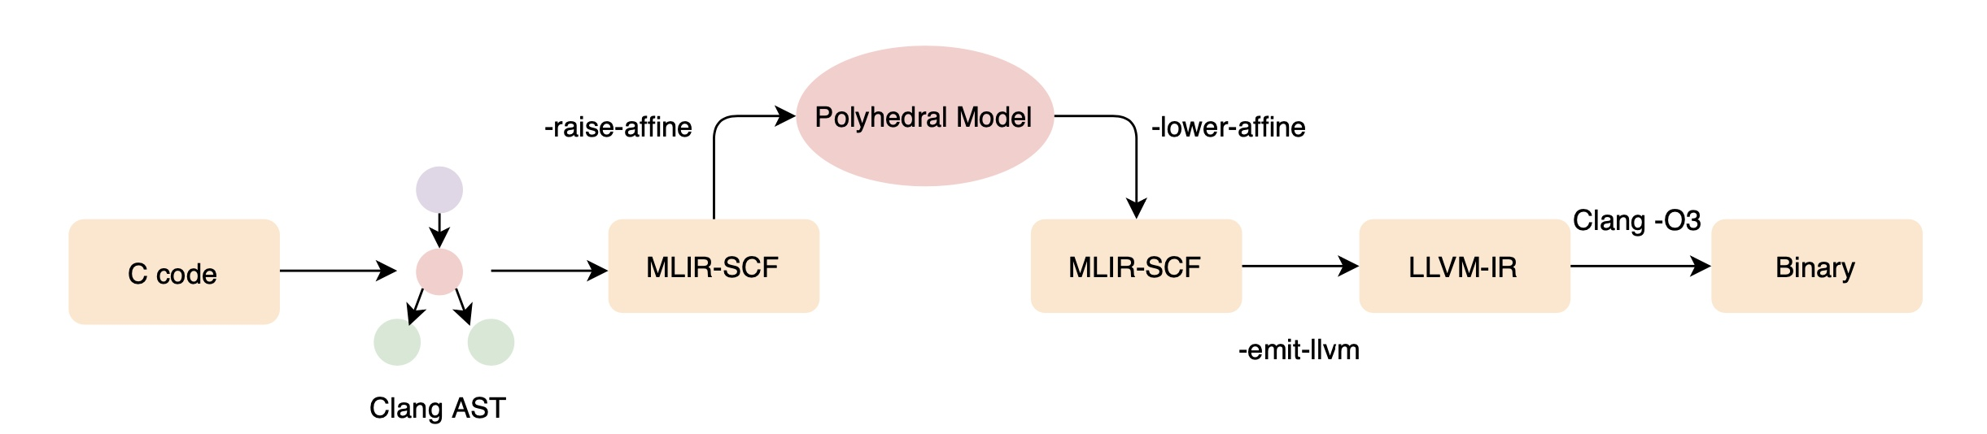
The Polygeist Compilation Flow
Generic C or C++ frontend that generates "standard" MLIR
Raising transformations for transforming "standard" MLIR to polyhedral MLIR (Affine)
Embedding of existing polyhedral tools (Pluto, CLooG) into MLIR
Novel transformations (statement splitting, reduction detection) that rely on high-level compiler representation
End-to-end evaluation of standard polyhedral benchmarks (Polybench)
Notes:
To create this end-to-end compilation flow, Polygeist contains several components that we will dive into shortly.
Polygeist begins as a new C and C++ frontend for MLIR that simultaneously preserves the program’s high-level structure. Unlike the existing AST-based tools used in the polyhedral community, the Polygeist frontend handles generic C or C++, not just the parts of the program representable by the polyhedral model.
Polygeist then implements several transformations that transform the “standard” structured MLIR directly emitted by the frontend into MLIR’s high-level polyhedral or Affine dialect, where applicable. Specifically, Polygeist performs this raising either where it can prove the raising to be legal, or where Polygeist is instructed by a pragma scop to assume an entire region to be polyhedral.
From here, Polygeist connects existing Polydral tools to MLIR, allowing them to perform transformations on programs in the MLIR affine dialect.
We then run several novel transformations such as statement splitting that were mentioned earlier.
Finally polygeist emits a binary that we can use to run an end-to-end evaluation of Polygeist as compared with other tools on standard polyhedral benchmarks, namely Polybench. In doing so, Polygeist creates MLIR versions of these benchmarks if anyone wants to create their own transformations in MLIR and compare with existing tools.
It has the following 4 major components
I will go through these modules step by step.

Slide 66
Polygeist on Polyhedral
An MLIR-based end-to-end polyhedral compilation flow
Keeps the best parts of high-level abstractions and low-level optimizations by directly lowering to and optimizing MLIR.
Multiple abstraction levels allows new polyhedral optimization opportunities and simplifies the implementation of others
State-of-the-art performance when compared with existing source and compiler-based tools.
Notes:
Building off of MLIR, we created Polygeist, an end-to-end polyhedral compilation flow that is able to keep the best parts of high-level abstractions and low-level optimizations by directly lowering to and optimizing MLIR.
Moreover, this added abstraction-crossing flexibility enables Polygeist to create new polyhedral optimization opportunities such as statement splitting and greatly simplify the implementation of others such as parallel reduction detection.
This enables Polygeist to achieve state-of-the-art performance when compared with existing source and compiler-based tools.

Slide 67
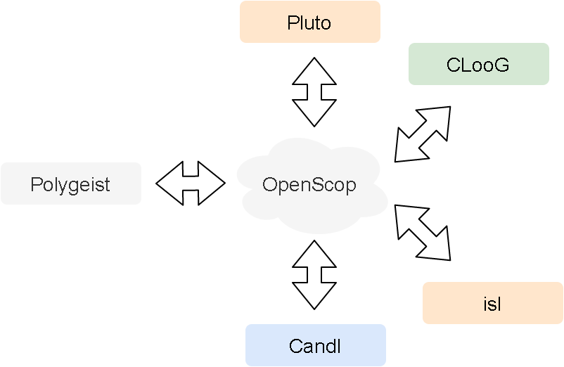
Connecting MLIR to Polyhedral Tools
Polygeist produces MLIR Affine
MLIR Affine <-> polyhedral model
Existing tools don't take Affine
OpenScop is a target representation
How to translate
Affine <-> OpenScop?

Slide 68
Polyhedral Optimization Pipeline
Polygeist
-raise-affine
Translate to
OpenScop
Translate
to MLIR
MLIR
-lower-affine
MLIR Affine
OpenScop
MLIR Affine
-reg2mem
-resolve-hazards
-extract-polystmt
-pluto-opt
Notes:
Ruizhe: We begin by taking the raised MLIR and performing some preprocessing transformations that make it easier to translate to OpenScop.
We then generate OpenScop and pass the result to a polyhedral scheduler. In our evaluation, we chose Pluto. Finally, we convert back to MLIR and run additional optimizations and lowering.

Slide 69
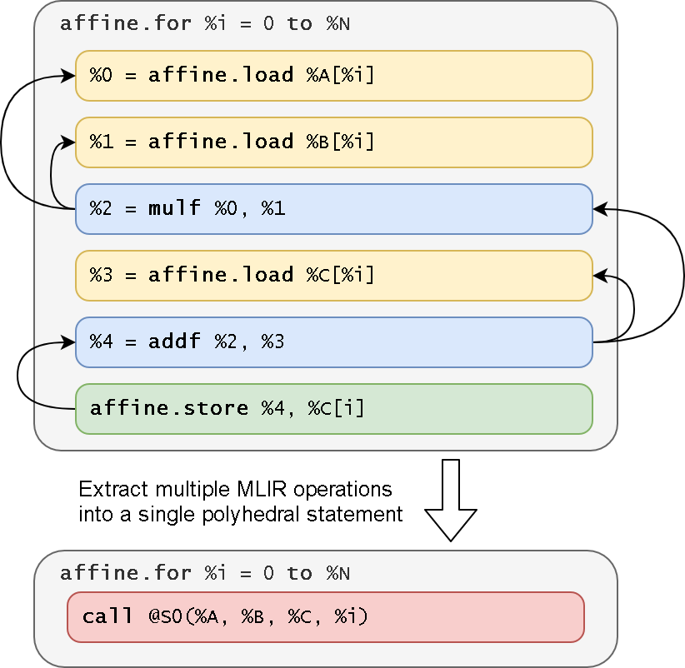
Polyhedral Statement
OpenScop expects C-like statements:
MLIR Affine is at a lower level.
To match C-like statements:
  Extract 1 MLIR memory write
  Traverse SSA use-def chains
  Gather until loads or symbols
C[i][j] += A[i][k] * B[k][j]​
Notes:
Ruizhe: The polyhedral scheduling algorithm schedules polyhedral statements.
Conventionally, a polyhedral statement is expected to be like a C statement, for example, this multiply-and-accumulate line in matrix multiplication.
The MLIR code we have as an input, however doesn't contain all of this information in a single operation. In fact, as shown on the right, this same program has 6 MLIR operations.
Thus to work collaboratively with OpenScop, we need to extract multiple MLIR operations into a single polyhedral statement.

Slide 70
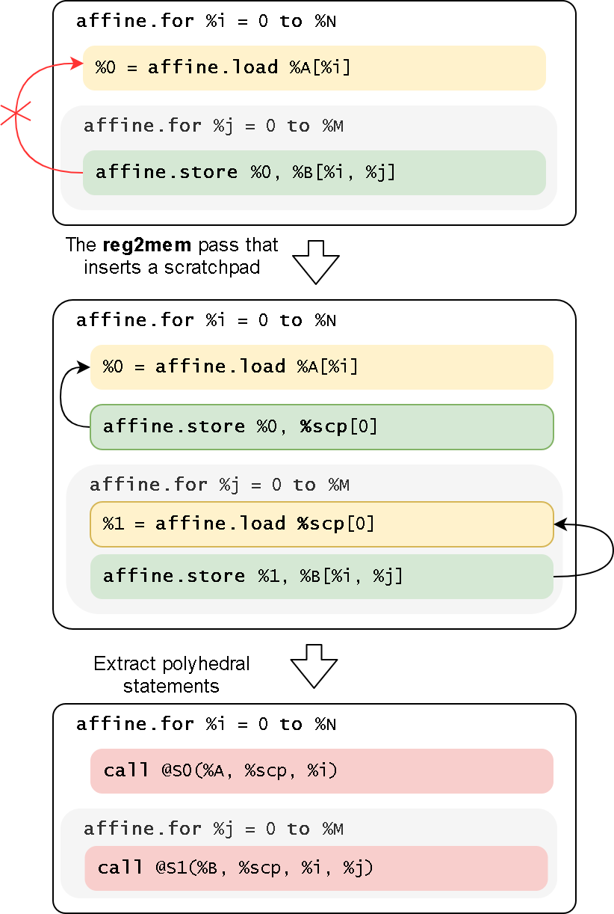
Region-Spanning Problem
A use-def chain spans across loops
Statement nesting is ambiguous
MLIR reconstruction is difficult
Reg2mem pass: insert a scratchpad for each region-spanning use-def chain
Notes:
One major problem we need to deal with for the simple statement extraction method is region-spanning.
Region-spanning appears when a use-def chain that our previous algorithm traces actually spans across multiple loops.
For example, a use-def chain may have a load and a store, in which the load operation is in the outermost loop and the store is in the innermost one. The store operation stores the value being loaded by the load operation, hence they're in the same use-def chain.
There are two issues when region-spanning occurs:
First, it is ambiguous to say where in the loop nest the extracted statement should belong to, the outer or the inner loop.
Second, it would be difficult for us to reconstruct such region-spanning statements back from OpenScop. There might not be a bidirectional mapping in this scenario.
Our solution is a reg2mem pass. We insert scratchpad memorys when a use-def chain spans across multiple loops, as you may find out from the RHS image. After this pass, we can still apply the previously mentioned statement extraction algorithm to create two statements.

Slide 71
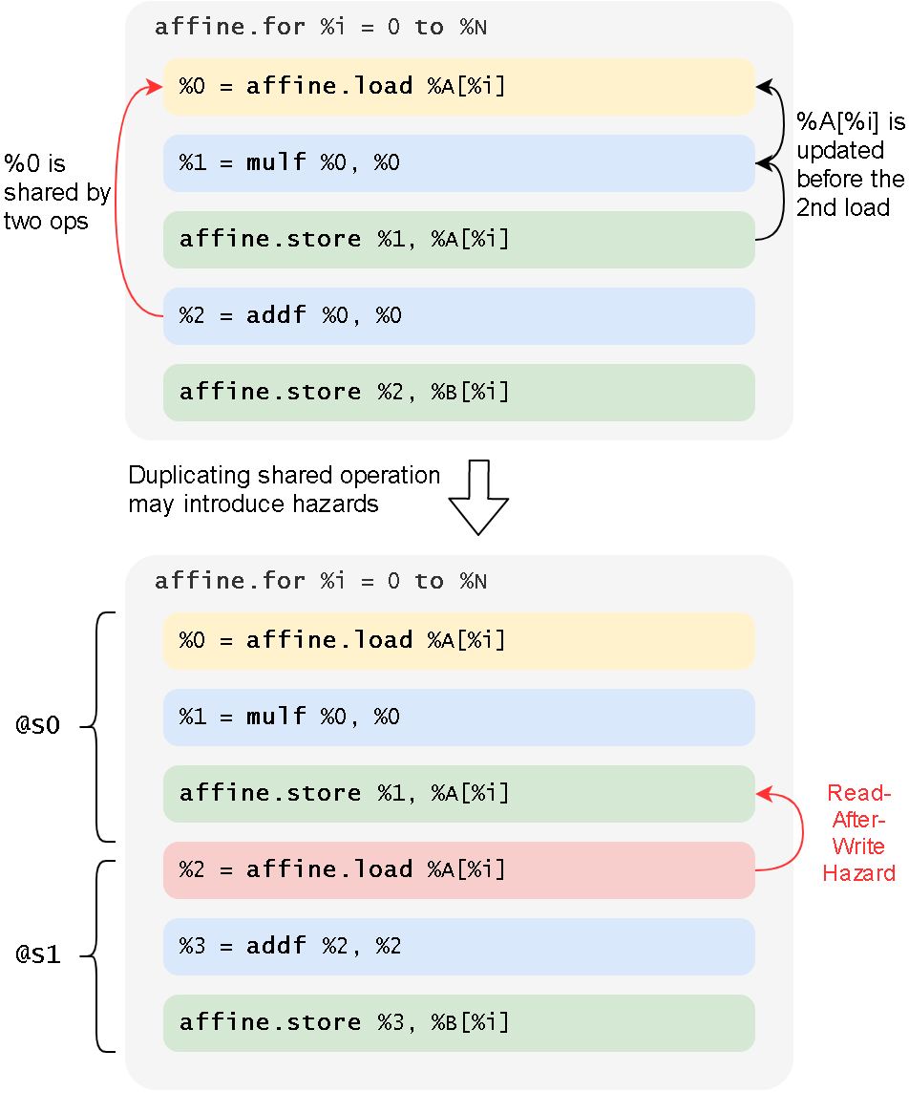
Avoid RAW Hazard
Two stores share the same load
1st store overwrite the address
Detected by value analysis
Solution: insert scratchpads
Notes:
Ruizhe: We must also content with a potential read-after-write hazard that might have been introduced by statement extraction.
Consider the code on the right. In this case, there are two store operations, both of which use instruction 0, which is loaded from A of i.
Unfortunately, the first store overwrites this value, making it impossible to redo this load in the second statement.
Happily this problem can be easily detected by value analysis.
To solve the problem, we insert scratchpads which cache the value immediately after it has been loaded. Stores that use the value after it may be overwritten instead load from the scratchpad.

Slide 72
Evaluation
Compare Polygeist frontend with Clang to establish a fair baseline
Compare Polygeist polyhedral optimization with Pluto (source-based) and Polly (compiler-based)
Novel optimizations

Slide 73
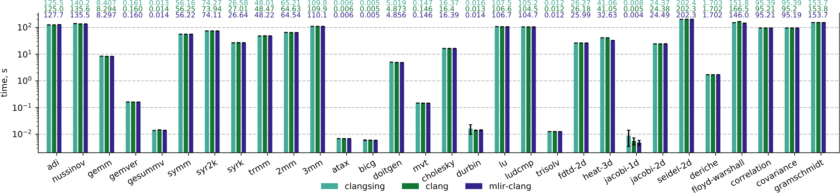
Serial Non-Polyhedral Comparison
polygeist

Slide 74
Serial Non-Polyhedral Comparison
polygeist
Frontend within 0.32% of “standard” frontend

Slide 75
Serial Non-Polyhedral Comparison
polygeist
Frontend within 0.32% of “standard” frontend
Remaining gap attributed to small tests where minor assembly differences matter

Slide 76
Parallel Reduction Detection (durbin)

Slide 77
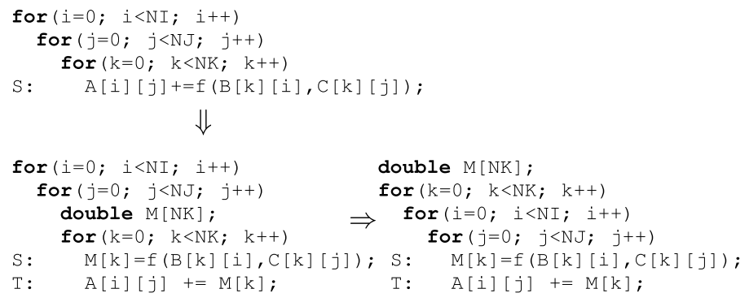
Statement Splitting
We don’t need to reconstruct the original C statements from Affine
We can split statements by inserting scratchpads.
Notes:
In addition to implementing reduction detection, the abstraction-spanning nature of Polygeist allows us to implement a new optimization: statement splitting.
Specifically, when generating statements, we previously described mechanisms to reconstruct similar statements to the original C program.
However, reconstructing the original statements isn't required, and may actually hinder scheduling.
Consider the program below with a single statement S which computes f and adds the result into a matrix A.
We can instead choose to insert a scratchpad M and split S into two statements which separately compute f and add the result into A.
This statement splitting results in finer-grained statements which can result in different schedules being explored.
In this example, without the splitting Pluto will never proposes the statement on the right because of the reduction dependency along k of A.
The schedule on the right, however, is found when the statement is split and results in temporal locality for B and spatial locality for C.

Slide 78
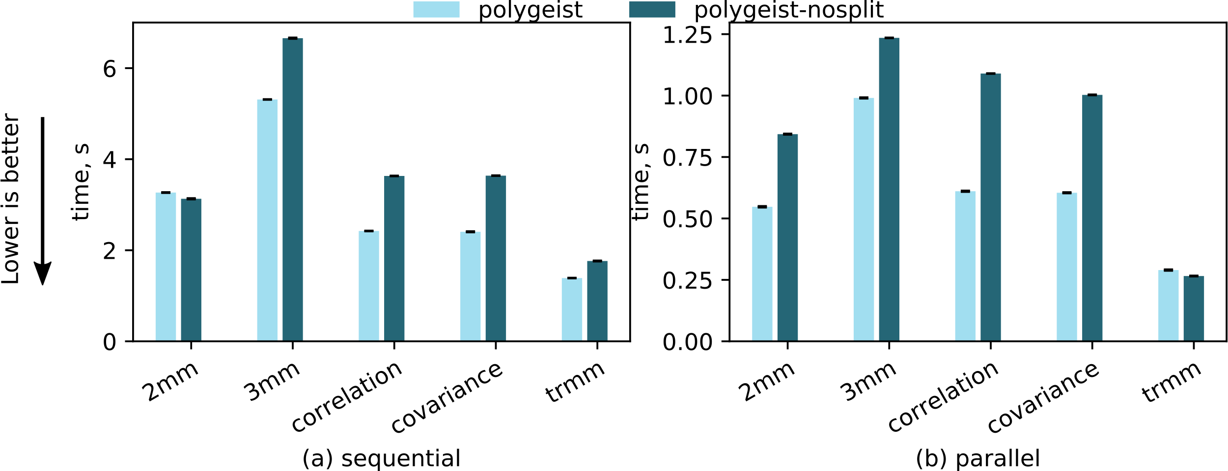
Statement Splitting
Notes:
Interestingly, even though the input program is functionally equivalent before and after splitting, the optimised schedule we can get from Pluto will be different if we split at the right place.
It is still an open question why there are such differences and how to find the right splitting point, but we've found certain heuristics that can let us split the statement in a way that will result in performance gain.
There are five examples in the Polybench that we've found such heuristics are applicable, and we have observed performance improvement by splitting at the places that the heuristics indicate.
More details about the heuristics are in the paper. It is still preliminary, and improving that is one of our future directions.

Slide 79
Future Work
Exploration of Statement Splitting beyond a simple heuristic
GPU optimization and GPU <-> CPU
Embedded DSL / C-style semantics for directly generating MLIR Ops
Upstreaming LLVM Incubator Project

Slide 80
Frontend Performance Differences
8% performance boost on Floyd-Warshall occurs if Polygeist generates a single MLIR module for both benchmarking and timing code by default
MLIR doesn't properly generate LLVM datalayout, preventing vectorization for MLIR-generated code (patched in our lowering)
Different choice of allocation function can make a 30% impact on some tests (adi)
LLVM strength-reduction is fragile and sometimes misses reversed loop induction variable (remaining gap in adi)

Slide 81
“Case Study 3”: Your Programs!
There are already several efforts starting using Polygeist/MLIR to leveraging the benefits of optimizable multi-level operations
  SYCL
  Circuit Compilation
  BLAS Kernels
  Databases
  …
If you’re interested in applying such techniques to your programs, please reach out!
Notes:
Polyhedral tools have become

Slide 82
GPU Synchronization Lowering
Most CPU backends (e.g. Cilk, OpenMP) do not have an equivalent & general synchronization instruction (more akin to a barrier)
Existing approaches create a heavy-weight state machine of all synchronizations that stores all values
Notes:
Polyhedral tools have become

Slide 83
GPU Synchronization Lowering: Registers
Registers defined before the synchronization and used after the synchronization must be preserved through an allocation.
If the memory semantics allow us to more efficiently recompute the value, it doesn’t need to be stored.
_{parallel_for %i = 0 to N {}
_{%off = %i + 1}
_{codeA(%off);}
_{sync_threads;}
_{codeB(%off);}
}
_{%offm = alloca N}
_{parallel_for %i = 0 to N {}
_{%off = %i + 1}
_{%offm[%i] = %off}
_{codeA(%off);}
}
_{parallel_for %i = 0 to N {}
_{codeB(%off_m%[%i]);}
}
_{parallel_for %i = 0 to N {}
_{%off = %i + 1}
_{codeA(%off);}
}
_{parallel_for %i = 0 to N {}
_{%off = %i + 1}
_{codeB(%off);}
}
Notes:
Polyhedral tools have become

Slide 84
GPU Synchronization Lowering: Registers
Registers defined before the synchronization and used after the synchronization must be preserved through an allocation.
If the memory semantics allow us to more efficiently recompute the value, it doesn’t need to be stored.
[Question] Is distributing the parallelism around the barrier the best approach?
[Question] How do we minimize the runtime of preserving registers?
  Tradeoff parallel recompute vs preserve
  Min Cut?
Notes:
Polyhedral tools have become

Slide 85
GPU Synchronization Lowering: Control Flow
Synchronization within control flow (for, if, while, etc) can be lowered by splitting around the control flop and interchanging the parallelism.
_{parallel_for %i = 0 to N {}
_{codeA(%i);}
_{for %j = … {}
_{codeB1(%i, %j);}
_{sync_threads;}
_{codeB2(%i, %j);}
}
_{codeC(%i);}
}
_{parallel_for %i = 0 to N {}
_{codeA(%i);}
_{sync_threads;}
_{for %j = … {}
_{codeB1(%i, %j);}
_{sync_threads;}
_{codeB2(%i, %j);}
}
_{sync_threads;}
_{codeC(%i);}
}
_{parallel_for %i = 0 to N {}
_{codeA(%i);}
}
_{parallel_for %i = 0 to N {}
_{for %j = … {}
_{codeB1(%i, %j);}
_{sync_threads;}
_{codeB2(%i, %j);}
}
}
_{parallel_for %i = 0 to N {}
_{codeC(%i);}
}
Notes:
Polyhedral tools have become

Slide 86
GPU Synchronization Lowering: Control Flow
Synchronization within control flow (for, if, while, etc) can be lowered by splitting around the control flop and interchanging the parallelism.
_{parallel_for %i = 0 to N {}
_{codeA(%i);}
}
_{parallel_for %i = 0 to N {}
_{for %j = … {}
_{codeB1(%i, %j);}
_{sync_threads;}
_{codeB2(%i, %j);}
}
}
_{parallel_for %i = 0 to N {}
_{codeC(%i);}
}
_{parallel_for %i = 0 to N {}
_{codeA(%i);}
}
_{for %j = … {}
_{parallel_for %i = 0 to N {}
_{codeB1(%i, %j);}
_{sync_threads;}
_{codeB2(%i, %j);}
}
}
_{parallel_for %i = 0 to N {}
_{codeC(%i);}
}
_{parallel_for %i = 0 to N {}
_{codeA(%i);}
}
_{for %j = … {}
_{parallel_for %i = 0 to N {}
_{codeB1(%i, %j);}
}
_{parallel_for %i = 0 to N {}
_{codeB2(%i, %j);}
}
}
_{parallel_for %i = 0 to N {}
_{codeC(%i);}
}
Notes:
Polyhedral tools have become

