Slide 1






High-Performance GPU-to-CPU Transpilation and Optimization via High-Level Parallel Constructs
William S. Moses
MIT
Ivan R. Ivanov
Tokyo Tech
Jens Domke
Riken
Toshio Endo
Tokyo Tech
Johannes Doerfert
LLNL
Alex Zinenko
Google
PPoPP
Feb 27, 2023

Slide 2

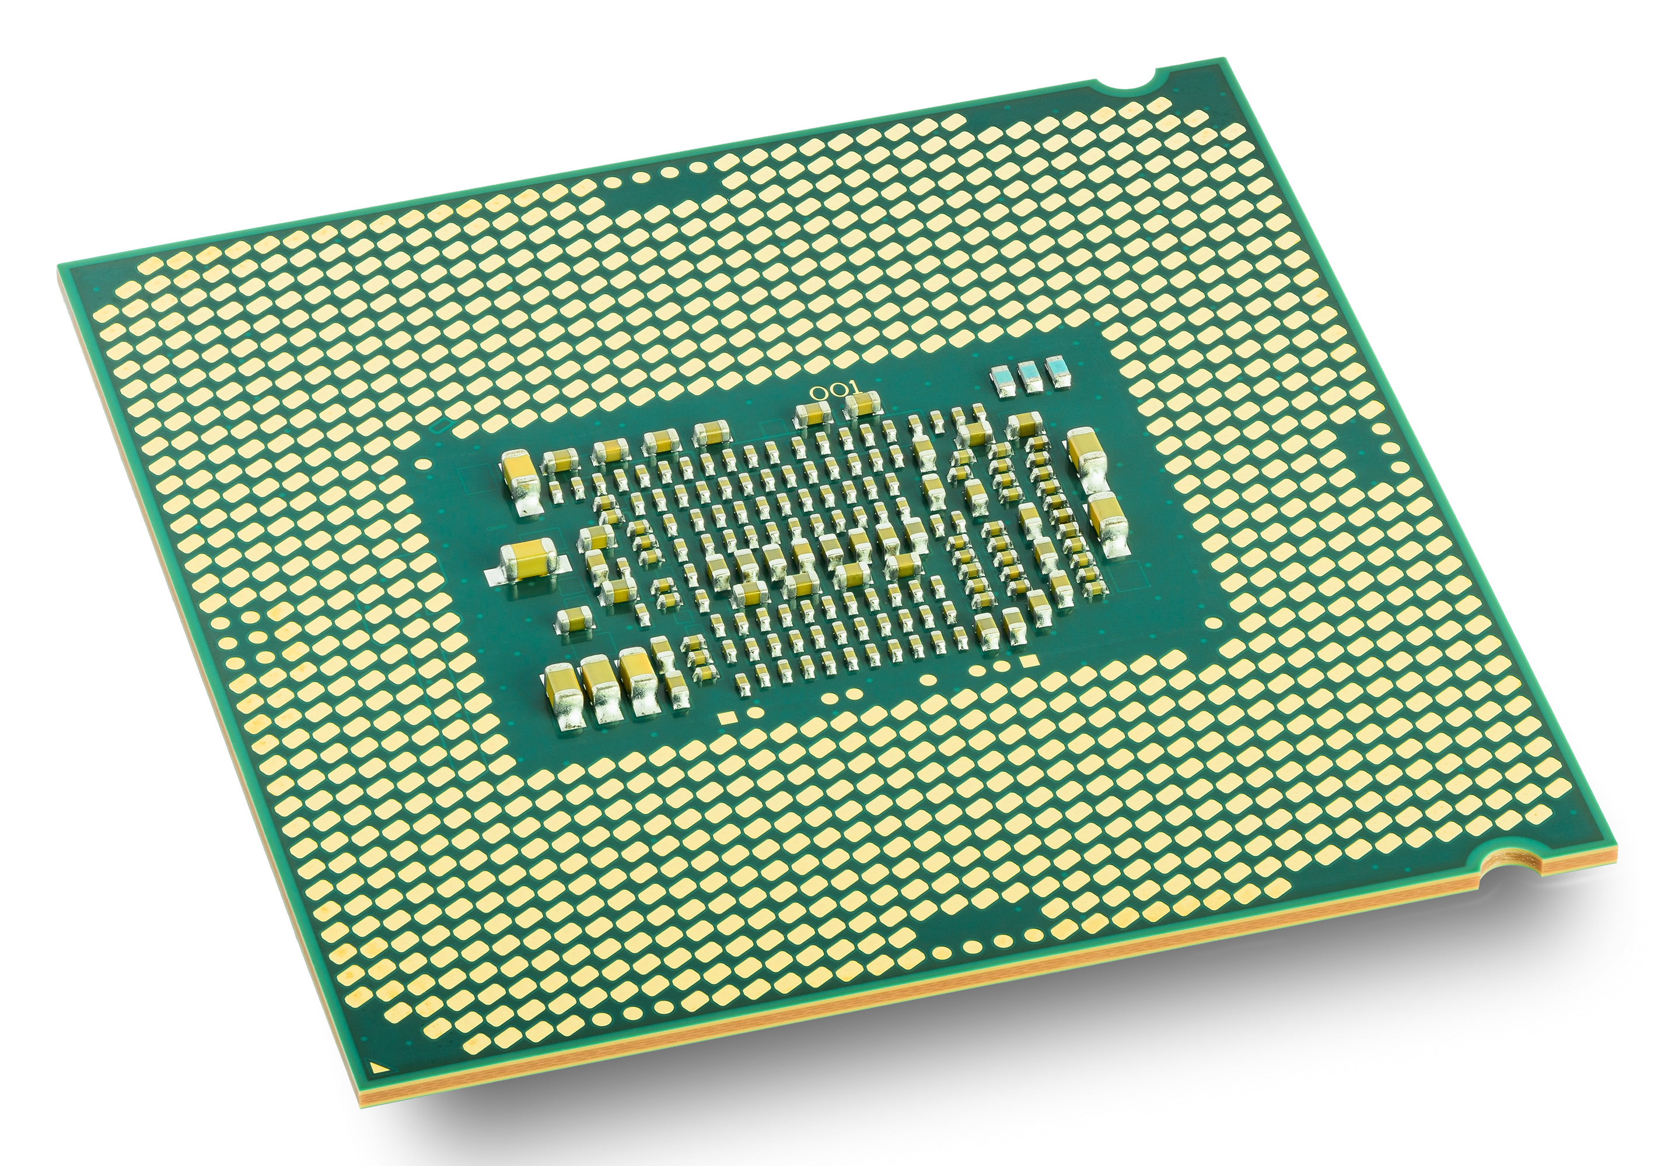



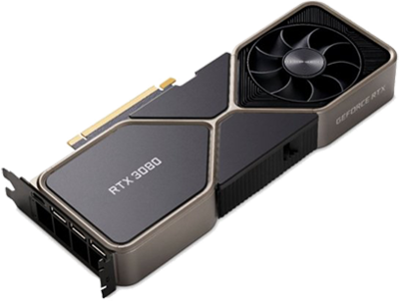


A Diverse Parallel Ecosystem
Recent explosion of parallel software packages and hardware architectures.
Changing landscape frequently requires re-engineering application to run at all, let alone fast.
Existing approaches require some rewriting in either a performance portability library or DSL – infeasible for large / complex applications.
Can fast and automated parallel performance portability be achieved through the compiler?

Slide 3


The Current Compilation Pipeline
void set(int *arr, int val) {
for(int i=0; i<10; i++){
arr[2*i] = val;
}
}
Optimize
Parse
Lowering
CodeGen
Clang AST
FunctionDecl set 'void (int *, int)'
ForStmt
DeclStmt
`-VarDecl used i 'int' cinit
`-IntegerLiteral 'int’ 0
BinaryOperator 'bool' '<'
|-ImplicitCastExpr 'int' <LValueToRValue>
| `-DeclRefExpr 'int' lvalue Var 0x563e22a396b8 'i' 'int'
`-IntegerLiteral 'int' 10
UnaryOperator 'int' postfix '++'
`-DeclRefExpr 'int' lvalue Var 0x563e22a396b8 'i' 'int’
…
define void @_Z3setPii(i32* %0, i32 %1) {
br label %4
3: ; preds = %4
ret void
4: ; preds = %2, %4
%5 = phi i64 [ 0, %2 ], [ %8, %4 ]
%6 = shl i64 %5, 1
%7 = getelementptr inbounds i32, i32* %0, i64 %6
store i32 %1, i32* %7
%8 = add i64 %5, 1
%9 = icmp eq i64 %8, 10
br i1 %9, label %3, label %4
}
Notes:
Enter ML or multi-level IR, a recent compiler representation able to simultaneously represent, optimize, and convert between different levels of abstraction, including loops, parallel reductions, polyhedral-inspired affine memory operations, and low-level instructions that fully cover LLVM.

Slide 4
Losing High Level Structure
LLVM, while general enough to represent any program, must represent all parts of a program in a single, low-level IR
  Loses control flow constructs (if, for, etc)
  Hides parallelism behind runtime
  High-level semantics & properties cannot be represented and are lost.
void foo(DataStructure& x) {
print(size(x));
insert(x);
print(size(x));
}
define void @foo(ptr %x) {
%2 = call @size(ptr %x)
call @print(i32 %2)
call @insert(ptr %x)
; %3 = add i32 %2, 1
%3 = call @size(ptr %x)
call @print(i32 %3)
ret void
}
Notes:
Enter ML or multi-level IR, a recent compiler representation able to simultaneously represent, optimize, and convert between different levels of abstraction, including loops, parallel reductions, polyhedral-inspired affine memory operations, and low-level instructions that fully cover LLVM.

Slide 5
GPU Programming
__global__ void normalize(int *out, int* in, int n) {
int tid = blockIdx.x;
if (tid < n)
out[tid] = in[tid] / sum(in, n);
}
void launch(int *out, int* in, int n) {
normalize<<<n>>>(d_out, d_in, n);
}
Mainstream compilers do not have a high-level representation of parallelism, making optimization difficult or impossible
This is accentuated for GPU
programs where the kernel is
kept in a separate module to
allow emission of different
assembly and synchronization
is treated as a complete optimization barrier.
Host Code
Device Code
target triple = "x86_64-unknown-linux-gnu”
define void @_Z6launchPiS_i(i32* %out,
i32* %in,
i32 %n) {
call i32 @pushCallConfiguration(…)
call i32 @cudaLaunch(@_device_stub, …)
ret void
}
target triple = ”nvptx”
define void @_Z9normalize(i32* %out,
i32* %in, i32 %n) {
%4 = call i32 @llvm.tid.x()
%5 = icmp slt i32 %4, %n
br i1 %5, label %6, label %13
6:
%8 = getelementptr i32, i32* %in, i32 %4
%9 = load i32, i32* %8, align 4
%10 = call i32 @_Z3sumPii(i32* %in, i32 %n)
%11 = sdiv i32 %9, %10
%12 = getelementptr i32, i32* %out, i32 %4
store i32 %11, i32* %12, align 4
br label %13
13:
ret void
}
Notes:
Polyhedral tools have become

Slide 6

Polygeist^{[1]}/MLIR ^{[2]}
Raise & Optimize
Optimize
Parse
Clang
AST
Lowering
Lowering
CodeGen
Generic C and C++ frontend that generates "standard” and user-defined MLIR (templates, classes, unions, etc. all supported)
Preserves the structure of programs (parallelism, control flow, etc)
Raising transformations for raising "standard" MLIR to high-level
Collection of high-level optimization and analysis passes (general mem2reg, parallel optimizations)
[1] Polygeist: Raising C to Polyhedral MLIR; Moses, Chelini, Zhao, and Zinenko. PACT ’21.
[2] MLIR: Scaling Compiler Infrastructure for Domain Specific Computation. CGO’21.
Notes:
Enter ML or multi-level IR, a recent compiler representation able to simultaneously represent, optimize, and convert between different levels of abstraction, including loops, parallel reductions, polyhedral-inspired affine memory operations, and low-level instructions that fully cover LLVM.

Slide 7
Polygeist Frontend Example
func @set(%arg0: memref<?xi32>, %arg1: i32) {
%c0 = constant 0 : index
%0 = alloca() : memref<1xmemref<?xi32>>
store %arg0, %0[%c0] : memref<1xmemref<?xi32>>
%1 = alloca() : memref<1xi32>
store %arg1, %1[%c0] : memref<1xi32>
%c0_i32 = constant 0 : i32
%c2_i32 = constant 2 : i32
%c10_i32 = constant 10 : i32
%2 = index_cast %c10_i32 : i32 to index
scf.for %arg2 = %c0_i32 to %2 {
%3 = index_cast %arg2 : index to i32
%4 = alloca() : memref<1xi32>
store %3, %4[%c0] : memref<1xi32>
%5 = load %0[%c0] : memref<1xmemref<?xi32>>
%6 = load %4[%c0] : memref<1xi32>
%7 = muli %c2_i32, %6 : i32
%8 = index_cast %7 : i32 to index
%9 = load %1[%c0] : memref<1xi32>
store %9, %5[%8] : memref<?xi32>
}
return
}
void set(int *arr, int val) {
for(int i=0; i<10; i++){
arr[2*i] = val;
}
}
Notes:
Let’s look at a simplified example. On the left we have some sample C code that sets every other index of an array arr to a given value val.
On the right we see a slightly simplified version of the MLIR that would be generated.
Immediately we see an allocation for a stack variable that holds the value of arr (and shaded out for val). As these values can be overwritten in the function an SSA register for the argument does not suffice and is upgraded to the stack allocation seen here.
We then see the structured for loop that represents the C for loop in our original program. Note that at this point this is simply a structured and not an affine or polyhedral for loop.
We can then example how the store take place, which first requires an explicit load of the induction variable, and multiplication to compute the desired index.

Slide 8
Polygeist Raising
func @set(%arg0: memref<?xi32>, %arg1: i32) {
%c0 = constant 0 : index
%0 = alloca() : memref<1xmemref<?xi32>>
store %arg0, %0[%c0] : memref<1xmemref<?xi32>>
%1 = alloca() : memref<1xi32>
store %arg1, %1[%c0] : memref<1xi32>
%c0_i32 = constant 0 : i32
%c10_i32 = constant 10 : i32
%2 = index_cast %c10_i32 : i32 to index
scf.for %arg2 = %c0_i32 to %2 {
%3 = index_cast %arg2 : index to i32
%4 = alloca() : memref<1xi32>
store %3, %4[%c0] : memref<1xi32>
%5 = load %0[%c0] : memref<1xmemref<?xi32>>
%c2_i32 = constant 2 : i32
%6 = load %4[%c0] : memref<1xi32>
%7 = muli %c2_i32, %6 : i32
%8 = index_cast %7 : i32 to index
%9 = load %1[%c0] : memref<1xi32>
store %9, %5[%8] : memref<?xi32>
}
return
}
Notes:
Using the same example as before, we can see how raising works.
First memory allocations are eliminated by the mem2reg pass. Additional simplifications are run. Finally we raise the remaining operations to affine variants by first raising the for and subsequently the store.

Slide 9
Polygeist Raising
func @set(%arg0: memref<?xi32>, %arg1: i32) {
%c0 = constant 0 : index
%0 = alloca() : memref<1xmemref<?xi32>>
store %arg0, %0[%c0] : memref<1xmemref<?xi32>>
%1 = alloca() : memref<1xi32>
store %arg1, %1[%c0] : memref<1xi32>
%c0_i32 = constant 0 : i32
%c10_i32 = constant 10 : i32
%2 = index_cast %c10_i32 : i32 to index
scf.for %arg2 = %c0_i32 to %2 {
%3 = index_cast %arg2 : index to i32
%4 = alloca() : memref<1xi32>
store %3, %4[%c0] : memref<1xi32>
%5 = load %0[%c0] : memref<1xmemref<?xi32>>
%c2_i32 = constant 2 : i32
%6 = load %4[%c0] : memref<1xi32>
%7 = muli %c2_i32, %6 : i32
%8 = index_cast %7 : i32 to index
%9 = load %1[%c0] : memref<1xi32>
store %9, %5[%8] : memref<?xi32>
}
return
}
func @set(%arg0: memref<?xi32>, %arg1: i32) {
%c0 = constant 0 : index
%c0_i32 = constant 0 : i32
%c10_i32 = constant 10 : i32
%2 = index_cast %c10_i32 : i32 to index
scf.for %arg2 = %c0_i32 to %2 {
%3 = index_cast %arg2 : index to i32
%c2_i32 = constant 2 : i32
%7 = muli %c2_i32, %3 : i32
%8 = index_cast %7 : i32 to index
store %arg1, %arg0[%8] : memref<?xi32>
}
return
}
Mem2Reg
Notes:
Using the same example as before, we can see how raising works.
First memory allocations are eliminated by the mem2reg pass. Additional simplifications are run. Finally we raise the remaining operations to affine variants by first raising the for and subsequently the store.

Slide 10
Polygeist Raising
func @set(%arg0: memref<?xi32>, %arg1: i32) {
%c0 = constant 0 : index
%0 = alloca() : memref<1xmemref<?xi32>>
store %arg0, %0[%c0] : memref<1xmemref<?xi32>>
%1 = alloca() : memref<1xi32>
store %arg1, %1[%c0] : memref<1xi32>
%c0_i32 = constant 0 : i32
%c10_i32 = constant 10 : i32
%2 = index_cast %c10_i32 : i32 to index
scf.for %arg2 = %c0_i32 to %2 {
%3 = index_cast %arg2 : index to i32
%4 = alloca() : memref<1xi32>
store %3, %4[%c0] : memref<1xi32>
%5 = load %0[%c0] : memref<1xmemref<?xi32>>
%c2_i32 = constant 2 : i32
%6 = load %4[%c0] : memref<1xi32>
%7 = muli %c2_i32, %6 : i32
%8 = index_cast %7 : i32 to index
%9 = load %1[%c0] : memref<1xi32>
store %9, %5[%8] : memref<?xi32>
}
return
}
func @set(%arg0: memref<?xi32>, %arg1: i32) {
%c0 = constant 0 : index
%c2 = constant 2 : i32
%c10 = constant 10 : i32
scf.for %arg2 = %c0 to %c10 {
%7 = muli %c2_i32, %arg2 : index
store %arg1, %arg0[%7] : memref<?xi32>
}
return
}
Mem2Reg
Canonicalize
Notes:
Using the same example as before, we can see how raising works.
First memory allocations are eliminated by the mem2reg pass. Additional simplifications are run. Finally we raise the remaining operations to affine variants by first raising the for and subsequently the store.

Slide 11
Polygeist Raising
func @set(%arg0: memref<?xi32>, %arg1: i32) {
%c0 = constant 0 : index
%0 = alloca() : memref<1xmemref<?xi32>>
store %arg0, %0[%c0] : memref<1xmemref<?xi32>>
%1 = alloca() : memref<1xi32>
store %arg1, %1[%c0] : memref<1xi32>
%c0_i32 = constant 0 : i32
%c10_i32 = constant 10 : i32
%2 = index_cast %c10_i32 : i32 to index
scf.for %arg2 = %c0_i32 to %2 {
%3 = index_cast %arg2 : index to i32
%4 = alloca() : memref<1xi32>
store %3, %4[%c0] : memref<1xi32>
%5 = load %0[%c0] : memref<1xmemref<?xi32>>
%c2_i32 = constant 2 : i32
%6 = load %4[%c0] : memref<1xi32>
%7 = muli %c2_i32, %6 : i32
%8 = index_cast %7 : i32 to index
%9 = load %1[%c0] : memref<1xi32>
store %9, %5[%8] : memref<?xi32>
}
return
}
func @set(%arg0: memref<?xi32>, %arg1: i32) {
affine.for %arg2 = 0 to 10 {
affine.store %arg1, %arg0 [2 * %arg2] :
memref<?xi32>
}
return
}
Mem2Reg
Canonicalize
If legal, raise while to for, for to affine, etc
Notes:
Using the same example as before, we can see how raising works.
First memory allocations are eliminated by the mem2reg pass. Additional simplifications are run. Finally we raise the remaining operations to affine variants by first raising the for and subsequently the store.

Slide 12
Polygeist Raising
func @set(%arg0: memref<?xi32>, %arg1: i32) {
affine.for %arg2 = 0 to 10 {
affine.store %arg1, %arg0 [2 * %arg2] :
memref<?xi32>
}
return
}
void set(int *arr, int val) {
for(int i=0; i<10; i++){
arr[2*i] = val;
}
}
Notes:
Using the same example as before, we can see how raising works.
First memory allocations are eliminated by the mem2reg pass. Additional simplifications are run. Finally we raise the remaining operations to affine variants by first raising the for and subsequently the store.

Slide 13
Preserving the GPU parallel structure
Maintain GPU parallelism in a form understandable to the compiler
Enables optimization between caller and kernel
Enable parallelism-specific optimization
__global__ void normalize(int *out, int *in, int n) {
int tid = blockIdx.x;
if (tid < n)
out[tid] = in[tid] / sum(in, n);
}
void launch(int *out, int* in, int n) {
normalize<<<n>>>(d_out, d_in, n);
}
func @_Z6launch(%out: memref<?xi32>,
%in: memref<?xi32>, %n: i32) {
%c1 = constant 1 : index
%c0 = constant 0 : index
parallel (%tid) = (%c0) to (%n) step (%c1) {
%2 = load %in[%tid]
%sum = call @_Z3sumPii(%in, %n)
%4 = divsi %2, %sum : i32
store %4, %out[%tid]
yield
}
return
}
Notes:
Polyhedral tools have become

Slide 14
Preserving the GPU parallel structure
Maintain GPU parallelism in a form understandable to the compiler
Enables optimization between caller and kernel
Enable parallelism-specific optimization
__global__ void normalize(int *out, int *in, int n) {
int tid = blockIdx.x;
if (tid < n)
out[tid] = in[tid] / sum(in, n);
}
void launch(int *out, int* in, int n) {
normalize<<<n>>>(d_out, d_in, n);
}
func @_Z6launch(%out: memref<?xi32>,
%in: memref<?xi32>, %n: i32) {
%c1 = constant 1 : index
%c0 = constant 0 : index
%sum = call @_Z3sumPii(%in, %n)
parallel (%tid) = (%c0) to (%n) step (%c1) {
%2 = load %in[%tid]
%4 = divsi %2, %sum : i32
store %4, %out[%tid]
yield
}
return
}
Notes:
Polyhedral tools have become

Slide 15
Preserve the parallel structure
func @launch(%h_out : memref<?xf32>, %h_in : memref<?xf32>, %n : i64) {
parallel.for (%gx, %gy, %gz) = (0, 0, 0) to (grid.x, grid.y, grid.z) {
%shared_val = memref.alloca : memref<f32>
parallel.for (%tx, %ty, %tz) = (0, 0, 0) to (blk.x, blk.y, blk.z) {
if %tx == 0 {
store …, %shared_val[] : memref<f32>
}
polygeist.barrier(%tx, %ty, %tz)
…
}
}
}
Notes:
Polyhedral tools have become

Slide 16
Synchronization via Memory
_{codeA(fib(idx));}
_{sync_threads;}
_{codeB(fib(idx));}
Synchronization (sync_threads) ensures all threads within a block finish executing codeA before executing codeB
The desired synchronization behavior can be reproduced by defining sync_threads to have the union of the memory semantics of the code before and after the sync.
This prevents code motion of instructions which require the synchronization for correctness, but permits other code motion (e.g. index computation).
_{off = fib(idx);}
_{codeA(off);}
_{sync_threads;}
_{codeB(off);}
Notes:
Polyhedral tools have become

Slide 17
Synchronization via Memory
__global__ void bpnn_layerforward(...) {
__shared__ float node[HEIGHT];
__shared__ float weights[HEIGHT][WIDTH];
if ( tx == 0 )
node[ty] = input[index_in] ;
// Unnecessary Barrier #1
// None of the read/writes below the sync
// (weights, hidden)
// intersect with the read/writes above the sync
// (node, input)
__syncthreads();
// Unnecessary Store #1
weights[ty][tx] = hidden[index];
__syncthreads();
// Unnecessary Load #1
weights[ty][tx] = weights[ty][tx] * node[ty];
…
}
High-level synchronization
representation enables new
optimizations, like sync elimination.
A synchronize instruction is not
needed if the set of read/writes
before the sync don’t conflict
with the read/writes after the sync.
Notes:
In contrast to SUIF which relies on a purpose-built communication analysis across the barrier

Slide 18
GPU Transpilation
A unified representation of parallelism enables programs in one parallel architecture (e.g. CUDA) to be compiled to another (e.g. OpenMP)
Most CPU backends do not have an equivalent block synchronization
  Many existing approaches create a heavy-weight state machine of all synchronizations that stores all values [1,2]
  Efficiently lower a top-level synchronization by distributing the parallel for loop around the sync, and interchanging control flow, pioneered by MCUDA for source code [3] and used in POCL, Ocelot, and COX
[1] Efficient Compilation of Fine-Grained SPMD-Threaded Programs for Multicore CPUs. CGO (2010)
[2] Improving performance of OpenCL on CPUs, CC (2012)
[3] MCUDA: An Efficient Implementation of CUDA Kernels for Multi-core CPUs. In Languages and Compilers for Parallel Computing (2008)
Notes:
Polyhedral tools have become

Slide 19
GPU Synchronization Lowering: Fission
Outermost synchronization can be handled by performing fission on the surrounding parallel for loop.
_{parallel_for %i = 0 to N {}
_{codeA(%i);}
_{sync_threads;}
_{codeB(%i);}
}
_{parallel_for %i = 0 to N {}
_{codeA(%i);}
}
_{parallel_for %i = 0 to N {}
_{codeB(%i);}
}
Notes:
Polyhedral tools have become

Slide 20
GPU Synchronization Lowering: Registers
Registers defined before the synchronization and used after the synchronization must be preserved through an allocation.
If the memory semantics allow us to more efficiently recompute the value, it doesn’t need to be stored.
_{parallel_for %i = 0 to N {}
_{%off = %i + 1}
_{codeA(%off);}
_{sync_threads;}
_{codeB(%off);}
}
_{%offm = alloca N}
_{parallel_for %i = 0 to N {}
_{%off = %i + 1}
_{%offm[%i] = %off}
_{codeA(%off);}
}
_{parallel_for %i = 0 to N {}
_{codeB(%off_m%[%i]);}
}
_{parallel_for %i = 0 to N {}
_{%off = %i + 1}
_{codeA(%off);}
}
_{parallel_for %i = 0 to N {}
_{%off = %i + 1}
_{codeB(%off);}
}
Notes:
Polyhedral tools have become

Slide 21
GPU Synchronization Lowering: Control Flow
Synchronization within control can be lowered by splitting around the control flop and interchanging the parallelism.
_{parallel_for %i = 0 to N {}
_{for %j = … {}
_{codeB1(%i, %j);}
_{sync_threads;}
_{codeB2(%i, %j);}
}
}
_{for %j = … {}
_{parallel_for %i = 0 to N {}
_{codeB1(%i, %j);}
_{sync_threads;}
_{codeB2(%i, %j);}
}
}
_{for %j = … {}
_{parallel_for %i = 0 to N {}
_{codeB1(%i, %j);}
}
_{parallel_for %i = 0 to N {}
_{codeB2(%i, %j);}
}
}
Notes:
Polyhedral tools have become

Slide 22
GPU Synchronization Lowering: Control Flow
Less structured control flow can still be lowered, but requires more infrastructure.
_{%helper = alloca i1}
_{do {}
_{parallel_for %i = 0 to N {}
_{run(%i);}
_{sync_threads;}
_{run2(%i);}
_{%c = condition();}
_{if %i == 0 {}
_{store %helper[] = %c;}
}
}
_{%c2 = load helper[]}
_{} while (%c2);}
_{parallel_for %i = 0 to N {}
_{do {}
_{run(%i);}
_{sync_threads;}
_{run2(%i);}
_{} while (condition());}
}
Notes:
Polyhedral tools have become

Slide 23
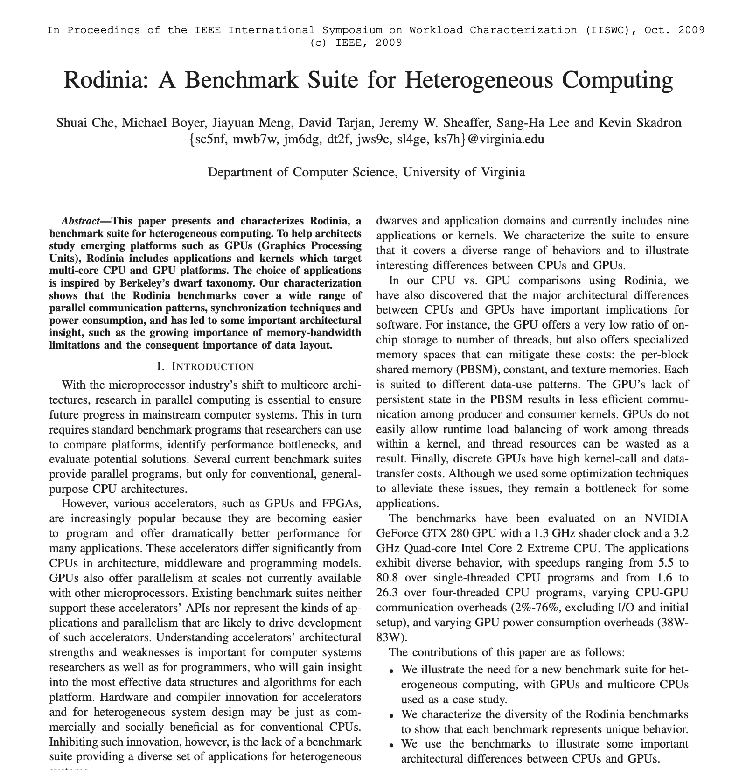

Evaluating Performance Portability
Motivation of this work was to enable the often GPU-only versions of programs to run on the CPU-only systems, like the Fugaku supercomputer.
Having demonstrated the ability to convert GPU code to CPU, how close do these transpiled versions get to hand written CPU performance?
Notes:
Polyhedral tools have become

Slide 24
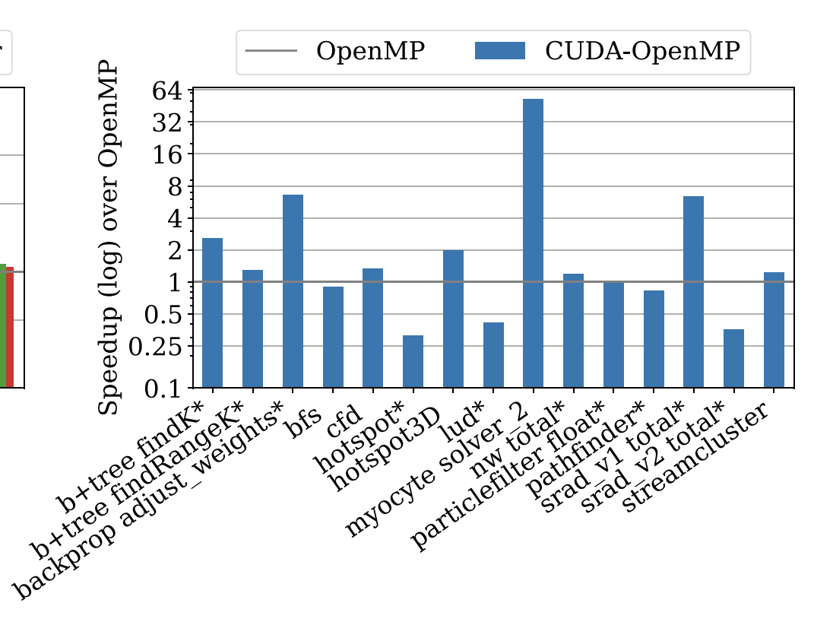
Rodinia Benchmarks
Geomean 54% improvement over hand-written OpenMP code.
Notes:
Myocyte improvement due to fewer instruction/cache misses, and fewer branches.
Backprop is due to parallel optimizations and linear array
Srad shared memory reduction and parallel optimizations which eliminate barriers/mem
hotspot and pathfinder slow down due to duplicated computation to reduce synchronization and use more parallelism
lud uses a transposed loop ordering for GPU in contrast to OpenMP

Slide 25
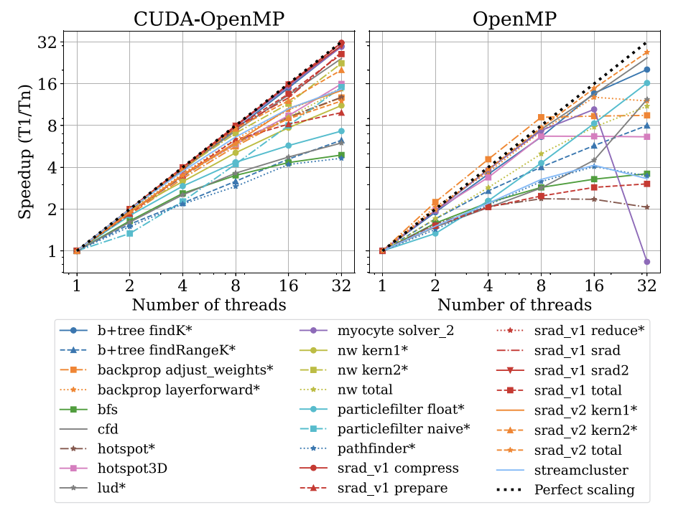
Rodinia Scalability
CUDA-OpenMP has 14x speedup over single code program on 32 cores
OpenMP has 7x speedup on 32 cores
Notes:
Myocyte improvement due to fewer instruction/cache misses, and fewer branches.
Backprop is due to parallel optimizations and linear array
Srad shared memory reduction and parallel optimizations which eliminate barriers/mem
hotspot and pathfinder slow down due to duplicated computation to reduce synchronization and use more parallelism
lud uses a transposed loop ordering for GPU in contrast to OpenMP

Slide 26
PyTorch Benchmark
Built compatibility layer called MocCUDA which allows us to overwrite CUDA versions of libraries with CPU versions, including those generated by Polygeist.
Evaluate training of Resnet-50 on Fugaku supercomputer
Tested existing Fugaku-tuned CPU backends, as well as expert-written kernels
Notes:
Myocyte improvement due to fewer instruction/cache misses, and fewer branches.
Backprop is due to parallel optimizations and linear array
Srad shared memory reduction and parallel optimizations which eliminate barriers/mem
hotspot and pathfinder slow down due to duplicated computation to reduce synchronization and use more parallelism
lud uses a transposed loop ordering for GPU in contrast to OpenMP

Slide 27
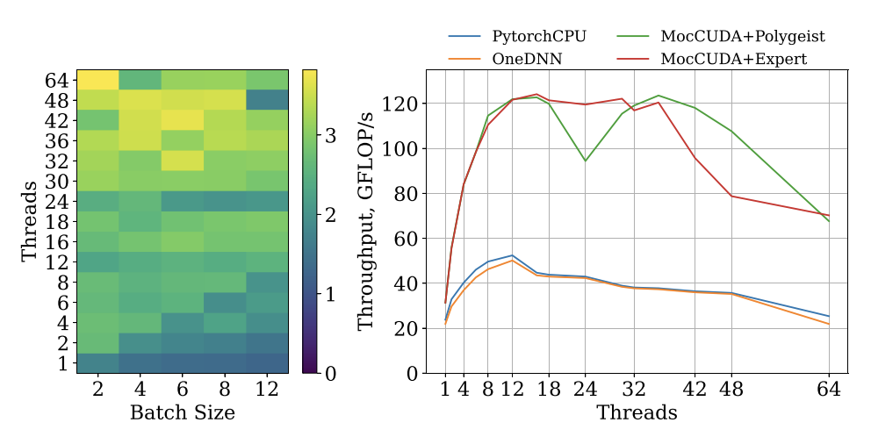
PyTorch Benchmark
MocCUDA outperforms Fujitsu-tuned oneDNN backend by 2.7x on average across batch sizes/thread counts (ranges 1.2x - 4.5x)
Notes:
Myocyte improvement due to fewer instruction/cache misses, and fewer branches.
Backprop is due to parallel optimizations and linear array
Srad shared memory reduction and parallel optimizations which eliminate barriers/mem
hotspot and pathfinder slow down due to duplicated computation to reduce synchronization and use more parallelism
lud uses a transposed loop ordering for GPU in contrast to OpenMP

Slide 28
Conclusion
Extending Polygeist/MLIR, we developed an end-to-end system capable of representing, optimizing, and transpiling CPU and GPU parallel programs.
Development of a high-level barrier operation, whose behavior is defined by memory semantics, enables interoperability with serial and parallel-specific optimizations.
Ability to preserve high-level structure, including parallelism, barriers, and control flow enables more efficient lowering to CPU’s
Validate approach by performing GPU to CPU transpilation on Rodinia and a PyTorch Resnet-50, which runs faster than existing CPU backends
LLVM incubator project, open sourced on Github (github.com/llvm/Polygeist), see polygeist.mit.edu & discuss on Discourse!

Slide 29
Acknowledgements
Thanks to Valentin Churavy, Albert Cohen, Charles Leiserson, Douglas Kogut, Jiahao Li, Bojan Serafimov, and Cosmin Oancea for thoughtful discussions on this work.
William S. Moses was supported in part by a DOE Computational Sciences Graduate Fellowship, in part by Los Alamos National Laboratories, and in part by the United States Air Force Research Laboratory. The views and conclusions contained in this document are those of the authors and should not be interpreted as representing the official policies, either expressed or implied, of the United States Air Force or the U.S. Government.
Johannes Doerfert was supported in part by the Exascale Computing Project (17-SC-20-SC) and in part by the Lawrence Livermore National Security, LLC ("LLNS") via MPO No. B642066, LLNL-CONF-843530.
This work was supported in part by the Japan Society for the Promotion of Science KAKENHI Grant Number 19H04119 and by the Japanese New Energy and Industrial Technology Development Organization (NEDO).

Slide 30
Conclusion
Extending Polygeist/MLIR, we developed an end-to-end system capable of representing, optimizing, and transpiling CPU and GPU parallel programs.
Development of a high-level barrier operation, whose behavior is defined by memory semantics, enables interoperability with serial and parallel-specific optimizations.
Ability to preserve high-level structure, including parallelism, barriers, and control flow enables more efficient lowering to CPU’s
Validate approach by performing GPU to CPU transpilation on Rodinia and a PyTorch Resnet-50, which runs faster than existing CPU backends
LLVM incubator project, open sourced on Github (github.com/llvm/Polygeist), see polygeist.mit.edu & discuss on Discourse!

Slide 31
Backup Slides

Slide 32
GPU Synchronization Lowering: Registers
Registers defined before the synchronization and used after the synchronization must be preserved through an allocation.
If the memory semantics allow us to more efficiently recompute the value, it doesn’t need to be stored.
_{parallel_for %i = 0 to N {}
_{%off = %i + 1}
_{codeA(%off);}
_{sync_threads;}
_{codeB(%off);}
}
_{%offm = alloca N}
_{parallel_for %i = 0 to N {}
_{%off = %i + 1}
_{%offm[%i] = %off}
_{codeA(%off);}
}
_{parallel_for %i = 0 to N {}
_{codeB(%off_m%[%i]);}
}
_{parallel_for %i = 0 to N {}
_{%off = %i + 1}
_{codeA(%off);}
}
_{parallel_for %i = 0 to N {}
_{%off = %i + 1}
_{codeB(%off);}
}
Notes:
Polyhedral tools have become

Slide 33
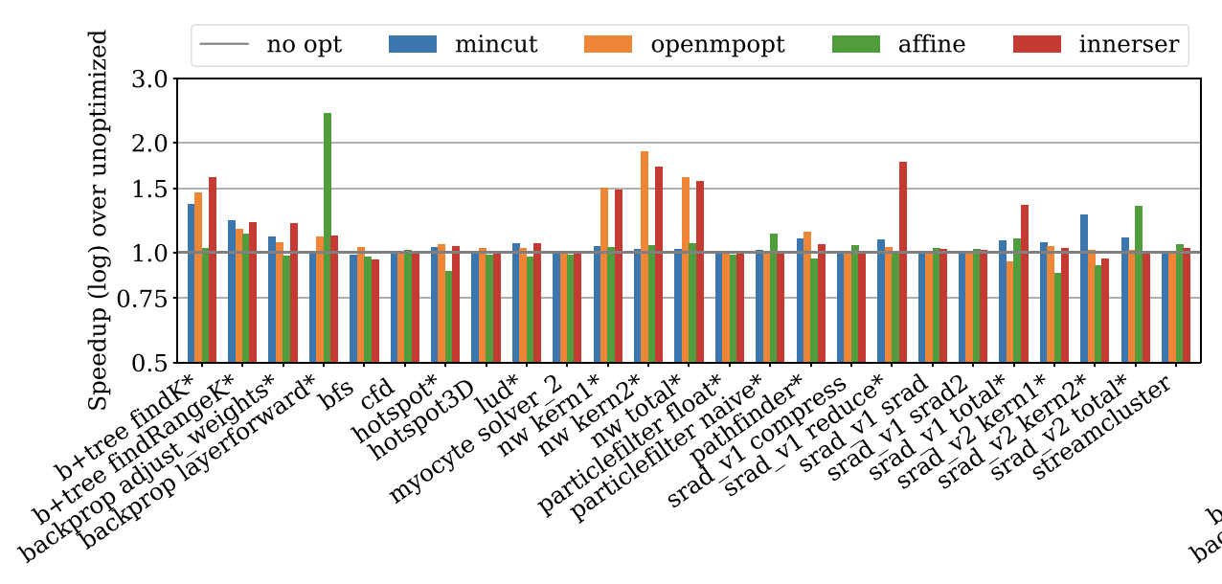
Rodinia Ablation
Mincut: 5.8%; OpenMPOpt: 10.5%; Affine: 5.4% (2.4x backprop)
Notes:
Myocyte improvement due to fewer instruction/cache misses, and fewer branches.
Backprop is due to parallel optimizations and linear array
Srad shared memory reduction and parallel optimizations which eliminate barriers/mem
hotspot and pathfinder slow down due to duplicated computation to reduce synchronization and use more parallelism
lud uses a transposed loop ordering for GPU in contrast to OpenMP

Slide 34
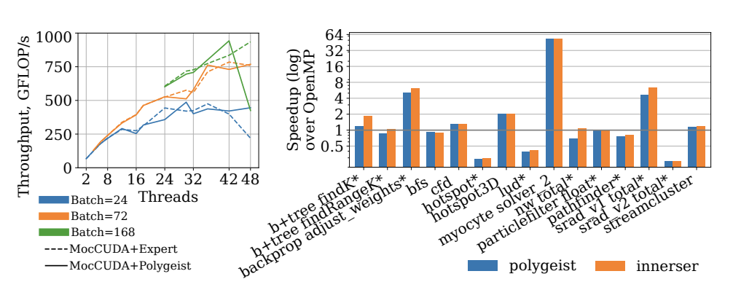
PyTorch Scaling
Notes:
Myocyte improvement due to fewer instruction/cache misses, and fewer branches.
Backprop is due to parallel optimizations and linear array
Srad shared memory reduction and parallel optimizations which eliminate barriers/mem
hotspot and pathfinder slow down due to duplicated computation to reduce synchronization and use more parallelism
lud uses a transposed loop ordering for GPU in contrast to OpenMP

Slide 35
Conclusion
Optimizable, multi-level operations are key to compiler extensibility and therefore performance
Polygeist/MLIR is a new Clang-based compiler that allows you to leverage this extensibility
  C/C++ frontend for MLIR
  Compiler transformations for raising MLIR to a higher-level
  Collection of high-level optimization passes (general mem2reg, etc)
  Polyhedral optimization via novel optimizations and integrating prior tools into MLIR
  Parallel/GPU optimizations & transformations
Polygeist beats existing polyhedral tools on sequential and parallel code
Polygeist can optimize and transcompile your GPU/parallel code
Supports recognizing and lowering to custom ops/dialects
LLVM incubator project, open sourced on Github, see https://polygeist.mit.edu and discuss on Discourse!

Slide 36
Acknowledgements
Thanks to Valentin Churavy, Albert Cohen, Henk Corporaal, Tobias Grosser, and Charles Leiserson for thoughtful discussions on this work.
William S. Moses was supported in part by a DOE Computational Sciences Graduate Fellowship, in part by Los Alamos National Laboratories, and in part by the United States Air Force Research Laboratory. The views and conclusions contained in this document are those of the authors and should not be interpreted as representing the official policies, either expressed or implied, of the United States Air Force or the U.S. Government.
Lorenzo Chelini is partially supported by the European Commission Horizon 2020
Ruizhe Zhao is sponsored by UKRI and Corerain Technologies Ltd. The support of the UK EPSRC is also gratefully acknowledged.
The work was supported in part by JSPS KAKENHI Grant Number JP19H04119 and in part by the Japan Society for the Promotion of Science KAKENHI Grant Number JP19H04119, and in part by the New Energy and Industrial Technology Development Organization (NEDO).

Slide 37
Conclusion
Optimizable, multi-level operations are key to compiler extensibility and therefore performance
Polygeist/MLIR is a new Clang-based compiler that allows you to leverage this extensibility
  C/C++ frontend for MLIR
  Compiler transformations for raising MLIR to a higher-level
  Collection of high-level optimization passes (general mem2reg, etc)
  Polyhedral optimization via novel optimizations and integrating prior tools into MLIR
  Parallel/GPU optimizations & transformations
Polygeist beats existing polyhedral tools on sequential and parallel code
Polygeist can optimize and transcompile your GPU/parallel code
Supports recognizing and lowering to custom ops/dialects
LLVM incubator project, open sourced on Github, see https://polygeist.mit.edu and discuss on Discourse!

Slide 38
Text

Slide 39
A first-class representation of parallelism
Current mainstream compilers do not have a good notion or representation of parallelism
This is accentuated for GPU programs where the kernel is kept in a separate module to allow emission of different assembly
__device__ int sum(int* in, int n);
__global__ void normalize(int *out, int *in, int n) {
int tid = threadIdx.x;
if (tid < n)
out[tid] = in[tid] / sum(in, n);
}
void launch(int* out, int* in, int n) {
normalize<<<nblocks, nthreads>>>(out, in, n);
}
Notes:
Polyhedral tools have become

Slide 40
Case Study 2: GPUs
__device__ int sum(int* data, int n);
__global__ void square(int *out, int* in, int n) {
int tid = blockIdx.x;
if (tid < n)
out[tid] = in[tid] / sum(in, n);
}
void launch(int *h_out, int* h_in, int n) {
int *d_out, *d_in;
cudaMalloc(&d_out, n*sizeof(n));
cudaMalloc(&d_in, n*sizeof(n));
cudaMemcpy(d_in, h_in, n*sizeof(n), cudaMemcpyHostToDevice);
square<<<(n+31)/32, 32>>>(d_out, d_in, n);
cudaMemcpy(h_out, h_out, n*sizeof(n), cudaMemcpyDeviceToHost);
}
GPU Code
CPU Code
CPU Memory
GPU Memory
Block
Thread
Notes:
Polyhedral tools have become

Slide 41
A first-class representation of parallelism
Current mainstream compilers do not have a good notion or representation of parallelism
This is accentuated for GPU programs where the kernel is kept in a separate module to allow emission of different assembly
target triple = "x86_64-unknown-linux-gnu”
define void @_Z6launchPiS_i(i32* %out, i32* %in, i32 %n) {
call i32 @__cudaPushCallConfiguration(…)
call i32 @cudaLaunchKernel(@_device_stub, …)
ret void
}
target triple = ”nvptx”
define void @_Z9normalizePiS_i(i32* %out, i32* %in, i32 %n) {
%4 = call i32 @llvm.nvvm.read.ptx.sreg.tid.x()
%5 = icmp slt i32 %4, %n
br i1 %5, label %6, label %13
6: ; preds = %3
%8 = getelementptr inbounds i32, i32* %in, i32 %4
%9 = load i32, i32* %8, align 4
%10 = call i32 @_Z3sumPii(i32* %in, i32 %n) #5
%11 = sdiv i32 %9, %10
%12 = getelementptr inbounds i32, i32* %out, i32 %4
store i32 %11, i32* %12, align 4
br label %13
13:
ret void
}
Notes:
Polyhedral tools have become

Slide 42
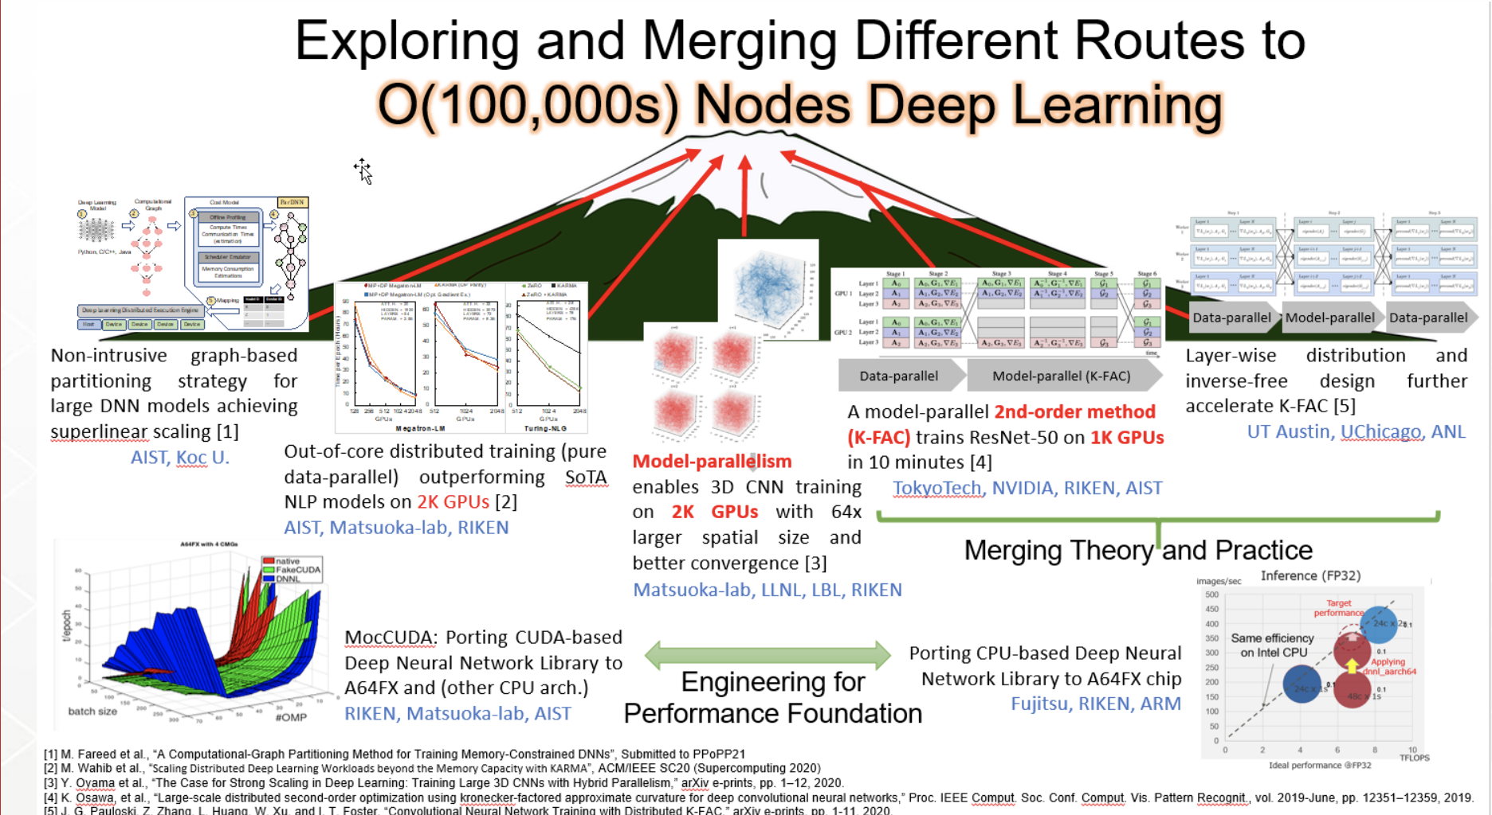
Open Research Directions
How can we optimize GPU programs?
Can we convert GPU to CPU (and vice versa)?
  Working with Riken/Tokyo Tech to port GPU to Fugaku supercomputer
What advantages can we gain
from compiler representations?
Notes:
Polyhedral tools have become

Slide 43
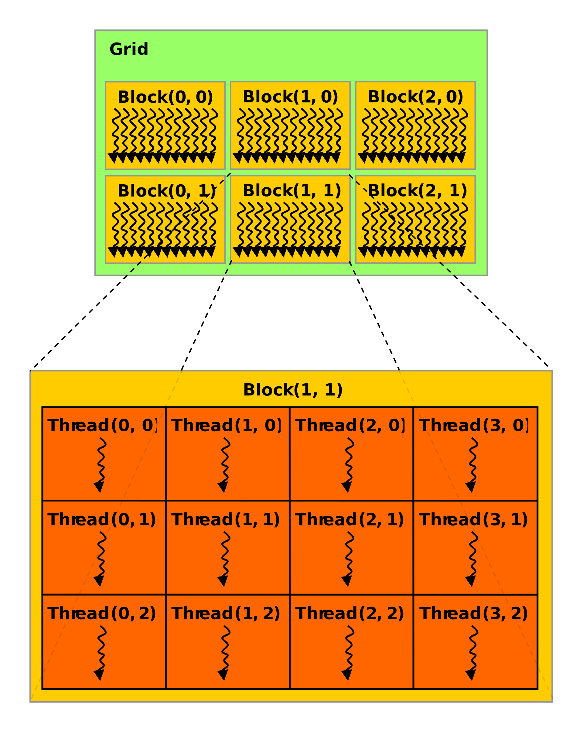
Introduction GPU Programming
GPU threads are like CPU threads in which they can run in parallel.
A group of threads (up to 32) are combined
in a block
Threads can share data and/or sync
within a block but not between blocks
All threads in a block are guaranteed
to execute at the same time (and may
run in lockstep)
Blocks are not
Notes:
Polyhedral tools have become

Slide 44
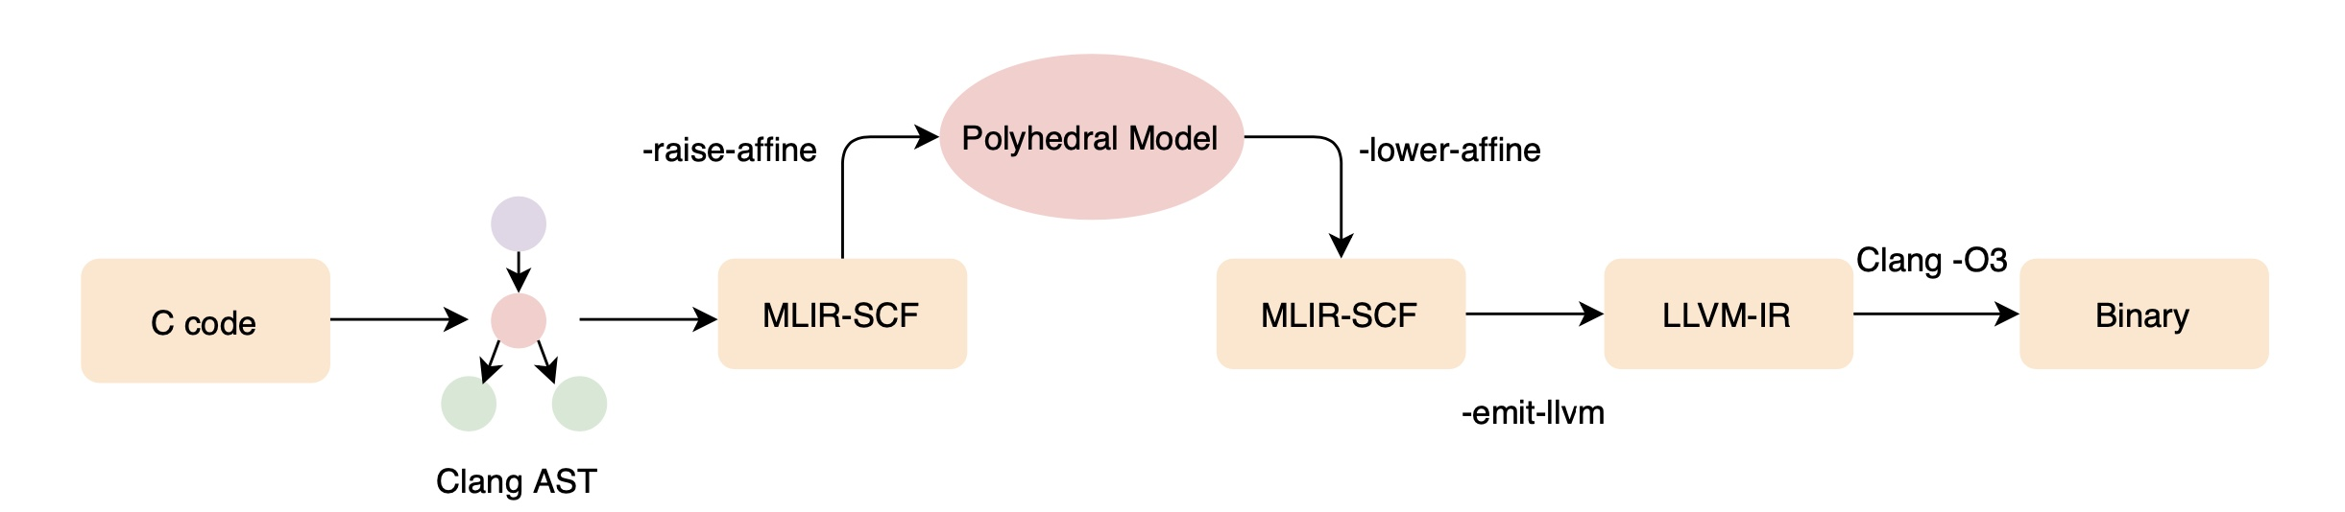
The Polygeist Compilation Flow
Generic C or C++ frontend that generates "standard" MLIR
Raising transformations for transforming "standard" MLIR to polyhedral MLIR (Affine)
Embedding of existing polyhedral tools (Pluto, CLooG) into MLIR
Novel transformations (statement splitting, reduction detection) that rely on high-level compiler representation
End-to-end evaluation of standard polyhedral benchmarks (Polybench)
Notes:
To create this end-to-end compilation flow, Polygeist contains several components that we will dive into shortly.
Polygeist begins as a new C and C++ frontend for MLIR that simultaneously preserves the program’s high-level structure. Unlike the existing AST-based tools used in the polyhedral community, the Polygeist frontend handles generic C or C++, not just the parts of the program representable by the polyhedral model.
Polygeist then implements several transformations that transform the “standard” structured MLIR directly emitted by the frontend into MLIR’s high-level polyhedral or Affine dialect, where applicable. Specifically, Polygeist performs this raising either where it can prove the raising to be legal, or where Polygeist is instructed by a pragma scop to assume an entire region to be polyhedral.
From here, Polygeist connects existing Polydral tools to MLIR, allowing them to perform transformations on programs in the MLIR affine dialect.
We then run several novel transformations such as statement splitting that were mentioned earlier.
Finally polygeist emits a binary that we can use to run an end-to-end evaluation of Polygeist as compared with other tools on standard polyhedral benchmarks, namely Polybench. In doing so, Polygeist creates MLIR versions of these benchmarks if anyone wants to create their own transformations in MLIR and compare with existing tools.
It has the following 4 major components
I will go through these modules step by step.

Slide 45
“Case Study 3”: Your Programs!
There are already several efforts starting using Polygeist/MLIR to leveraging the benefits of optimizable multi-level operations
  SYCL
  Circuit Compilation
  BLAS Kernels
  Databases
  …
If you’re interested in applying such techniques to your programs, please reach out!
Notes:
Polyhedral tools have become

Slide 46
GPU Synchronization Lowering
Most CPU backends (e.g. Cilk, OpenMP) do not have an equivalent & general synchronization instruction (more akin to a barrier)
Existing approaches create a heavy-weight state machine of all synchronizations that stores all values
Notes:
Polyhedral tools have become

Slide 47
GPU Synchronization Lowering: Registers
Registers defined before the synchronization and used after the synchronization must be preserved through an allocation.
If the memory semantics allow us to more efficiently recompute the value, it doesn’t need to be stored.
_{parallel_for %i = 0 to N {}
_{%off = %i + 1}
_{codeA(%off);}
_{sync_threads;}
_{codeB(%off);}
}
_{%offm = alloca N}
_{parallel_for %i = 0 to N {}
_{%off = %i + 1}
_{%offm[%i] = %off}
_{codeA(%off);}
}
_{parallel_for %i = 0 to N {}
_{codeB(%off_m%[%i]);}
}
_{parallel_for %i = 0 to N {}
_{%off = %i + 1}
_{codeA(%off);}
}
_{parallel_for %i = 0 to N {}
_{%off = %i + 1}
_{codeB(%off);}
}
Notes:
Polyhedral tools have become

Slide 48
GPU Synchronization Lowering: Registers
Registers defined before the synchronization and used after the synchronization must be preserved through an allocation.
If the memory semantics allow us to more efficiently recompute the value, it doesn’t need to be stored.
[Question] Is distributing the parallelism around the barrier the best approach?
[Question] How do we minimize the runtime of preserving registers?
  Tradeoff parallel recompute vs preserve
  Min Cut?
Notes:
Polyhedral tools have become

Slide 49
GPU Synchronization Lowering: Control Flow
Synchronization within control flow (for, if, while, etc) can be lowered by splitting around the control flop and interchanging the parallelism.
_{parallel_for %i = 0 to N {}
_{codeA(%i);}
_{for %j = … {}
_{codeB1(%i, %j);}
_{sync_threads;}
_{codeB2(%i, %j);}
}
_{codeC(%i);}
}
_{parallel_for %i = 0 to N {}
_{codeA(%i);}
_{sync_threads;}
_{for %j = … {}
_{codeB1(%i, %j);}
_{sync_threads;}
_{codeB2(%i, %j);}
}
_{sync_threads;}
_{codeC(%i);}
}
_{parallel_for %i = 0 to N {}
_{codeA(%i);}
}
_{parallel_for %i = 0 to N {}
_{for %j = … {}
_{codeB1(%i, %j);}
_{sync_threads;}
_{codeB2(%i, %j);}
}
}
_{parallel_for %i = 0 to N {}
_{codeC(%i);}
}
Notes:
Polyhedral tools have become

Slide 50
GPU Synchronization Lowering: Control Flow
Synchronization within control flow (for, if, while, etc) can be lowered by splitting around the control flop and interchanging the parallelism.
_{parallel_for %i = 0 to N {}
_{codeA(%i);}
}
_{parallel_for %i = 0 to N {}
_{for %j = … {}
_{codeB1(%i, %j);}
_{sync_threads;}
_{codeB2(%i, %j);}
}
}
_{parallel_for %i = 0 to N {}
_{codeC(%i);}
}
_{parallel_for %i = 0 to N {}
_{codeA(%i);}
}
_{for %j = … {}
_{parallel_for %i = 0 to N {}
_{codeB1(%i, %j);}
_{sync_threads;}
_{codeB2(%i, %j);}
}
}
_{parallel_for %i = 0 to N {}
_{codeC(%i);}
}
_{parallel_for %i = 0 to N {}
_{codeA(%i);}
}
_{for %j = … {}
_{parallel_for %i = 0 to N {}
_{codeB1(%i, %j);}
}
_{parallel_for %i = 0 to N {}
_{codeB2(%i, %j);}
}
}
_{parallel_for %i = 0 to N {}
_{codeC(%i);}
}
Notes:
Polyhedral tools have become

