Slide 1

Nicolas Vasilache, Oleksandr Zinenko, Theodoros Theodoridis, Priya Goyal,
Zach DeVito, William S. Moses, Sven Verdoolaege, Andrew Adams, Albert Cohen
LLVM Workshop at CGO 2018
February 24, 2018

Slide 2
The Tensor Comprehensions Team

Slide 3

A tale of many layers
Input
caffe2.python.brew.conv()
...
W₁
Conv
cudnnConvolutionForward()...
B₁
Add
torch.nn.conv2d()
...
ReLU
*
dnnConvolutionCreateForward_F32()
...
…
tf.contrib.layers.conv2d()
...
* TF also can compile via XLA, discussed later

Slide 4

Someone has a clever idea
Suppose a ML researcher invents a new layer: hconv
He/she can implements it two ways:
    Inefficiently cobbling together existing operators [slow]
    Write optimized GPU/CPU kernel [difficult, time-consuming]
Even when the operator exists, it often misses peak-performance, lacking cross-operator-optimization and data-shape/size tuning [1]
[1] Fast Convolutional Nets With fbfft : A GPU Performance Evaluation, ICLR, 2015

Slide 5
“Abstraction without regret”
To make development efficient, we need abstractions that provide productivity without sacrificing performance
Given the enormous number of potential kernels, suggests a dynamic-code-generation approach

Slide 6
Prior work
“Direct generation” such as active library [2] or built-to-order (BTO) [3] provide usability, but miss optimization
DSLs such as Halide [4] provide usability, and permit scheduling transformations, though manually specify.
Compilers like XLA [5] or Latte [6] optimize and fuse operators, though performance lacking as the language can’t represent complex schedules crucial to GPU/others.
[2] Run-time code generation in C++ as a foundation for domain-specific optimization, 2003
[3] Automating the generation of composed linear algebra kernels, 2009
[4] Halide: a language and compiler for optimizing parallelism, locality, and recomputation in image processing pipelines, 2013
[5] Xla:domain-specific compiler for linear algebra to optimizes tensorflow computations, 2017
[6] Latte: A language, compiler, and runtime for elegant and efficient deep neural networks, 2016

Slide 7
Tensor Comprehensions
High-level DSL to express tensor computations by extending Einstein-notation.
End-to-End compilation flow capable of lowering tensor comprehensions to efficient GPU code (CPU in progress)
Collection of polyhedral compilation algorithms with a specific domain and target orientation
Autotuning framework built off JIT compilation and caching
Integration into ML Frameworks (Caffe2, Pytorch)

Slide 8
Tensor Comprehensions
Range Inference
and Specialization
Halide IR
Polyhedral
Transformations
Polyhedral IR (ISL)
Polly
Tapir/LLVM
CUDA Kernel
ATen
Cilk/OpenMP
CUDA Module
libTHC.so
Exec

Slide 9
Tensor Comprehensions
Range Inference
and Specialization
Halide IR
In Progress
Polyhedral
Transformations
Polyhedral IR (ISL)
Polly
Tapir/LLVM
CUDA Kernel
ATen
Cilk/OpenMP
CUDA Module
libTHC.so
Exec

Slide 10
Optimizations at the appropriate time
High-level polyhedral: broader scheduling optimizations (mapping, tiling, fusion, etc)
Halide: Expression simplification / optimizations
Tapir/LLVM [7] <-> Polly [8]: Runtime-level optimization/scheduling (coarsening, vectorization), instruction-level optimization (i.e. LICM, fuse instructions)
[7] Tapir: Embedding Fork-Join Parallelism into LLVM's Intermediate Representation, 2017
https://github.com/wsmoses/Tapir-LLVM
[8] Polly - Performing polyhedral optimizations on a low-level intermediate representation, 2012
https://github.com/wsmoses/Tapir-Polly

Slide 11
TC language
Concise, emits 1000’s of optimized LOC
def mv(float(M,K) A, float(K) x) -> (C) {
C(i) +=! A(i,k) * x(k)
}
def conv3(float(N,C,H,W) I, float(O,C,H,W) W1, float(D,O,H,W) W2, float(E,D,H,W) W3) -> (O1, O2, O3) {
O1(n, o, h, w) +=! I(n, c, h + kh, w + kw) * W1(o, c, kh, kw)
O1(n, o, h, w) = fmax(O1(n, o, h, w), 0) // relu
O2(n, d, h, w) +=! O1(n, d, h + kh, w + kw) * W2(d, o, kh, kw)
O2(n, d, h, w) = fmax(O2(n, d, h, w), 0)
O3(n, e, h, w) +=! O2(n, c, h + kh, w + kw) * W3(e, d, kh, kw)
O3(n, e, h, w) = fmax(O3(n, e, h, w), 0)
}
Iteration bounds inferred
Variables only on one side are reduced

Slide 12
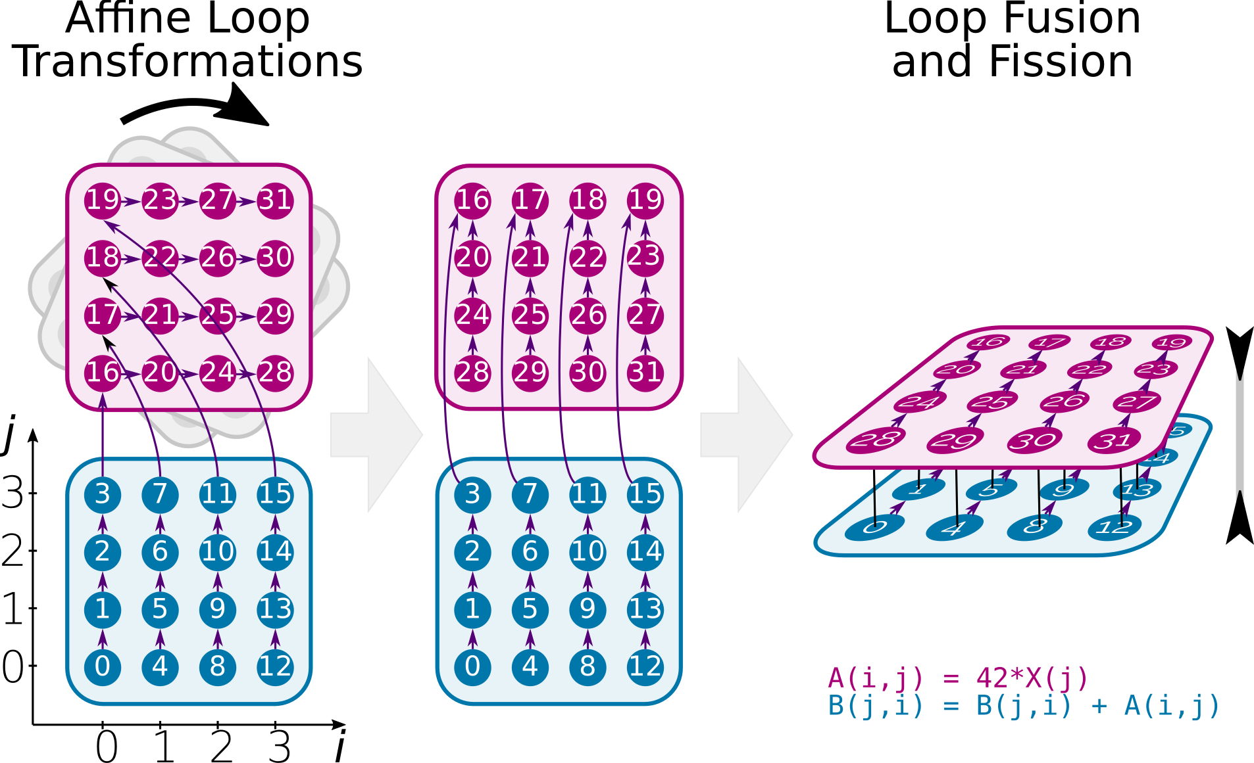
Polyhedral + TC
High Level Polyhedral IR (ISL) =>
Easy Transformations
Schedule heuristic folds into a single kernel
Schedule tiled to facilitate the mapping and reuse of memory hierarchy of GPU/CPU
GPU mapping borrows from PPCG, with extensions for more complex/imperfectly nested structures
Memory promotion into shared cache

Slide 13
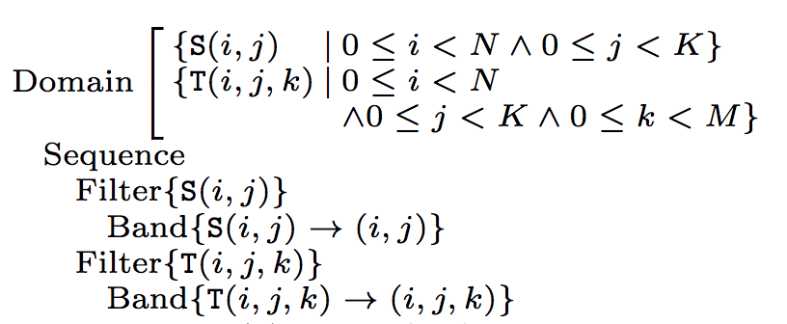
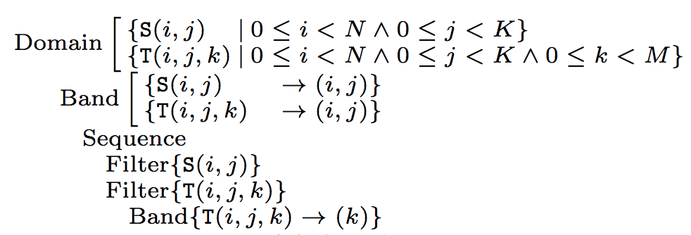
ISL scheduling
def sgemm(float a, float b float(N,M) A, float(M,K) B) -> (C) {
C(i,j) = b //S(i,j)
C(i,j) += a * A(i,k) * B(k,j) //T(i,j,k)
}
Fuse
Sequence node: order-dependent collection of nodes
Band node: (partial) execution
Filter node: partition iteration space

Slide 14
ISL scheduling
ISL’s scheduling algorithm
  Works by solving a linear program
  Uses affine clustering, computing schedule for each strongly-connected components then scheduling those together

Slide 15
Extending ISL scheduling
Extended ISL’s scheduler to allow additional constraints
  Affine constraint added to the LP
  Supply clustering decision for graph component combining
Clustering allows for conventional minimum and maximum fusion targets AND maximum fusion that preserves at least three nested parallel loops (i.e. for mapping to CUDA blocks / threads)

Slide 16
Memory promotion
Cache indirectly accessed arrays
Only done when O and Idx are only read (not written)
Promote directly accesses if tile of fixed size, elements reused, and >= 1 access without memory coalescing
Promote indirectly accessed arrays in same way (ignore coalescing)
O[l+Idx[i][j]][k] => shared_O[l][i][j][k]

Slide 17
Autotuning
Even with heuristics, there’s a large space of options
Derive schedule (and other parameters) by searching via genetic algorithm with fixed search-time.

Slide 18
How well does it work?

Slide 19
End-to-end benchmarks
Baseline CUDA 8.0, CUBLAS 8.0, CUDNN 6.0, CUB recent
8 Pascal nodes with 2 socket, 14 core Intel(R) Xeon(R) CPU E5-2680 v4 @ 2.40GHz, with 8 Tesla P100-SXM2 GPUs and 16GB of memory each.
Median runtime out of a batch of 1000
Autotuning time out O(hours)

Slide 20
TC overview
“Natural ML math running faster than libraries”
Productive environment to develop ML
Comparable or better than hand-coded operators
Perform true kernel fusion, with optimization
Specialize to specific architecture and sizes
Autotuning “unlocks” much of polyhedral benefits

Slide 21
Future work
Share best implementations, for any architecture
Port to more architectures & accelerators, leveraging highly optimized primitives
Implement symbolic automatic differentiation directly
Allow sparse, vector and mixed- precision types
Support more dynamic control flow and ML architectures
Integrate with other frameworks

Slide 22
TC overview
“Natural ML math running faster than libraries”
Available stand-alone and in Caffe2/PyTorch bindings [public in a few days]
Open source: https://github.com/facebookresearch/tensorcomprehensions
Paper:
https://arxiv.org/abs/1802.04730

Slide 23
Questions?

Slide 24
Backup Slides

Slide 25
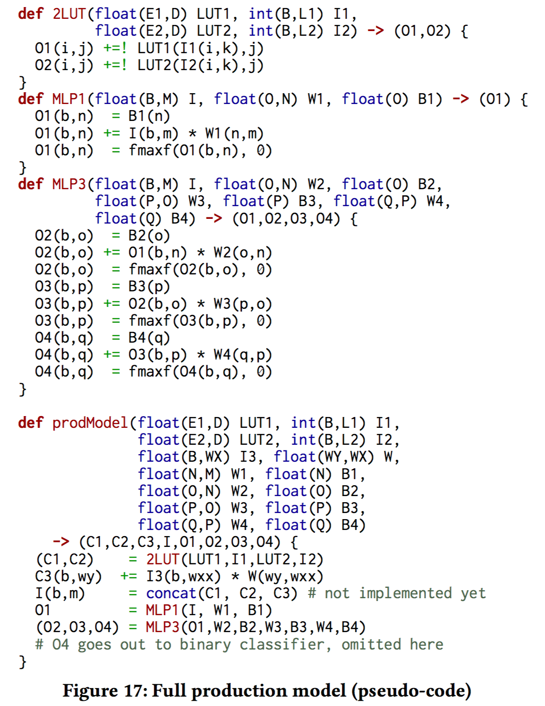
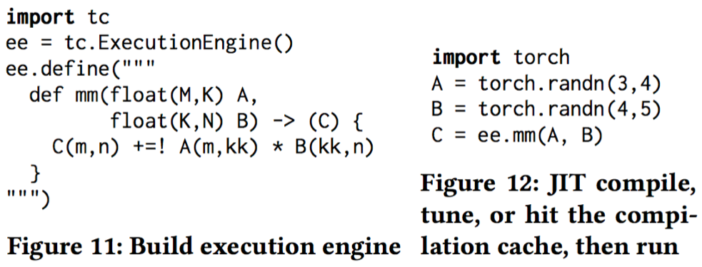
TC in Practice

